Slide 1
Qualifications in
Cyber Security
College cyber security conference
workshop
april 2019
Notes:
Welcome to this short webinar, when I will discuss the current and new qualifications in cyber security.
The presentation should take no more than 15-20 minutes.

Slide 2
bobby.elliott@sqa.org.uk
lorraine.mcfadyen@sqa.org.uk
helen.zhang@sqa.org.uk
Notes:
I’ll share this presentation so there is no need to write down these e-mail addresses.
My name is Bobby Elliott and Lorraine and Helen provide support for the NPA and HN qualifications respectively.

Slide 3
Workshop
Existing awards
  NPA Cyber Security
  HNC Cyber Security
Future awards
  HND Cyber Security
  PDA Cyber Security
Consultation on HND
Notes:
The presentation has two parts.
Is about existing qualifications.
Is about new qualifications, which are coming in the next year or two.

Slide 4

Internet Safety
Cyber Security Fundamentals
Cyber Security
Notes:
Before I talk about the NPAs and HN awards, I’d like to highlight two other related qualifications.
Award in Internet Safety.
Cyber Security Fundamentals.
These are both short, stand-alone units at Level 4.
Ideal preparation for the NPAs.

Slide 5
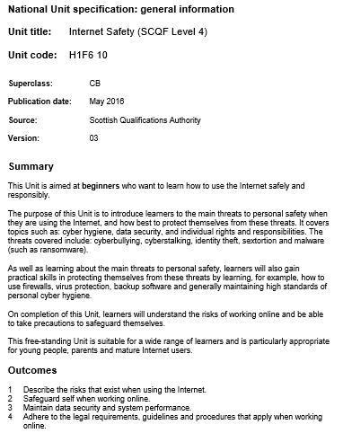
Internet Safety
SCQF Level 4
Essential knowledge and skills for everyone
Online risks
  Sextortion
Safeguards
Data security
Legal requirements
Notes:
The Internet Safety award was introduced in 2007 and is very popular in many schools and some colleges.
It was recently refreshed in 2016 to include the latest threats and generally update the unit.
There are online support materials for this unit.
Also an ASP.
Centres need do little preparation to offer it.

Slide 6
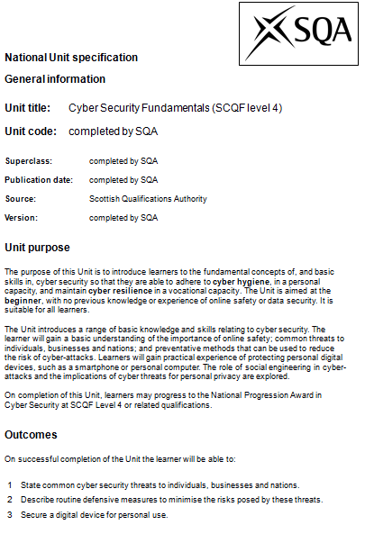
Cyber
Security
Fundamentals
SCQF Level 4
Essential knowledge and skills for everyone
Personal cyber hygiene
Workplace cyber resilience
Cyber security threat
  Most common attacks
  Social Engineering
  Cyber warfare
Cyber defences
Part of the National Certificate (Level 4)
Notes:
This unit was developed in 2015.
It is a single credit, Level 4 unit.
Provides the very basics of cyber security.
Suitable for all learners but ideal preparation for the NPAs.

Slide 7
SCQF
Level 4
NPA Cyber Security
SCQF
Level 5
NPA Cyber Security
SCQF
Level 6
SCQF
Level 7
SCQF
Level 8
SCQF
Level 9
NPA Cyber Security
HNC Cyber Security
PDA Cyber Security
HND Cyber Security
PDA Cyber Security
PDA Cyber Security
Cyber Security Fundamentals
Internet Safety
Notes:
There are cyber security qualifications from SCQF Levels 4 to 9.
At level 4 we have the two aforementioned unit and the NPA.
At 5 and 6 there is the NPA.
At 7 there is currently the HNC.
At 8 there is about to be an HND (June).
And next year we will develop new PDAs at Levels 7, 8 and 9.
It’s a comprehensive framework of national qualifications.

Slide 8
NPA Cyber Security
Available in 2015
SCQF Levels 4, 5, 6
  National 4, National 5, Higher
Group Award Specification
Unit specifications
Assessment Support Packs
Teaching and learning materials
Online support
Notes:
The NPAs were introduced in 2015.
They are available at SCQF Levels 4, 5 and 6.
The GAS can be found on the SQA website.
As can the unit specifications.
There are ASPs for all units.
And we recently developed comprehensive teaching and learning materials for all of the units.
We also provide online support for teachers of this qualification…

Slide 9
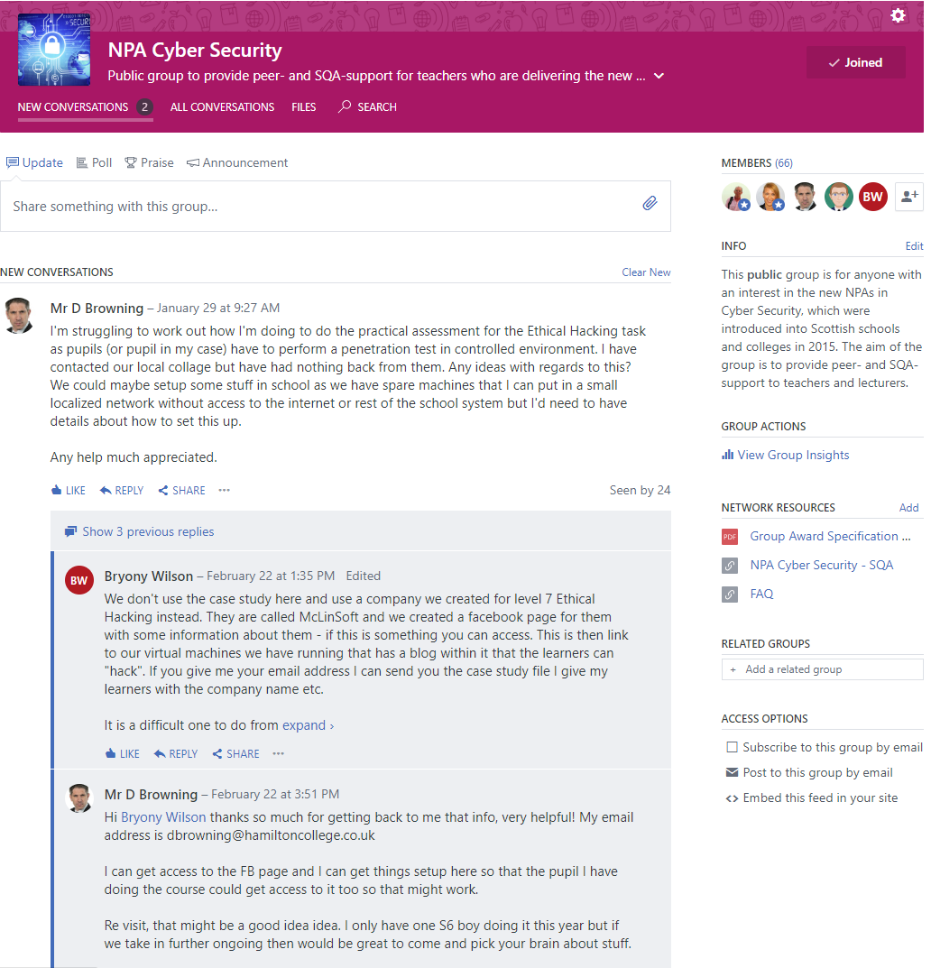
https://www.yammer.com/sqacomputing
Notes:
There is a dedicated Yammer group to support teachers.
We promise a quick response to any query you may raise.
The group has over 60 members so you’re guaranteed to get a response no matter your query.

Slide 10
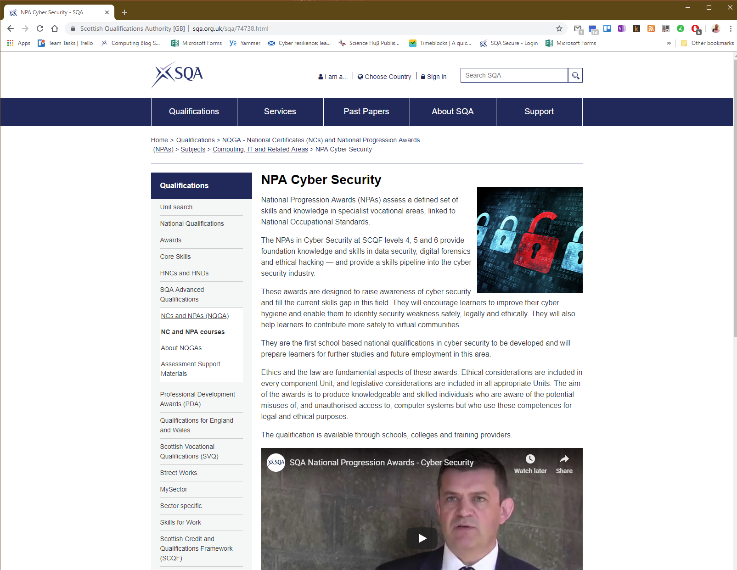
Notes:
This is the subject page for the NPAs.
You will find information about the awards here.
Including a link to the GAS.

Slide 11
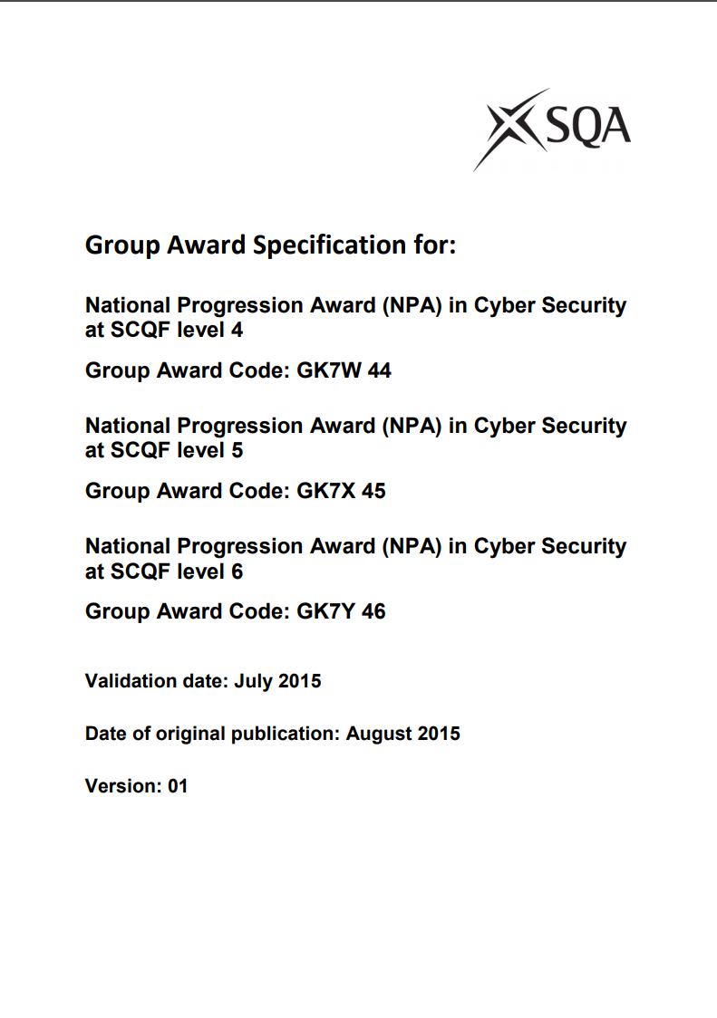
Notes:
The GAS provides essential information about the qualifications.
Including structures and advice about delivery.
It’s an essential document that should be read by everyone who teaches it.

Slide 12
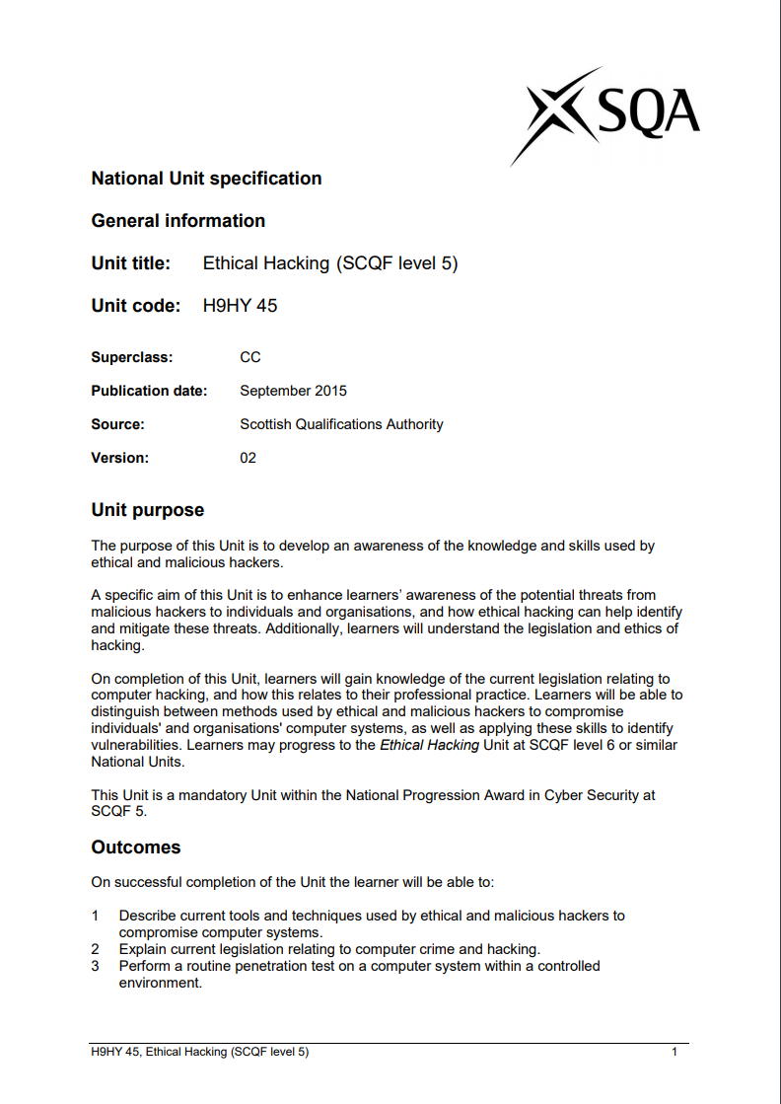
Notes:
The unit specs are available on the SQA website.
There is a specification for every unit at each level.
The unit spec is the “syllabus” and is also an essential read.
The units were written to be as timeless as possible.
For example, Outcome 2 here.
They’re four years old now but seem to have stood the test of time.

Slide 13
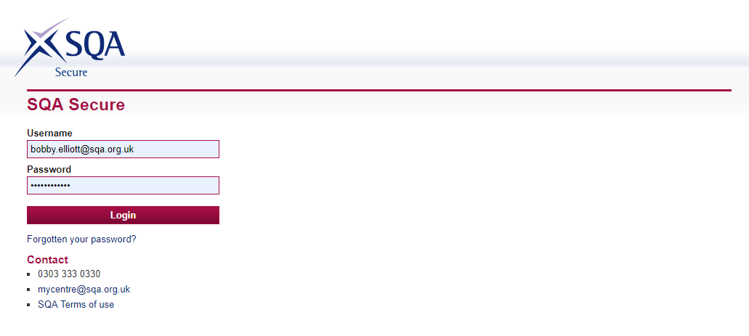
https://secure.sqa.org.uk
Notes:
You will also get access to a range of support materials through SQA Secure.
You will need a log in to access this service.
Your SQA Co-Ordinator will have access.

Slide 14
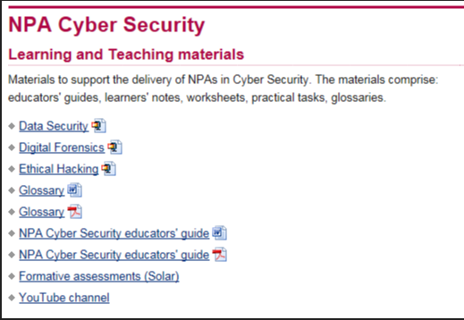
Notes:
Here you will find all of the assessments for the NPAs and a lot of other materials.
Including a guide for teachers and notes for learners.
These materials are comprehensive and cover the entire course.
There is even a YT channel for videos to help you deliver the award.

Slide 15
Features of the award
Simple structure
  120 hours
Consistent structure
  3 units per level
Hierarchical
  Mix and match units across levels
Easy to timetable
No final exam
Continuous assessment
  Practical exercise plus test of knowledge (SOLAR)
Interesting, engaging content
Notes:
The qualification has a simple structure – consisting of three units at each level.
Learners can mix and match units (at different levels) and still get an award.
The size of the qualification (3 credits) is easy to timetable.
The assessment is a mix of MCQs and short practical assessments.
Assessment will not take much time to complete (about an hour or two).
Learners seem to really enjoy the course.

Slide 16
NPA Cyber Security
SCQF 4 | SCQF 5 | SCQF 6
Data Security | Data Security | Data Security
Digital Forensics | Digital Forensics | Digital Forensics
Ethical Hacking | Ethical Hacking | Ethical Hacking
Notes:
This is the structure.
Note that the framework has the same structure at each level (hence hierarchy).
Each qualification consists of three units – name them.
The units are similar from level to level but higher level units extend the KS in lower level units.
You could gain the L4 award by passing DS5, DF5 and EH4 (gaining L4 award – the lowest level unit pass).

Slide 17
Notes:
Uptake is rising fast.
Mostly schools but colleges too.
The NPAs are inside the NC Computing with Digital Media and is popular in colleges.
From 58 learners in 2015, there are now over 1000 (1064).

Slide 18
Enhanced materials
Improved learner notes
Improved educator’s guide
Improved item bank (SOLAR)
Additional Assessment Support Packs
Online support for teachers
CPD events (Autumn 2019)
Notes:
We’re also currently improving the materials (thanks to Scot. Gov. funding).
We’re going to professionally publish the learner notes.
Add to the educator guide.
Improve the SOLAR questions.
Create new alternative assessments that combine all three units (at each level).
And provide CPD events for teachers (next session).

Slide 19
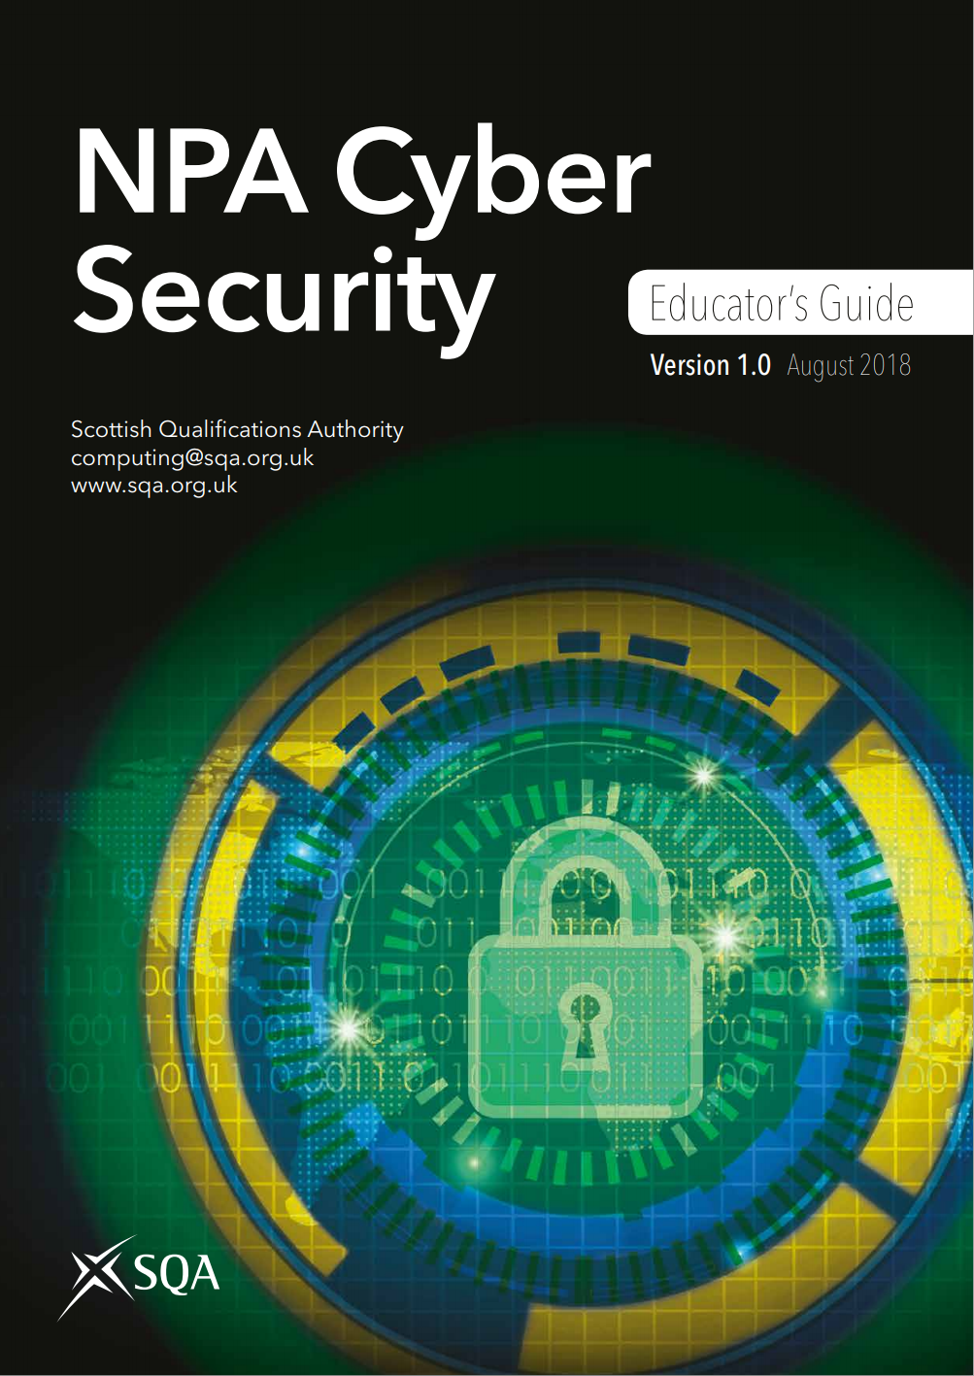

Slide 20
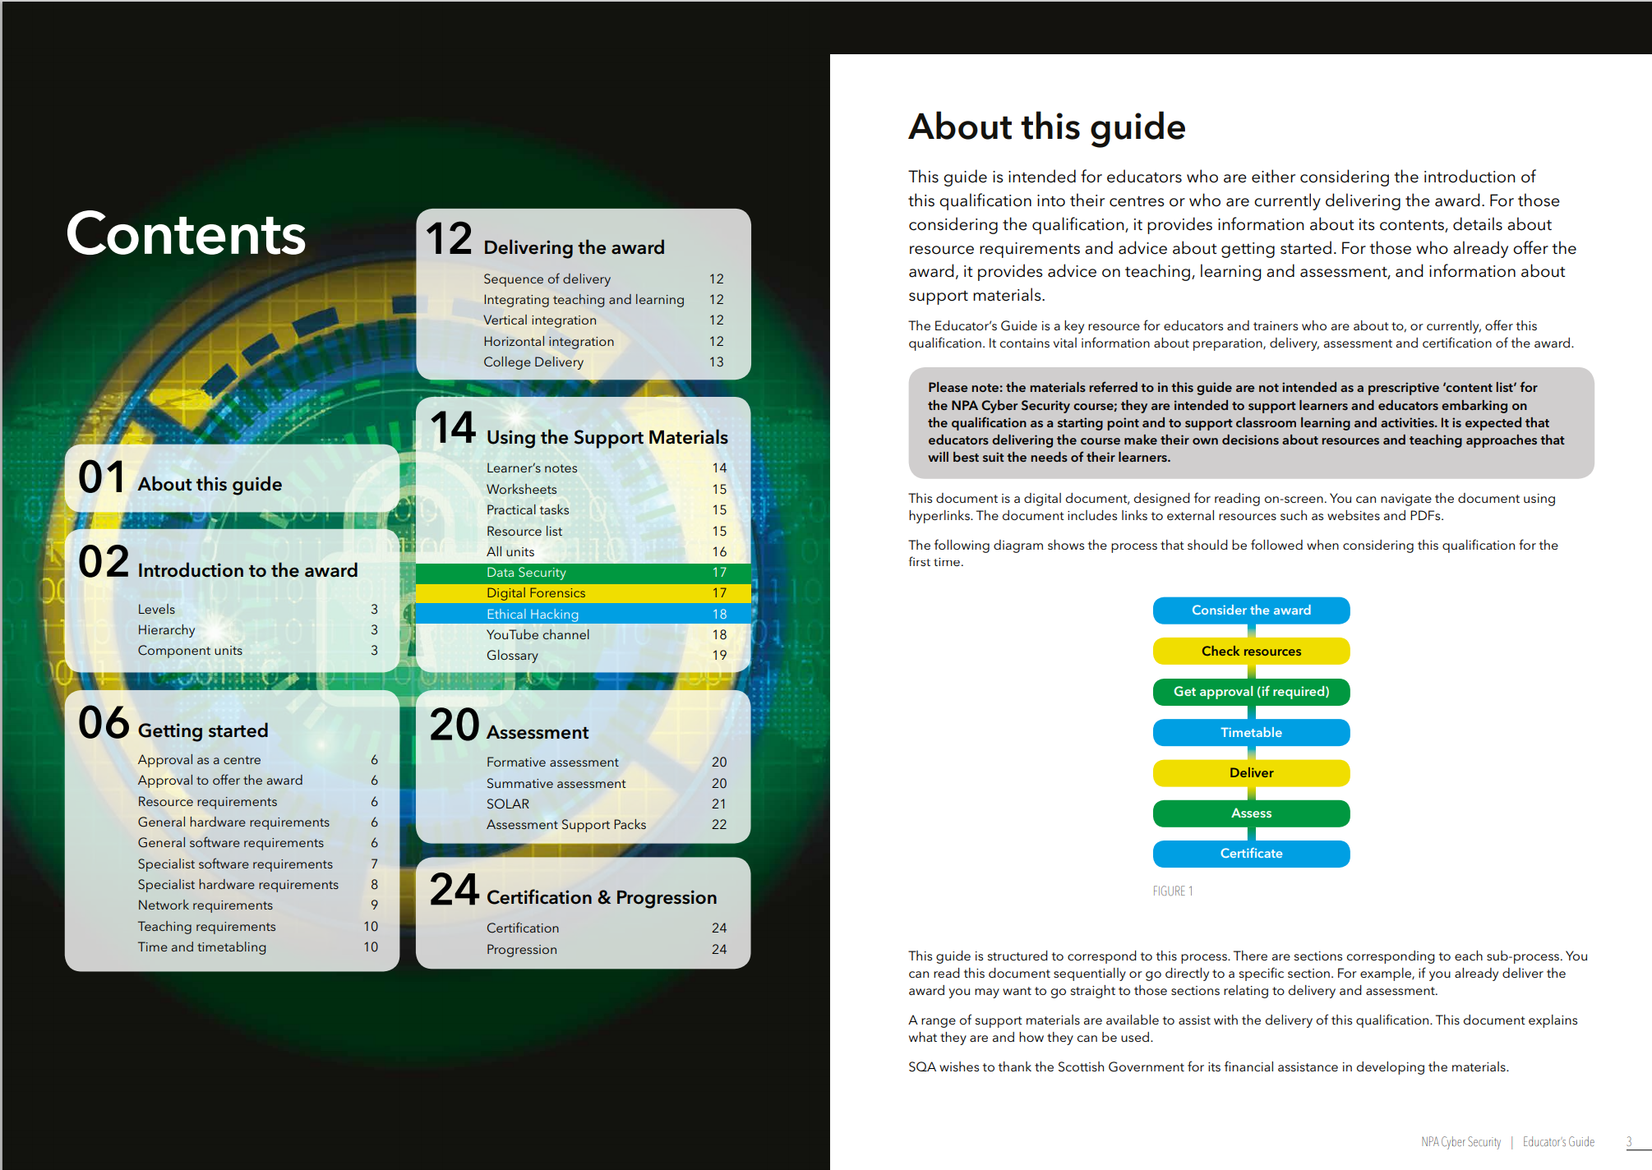

Slide 21
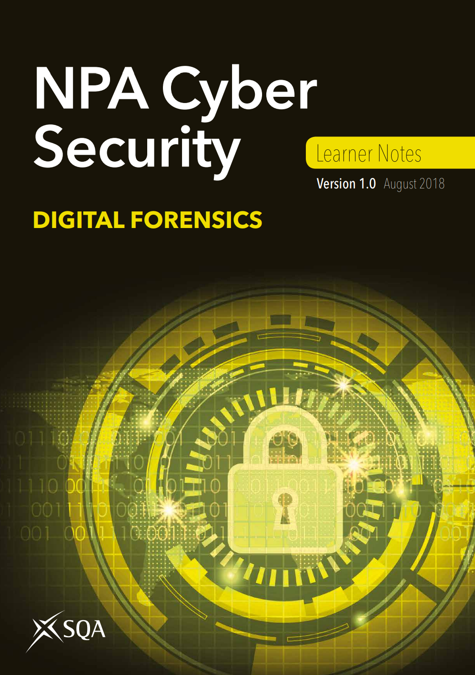

Slide 22
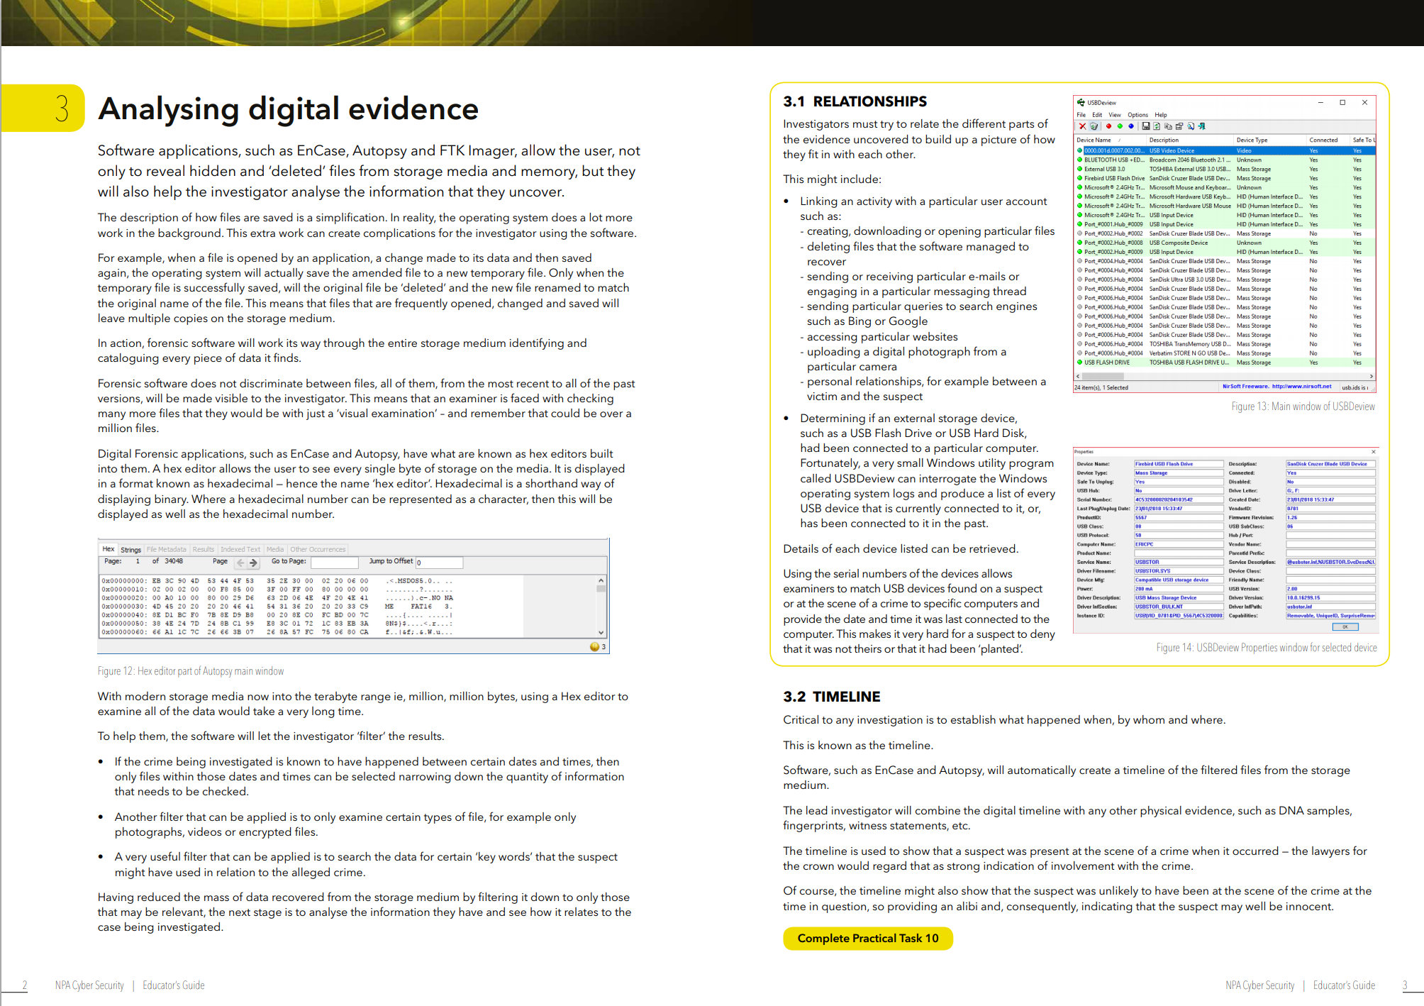

Slide 23
HNC Cyber Security
Developed during 2017-18
Available NOW
  Subject page
  Unit specifications
  Support materials
Some centres already delivering
helen.zhang@sqa.org.uk
Notes:
We commenced the development of the HNC in 2017 and it has been available to colleges since last June.
Three colleges are offering it this session, with over 100 entries between them.
I’m expecting that to rise sharply next session (300-500).
It’s available NOW with the usual support materials.
Contact Helen for help.

Slide 24
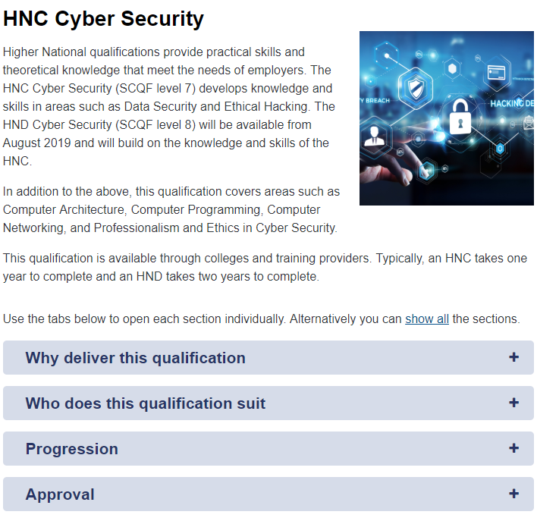
Notes:
Here is the subject page with the usual information.

Slide 25
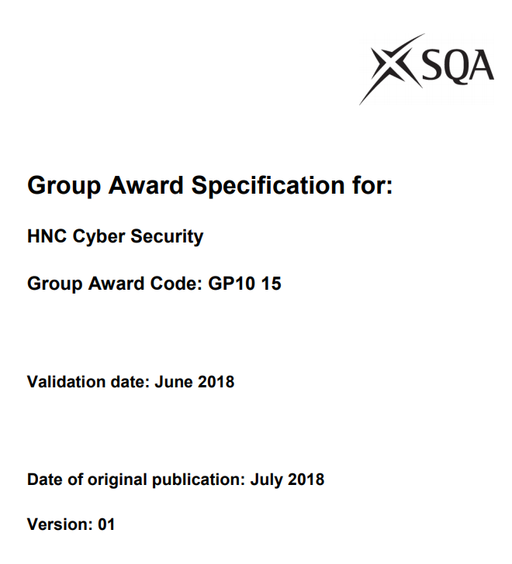
Notes:
The GAS is vital to read.

Slide 26
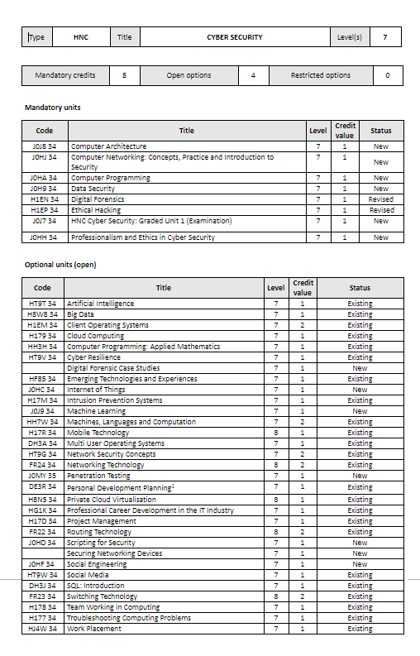
Notes:
It contains the framework for the HNC.
Note the framework.
8 mandatory units and 4 optional ones.
Mandatory includes architecture, programming, data security and forensics.
Options include AI, ML, Big Data, cyber resilience, IoT, Pen Testing.

Slide 27
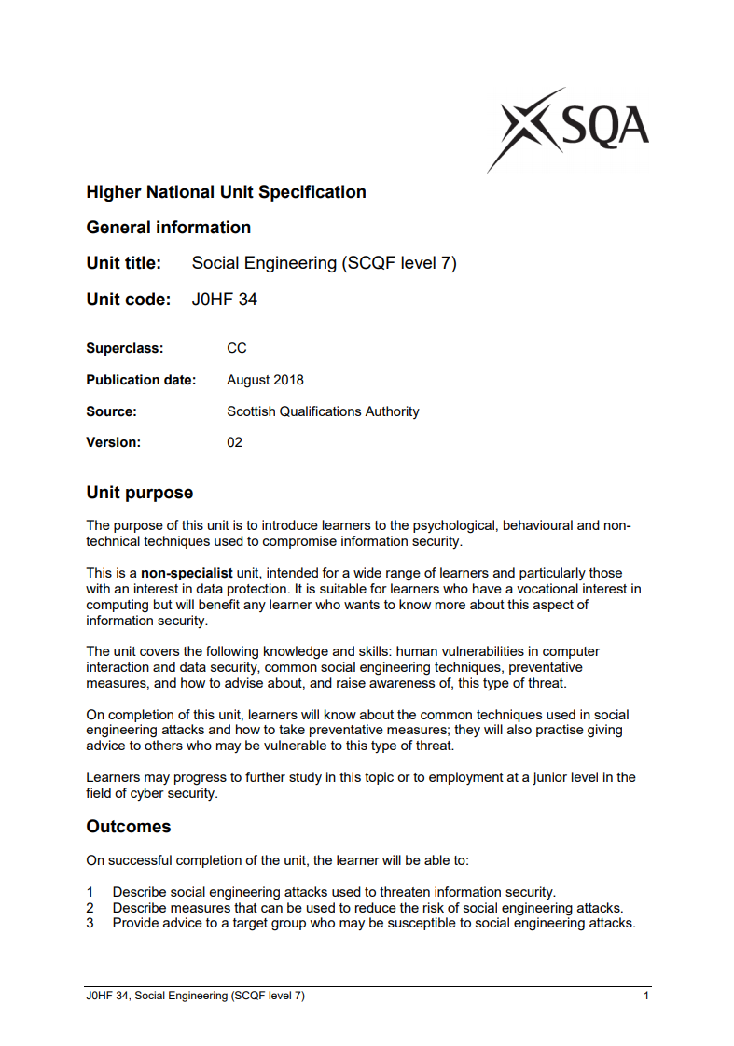
Notes:
All of the unit specifications are on the SQA website.
This is one of the new units on social engineering.
It’s a popular optional unit.
We’ve tried to keep the units simple – 3 outcomes, minimal assessment, etc.

Slide 28
Support Materials
Data Security
Computer Programming
Professionalism and Ethics in Cyber Security
Digital Forensics
Ethical Hacking
Computer Networking: Concepts, Practice
Introduction to Security
HNC Cyber Security: Graded Unit 1
Notes:
ASPs are available for all of the mandatory units and some of the optional units.
We’re currently developing more assessments.

Slide 29
HND Cyber Security
In development
Qualification Development Team formed
Lead Developer selected
Draft framework agreed
Unit writing almost complete
Validation Spring 2019
Available August 2019
Notes:
We started the last year.
It’s progressing well.
We’re almost at the stage of validation (May).
Most of the units have been written.
It will be finished for around June and available from August.
Ask Helen for a preview.

Slide 30
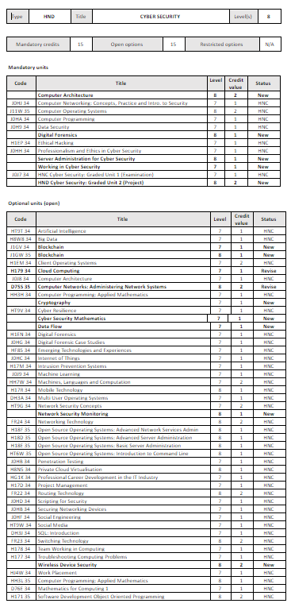
Notes:
The HND framework is much bigger – 30 credits instead of 12.
We have developed 15 new or revised units.
Including new ones in Blockchain, cryptography, software security and working in cyber security.
15 mandatory and 15 optional units (credits).

Slide 31
https://1drv.ms/w/s!Av71_tveB0_uhdh95W34S12j6jHHnQ

Slide 32
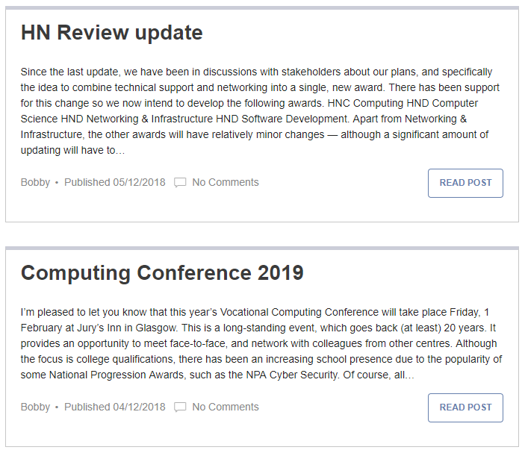
http://blogs.sqa.org.uk/computing/
Notes:
Don’t forget to check the blog where you will find more information about all of these awards including more information about the HND.

Slide 33
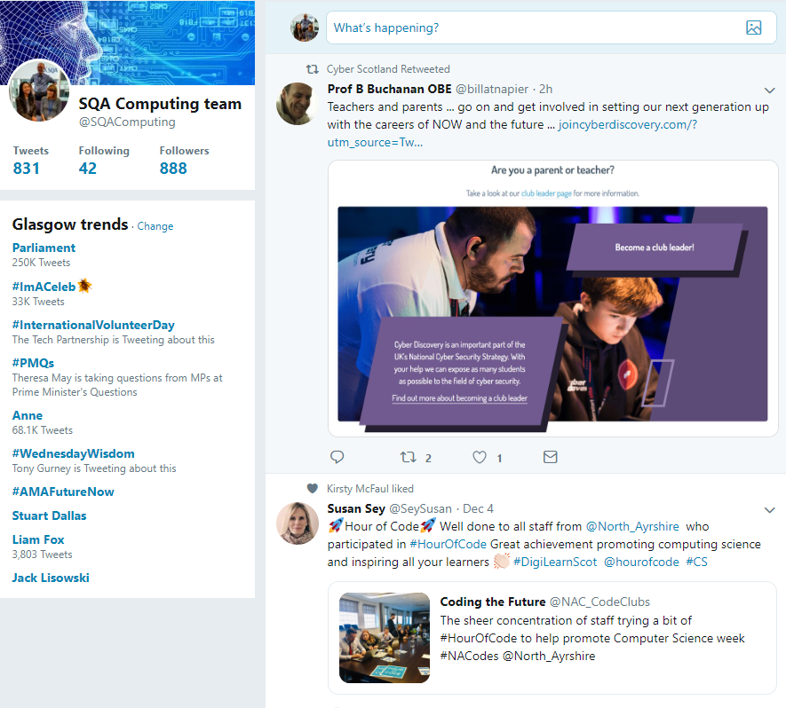
https://twitter.com/SQAComputing
Notes:
Or you can follow us on Twitter.

Slide 34
computing@sqa.org.uk

Slide 35


