Slide 1



Digital Participation
David McNeill
Digital Director, SCVO
@david_mcneill
Notes:
1
1

Slide 2
SCVO Digital Participation team
Increase digital participation throughout Scotland
Build
digital capability in the third sector

Slide 3
Basic digital skills
Managing information
Communicating
Transacting
Problem solving
Creating

Slide 4
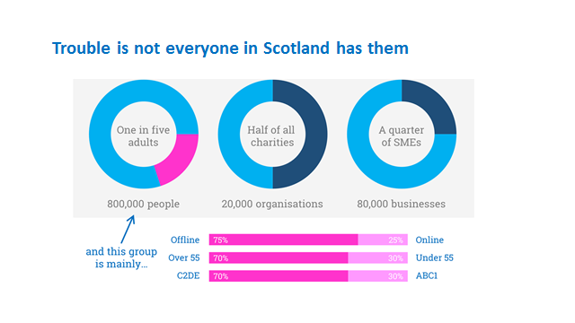

Slide 5
Why are basic digital skills important?
Employment
90% of jobs require Basic Digital Skills
Public services
A digital first agenda
Making the most of your cash
Best prices for goods and services online

Slide 6










Why else are they important?

Slide 7
Scotland’s
Digital Participation Charter
1
Invest in staff and volunteers
2
Empower staff and volunteers to help others
3
Contribute practical support for projects
4
Work together and coordinate our efforts
5
Adopt common language
Find out more and pledge your support at digitalscotland.org

Slide 8



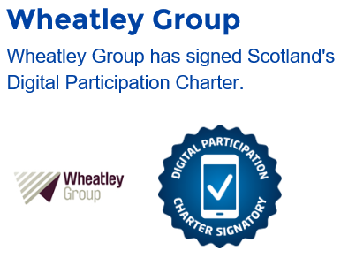
&
Notes:
Earlier this year we (SQA) carried out a survey to establish staff's digital skills levels and any areas they felt they needed more support or training. We also asked for staff members with more advanced digital skills who wished to help others through volunteering opportunities as part of our Corporate Social Responsibility programme, Hands Up. Around 35 people across our two sites in Glasgow and Edinburgh expressed an interest in helping as a digital volunteer.
We then approached Wheatley Group and asked if there were any opportunities to help increase digital skills. They were about to roll out a survey to their employability programme community janitors to measure their levels of digital competence and then to work with Jobs and Business Glasgow staff to help them close that development gap. Graeme Hamilton, Innovation and Online Services Manager at Wheatley, felt that engaging SQA volunteers might be a great way of ensuring they had the capacity to support these individuals and help them find secure long-term work.
Longer term they also planned to survey all staff in the group in a similar vein and then develop training to close that digital gap, all ultimately with the aim of all their staff being sufficiently skilled to be able to help all of their customers go or get online. SQA is producing video guides to help people engage in a range of online activities and we hope these can be used as training material to build digital skills.
Both Wheatley and SQA are organisations committed to improving both digital inclusion and literacy and for our volunteers it’s a great opportunity to also develop mentoring and social skills. We held a ‘meet and greet’ session at Wheatley’s Click and Connect learning centre in Whiteinch, Glasgow, last week, pairing up community janitors keen to learn with SQA staff keen to help them get online. We hope to see a strong partnership developing and to continue to set up support opportunities through volunteers at other depots where Wheatley operate.
We are delighted to be involved in this venture which ticks all the boxes of the Scottish Government’s Digital Participation Charter.

Slide 9

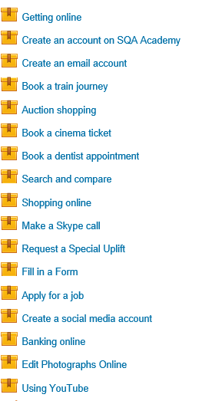


Slide 10



Trusted intermediaries acting as ‘Digital Champions’
Within the third sector…
3. Making Digital Leaders
Digital organisations
1. Making Digital Work
Basic digital skills
2. Making Digital Everyday
Digital champions
Using the appropriate resources to support learning

Slide 11

digital.scvo.org.uk
@digiscot
@david_mcneill

