Slide 1


Digital learning guides
Launch event – 30 March 2016
Wheatley Academy, Glasgow
Hilary Weir, SQA &
Graeme Hamilton, Wheatley Group

Slide 2
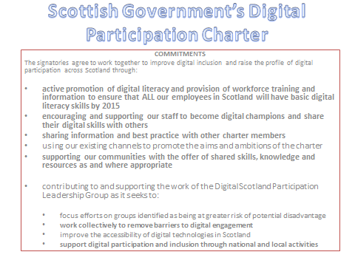

Slide 3
Managing information
Communicating
Transacting
Problem-solving
Creating

Slide 4
82% important to use up-to-date technology
4% prefer to avoid tech
6% difficult to ask for support
35% would like to have more confidence
71% enthusiastic
57% used more tech at home
46% satisfied with level at work
80% SQA responsible for upskilling staff

Slide 5


Hands Up
Hands Up is a key part of our CSR strategy,
focusing on how our staff can help our local communities.
All schemes are linked to the following broad themes:
Young people/social inclusion
Enterprise/employability
Sustainability/environment
Human health and well-being
Notes:
Running staff volunteering 'Hands up' scheme, for four years which is growing rapidly. All our colleagues have 21 hours a year to devote to volunteering in our local communities.
Very conscious that supporting volunteering opportunities brings advantages to SQA, our staff, and the people and organisations being supported. As well as acting as ambassadors for SQA, our staff volunteers are learning new skills which they bring back into our business.
With skills and volunteers in place, next step for me to identify partnership activities
other stakeholders to help reach people who have little or no digital skills and therefore at risk of further economic disadvantage.

Slide 6
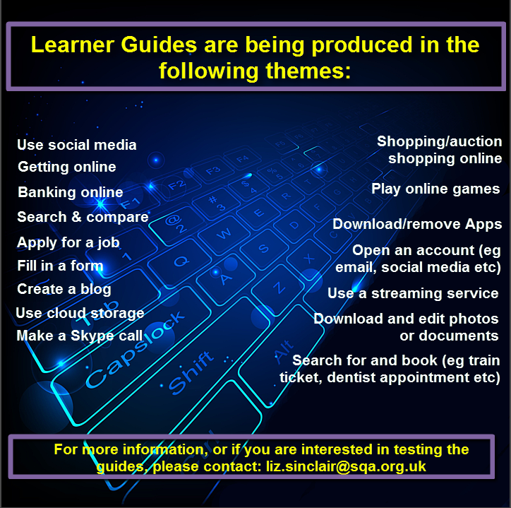

Slide 7
Skills pathways
Digital skills
Internet Safety
AWARDS
NPAs
Digital Literacy
Digital Passport
UNITS
Computer Basics
Badges linked
to digital skills
competency
framework
Transferable skills
Mentoring award
Part of HN qualification
Volunteering
Notes:
For learners, could be start of educational journey. SQA has developed suite of guides for reference, working with a volunteer and completing online leads to set of activities linked to competency badges which in turn start of pathway to accredited learning.
The recently validated National Progression Awards in Digital Passport, Units or themed activities developed as learning resources to support Unit Outcomes have potential use as training material both for staff and for volunteers. There is opportunity to promote use of this new qualification or elements thereof to a new market when working with voluntary organisations to reach people who are not currently digitally engaged.

Slide 8

Our digital partnership
Volunteering to develop digital skills
Graeme Hamilton, Wheatley Group
Hilary Weir, SQA

Slide 9
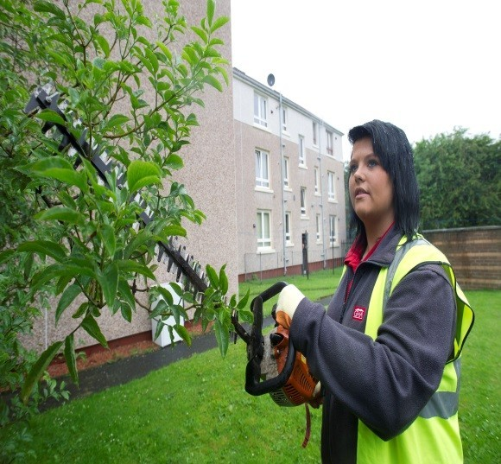
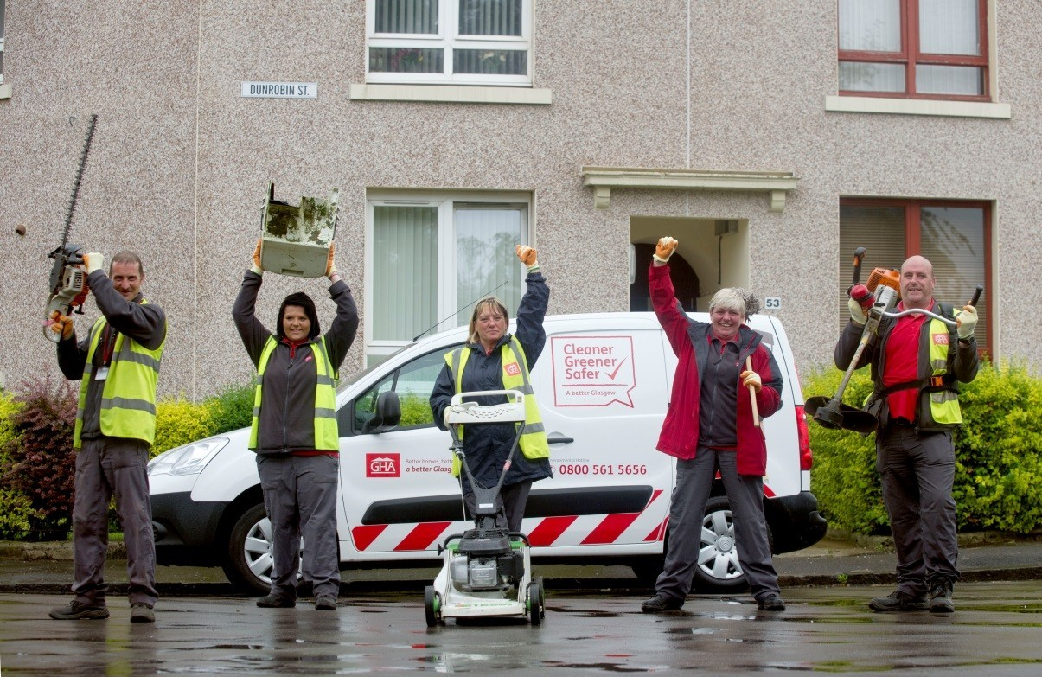
Our learners
  Community Janitors- employability programme
  Survey results
  Benefits to individual and to Glasgow

Slide 10
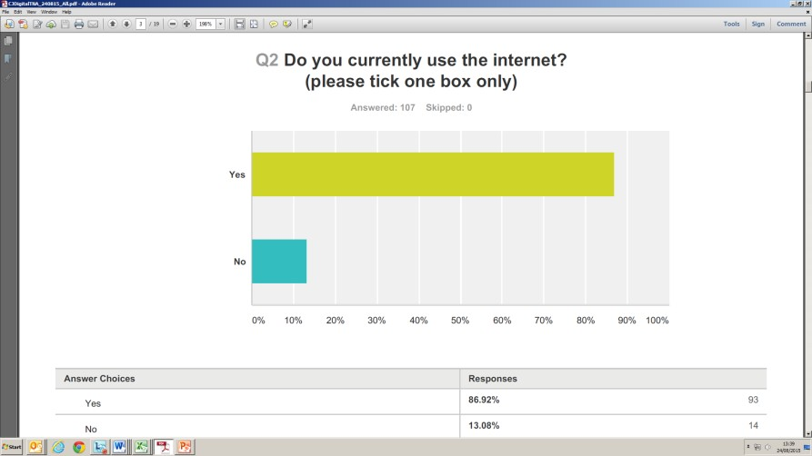
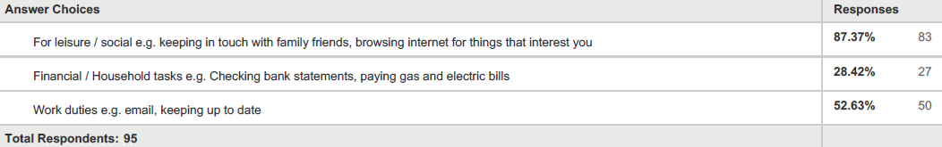
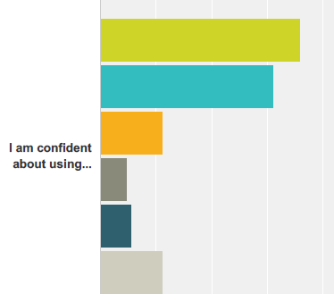
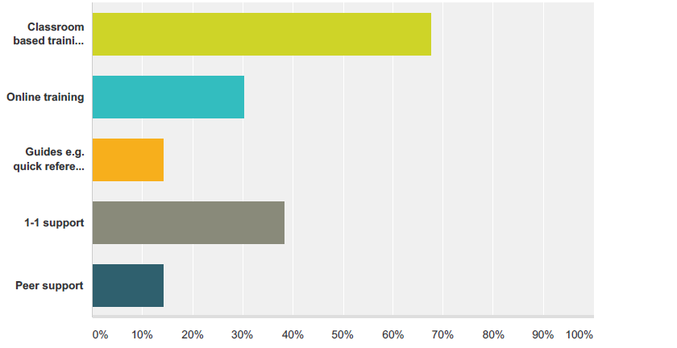
Our survey results

Slide 11
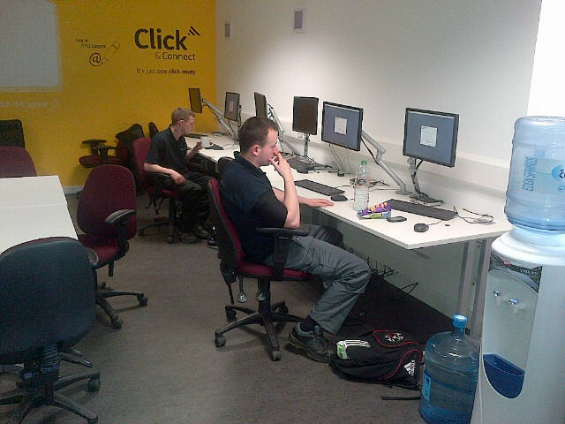
Our partnership
121 or small group coaching
Developing those skills gaps identified in survey
Start with nine volunteers and nine janitors
Potential to extend
- Edinburgh/Bathgate
-Tenants in very sheltered sites
-Employees, e.g. care staff, environmental staff

Slide 12
What’s happened so far?
Michael/Lucy
Use of smart phone
accessing emails
auto-rotate screen
Work through learner guide
Ted/Robert
Surfed job search engines
Practiced with mouse
Paul/Karen
Saving documents
Compose/send emails
Using You tube
Harry/Andy
Submit a job application on S1 jobs
Adrian/Lucy
Logged in and out of PC
Keyboard practice
Jim/Charles
Upload CV
Set up account with SQA academy
Use BBC I player

Slide 13
Digital learning guides
Launch event – 30 March 2016
Wheatley Academy, Glasgow
Malcolm Allan & Peter Healy
Wheatley Group Community Janitors

