Slide 1



Martyn Shields
Larbert High School
PT Pupil Support
Mental Health and Wellbeing
@MrShieldsLHS
@LarbertHighMH
Notes:
Introduction of self - 1 min

Slide 2
  Aims
Mental Health and Wellbeing overview at LHS
How we deliver the Level 4 and 5 Courses
Our approach to assessment and gathering evidence
Notes:
Give overview of what we are going to be speaking about – 1 min

Slide 3


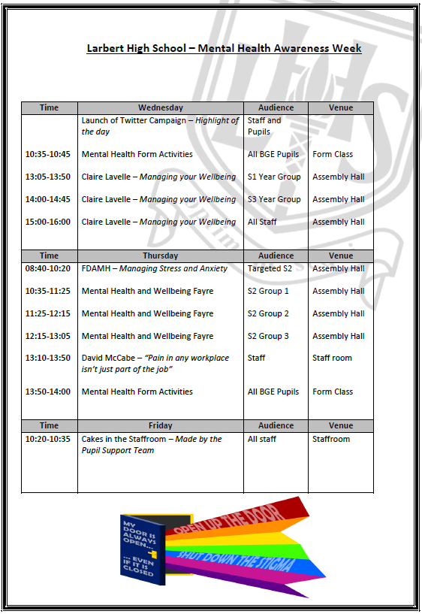


Mental Health and Wellbeing Overview
Notes:
Give an overview of the different ‘things’ that go on at LHS to support Mental Health and Wellbeing – 4 mins

Slide 4
How We Deliver the Courses
Level 4
Completed by all S2 pupils through MESP time
Working towards 2 units
Other approaches
Notes:
Level 4 course – doing this for the first time this year.
One period per week – aim for 2 units. Finish the award by end of S3
Explain some other approaches saw at other schools.
2 mins

Slide 5
How We Deliver the Courses
Level 5
Can be picked as a Wider Achievement Opportunity (WAO)
36 Pupils last year – Some of these pupils have formed a Pupil MH Leadership Academy
Notes:
2 periods per week. Pupils can pick as a WAO in senior school. Pupils are picking it for a variety of reasons (explain them)
Using the course for some pupils to become MH Pupil Leaders in the school
2 mina

Slide 6
Notes:
Most Popular WAO Choice across the school - Shows us pupils value the importance of MH
100% rise of pupils picking the course this year.
1 min

Slide 7

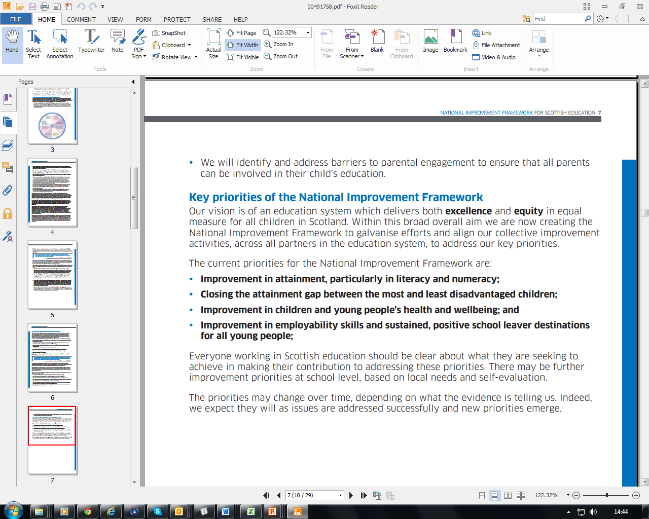
Notes:
I believe the courses can be key to meeting the NIF priorities.
Building resilience in pupils so they can cope with the demands of school – raises attainment and closes gap
Can Support Positive destinations
1 min

Slide 8
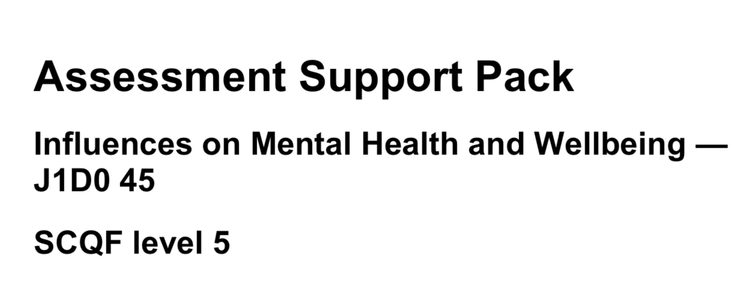
Our Approach to Assessment
Notes:
ASPS are beneficial and key to understanding evidence requirements however the fact they were not ‘there’ last year allowed us to be more flexible with assessment.
Will only use the ASPS for 1 unit this year.
1 min

Slide 9
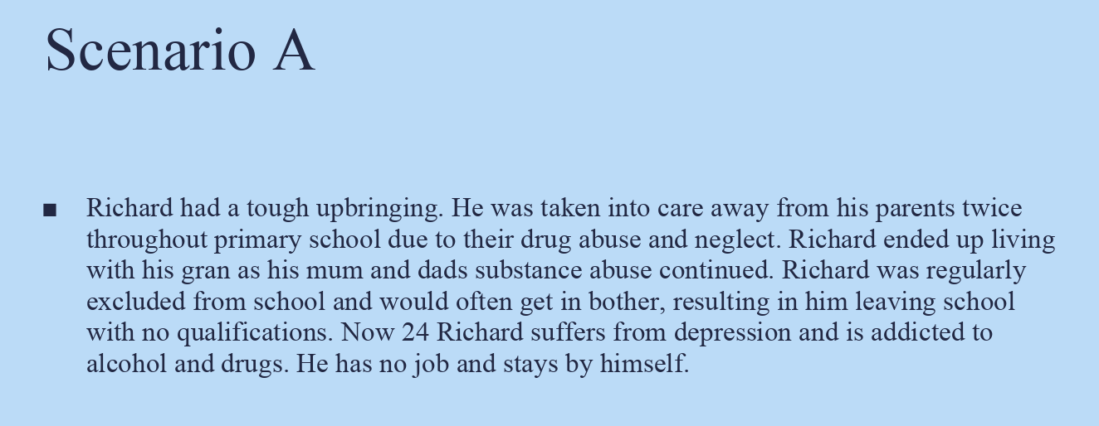
Coping Strategies and Building Resilience
Notes:
Notes:
Pupils have a range of Scenarios to choose from
Meet all evidence requirements through making a poster/presentation/leaflet/powerpoint on how their ‘person’ in their scenario could get help/help themselves.
2min

Slide 10
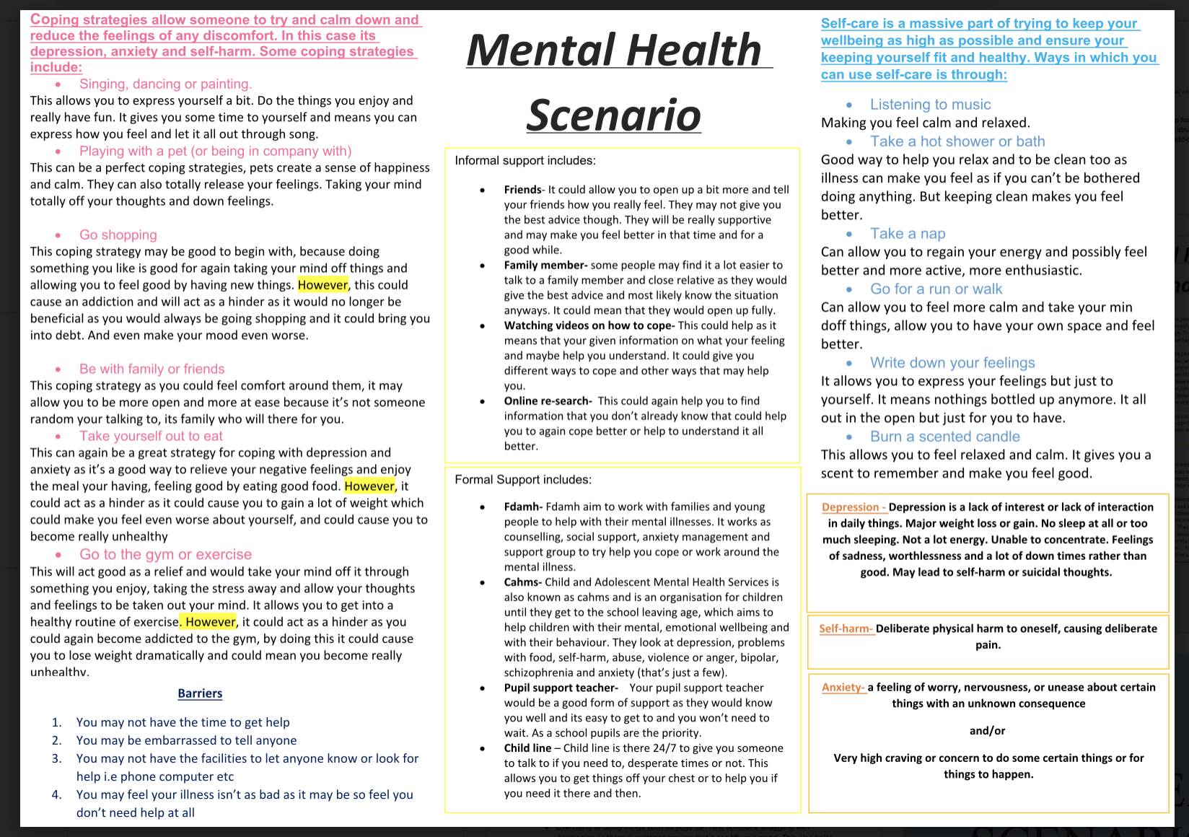
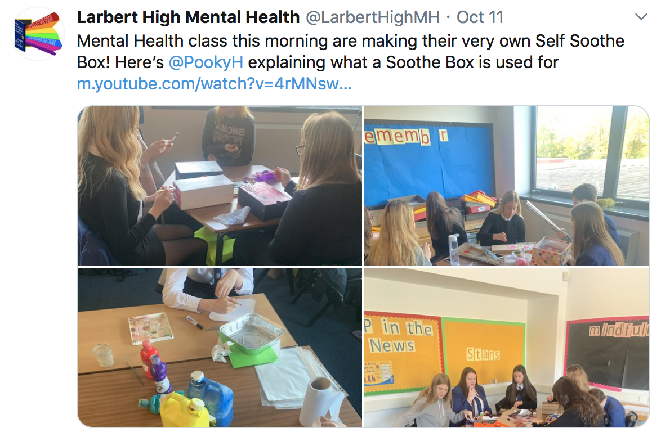
Notes:
Examples of work and lesson 1 min

Slide 11
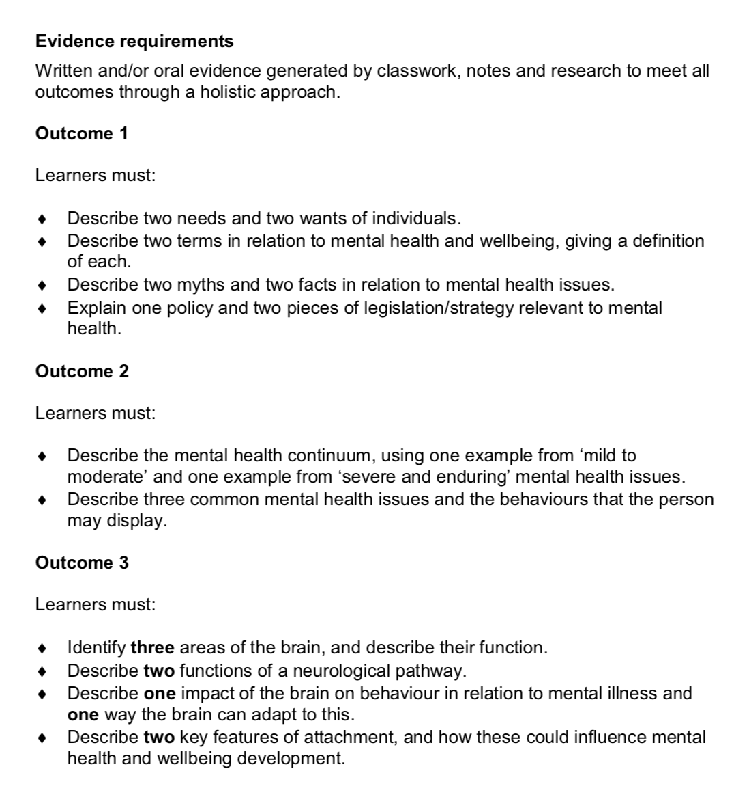
Understanding Mental Issues
Notes:
1 min

Slide 12



Research a well known person who has at times had poor Mental Health
Link the outcomes to the person you are researching, all answers should be geared towards your ‘person’
Again, work can be presented in any way a candidate wishes.
Understanding Mental Issues
Notes:
Pupil more engaged in work
Ongoing process
Doesn’t feel like an ‘assessment’
Gives the work a meaning
3 min

Slide 13
Questions?
@MrShieldsLHS
@LarbertHighMH

