Slide 1

Zoe Ramage
Psychology Teacher
St Ambrose High
RamageZ@st-ambrose.n-lanark.sch.uk
@PsychologyStAmb
Notes:
Introduction of self - 1 min

Slide 2
Teaching and enquiry based approaches at St Ambrose High

Slide 3
Background: how we are running it
One “coursed” class: 30 pupils, 3 double periods a week
Two “elective” classes: 30 pupils each, 1 period a week – working towards Unit 1 only
Huge range of pupils choosing to participate

Slide 4
Your aims?

Slide 5
Inquiry based learning
Didn’t want it to be “chalk and talk” – although still very much a process of work
Wanted this course to prioritise their questions and develop their ability to investigate, learn and apply understanding about mental health and wellbeing
On top of this – it means we can learn more as we go, teacher and student – you don’t need to know it all to deliver

Slide 6
Resilience?

Slide 7
Developing resilience
Prompting the development of many of the seven C’s of resilience: Competence, confidence, connection, character, contribution, coping, control
Facilitating this dynamic in the classroom will help students develop resilience in and through their work and relationships, meaning that they will be developing skills to better be able to cope, adapt and recover from challenging situations in all parts of their life

Slide 8
Stages of most topics
Developing questions – what sort of knowledge would they want to gain in this area?
Researching the topic or carrying out activities that prompt curiosity or encourage new understanding
Discussing and passing on what we have learned
Reflecting and forming connections with past and future knowledge

Slide 9
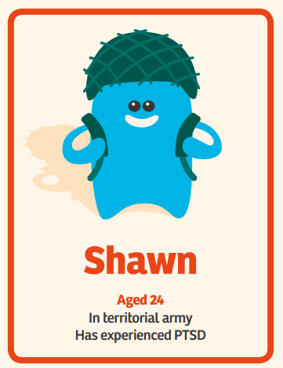
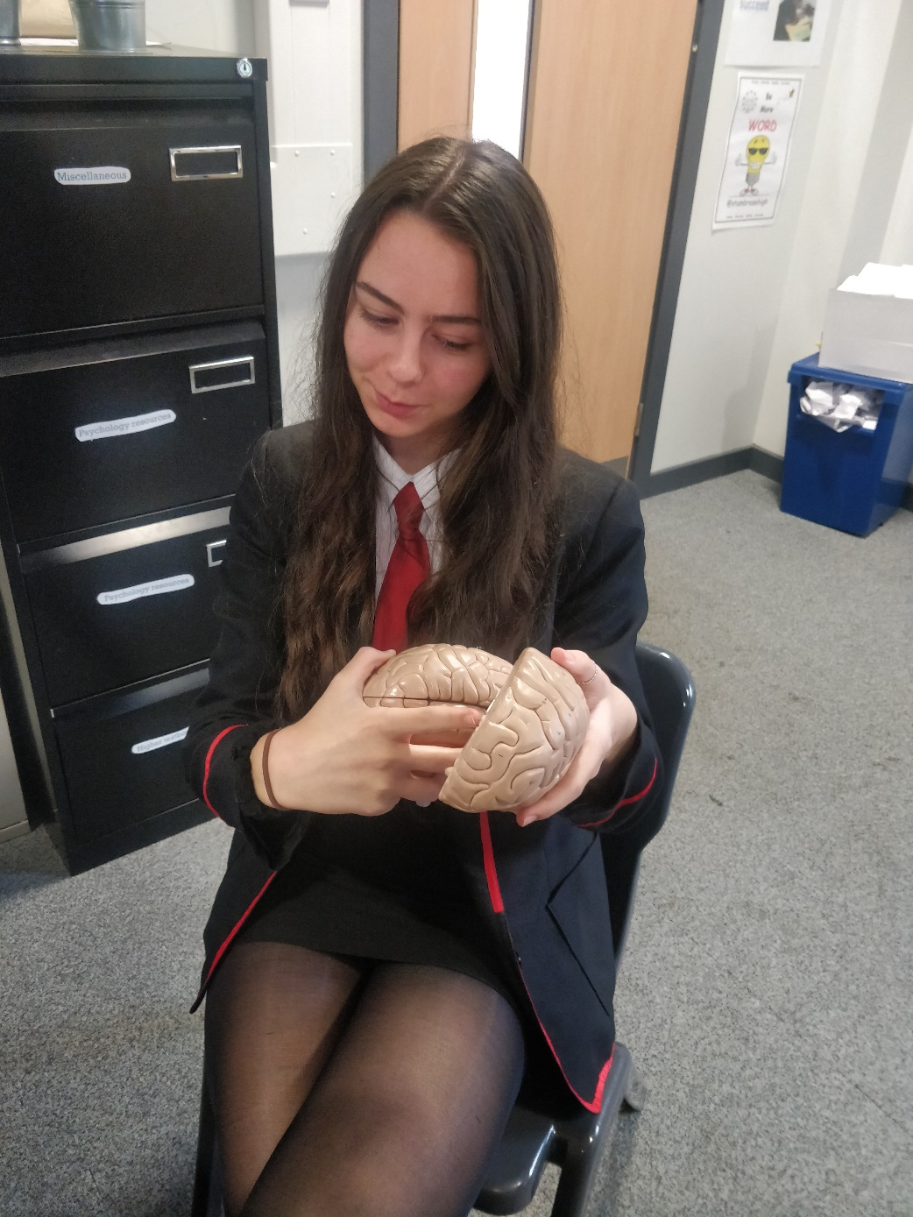
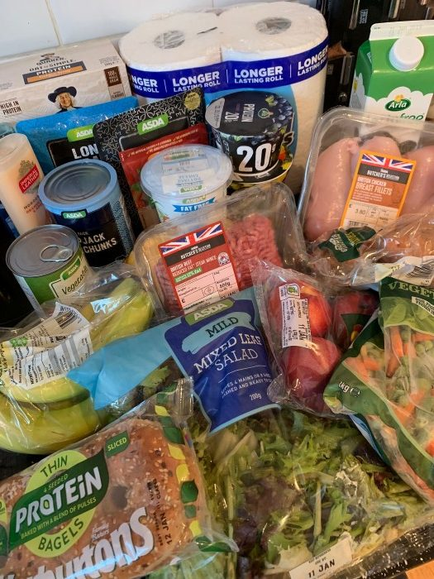
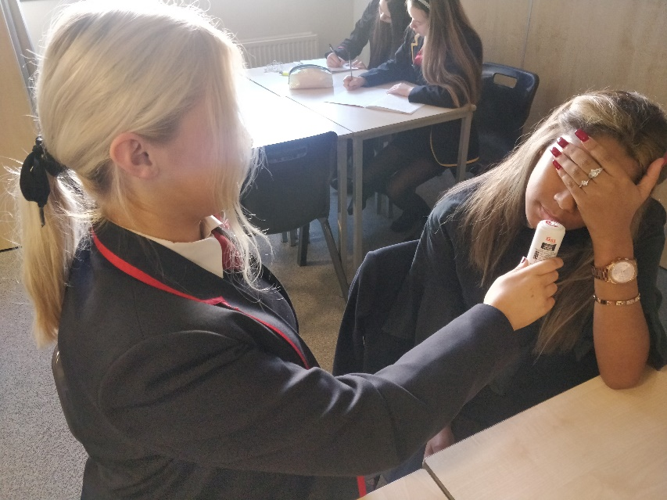
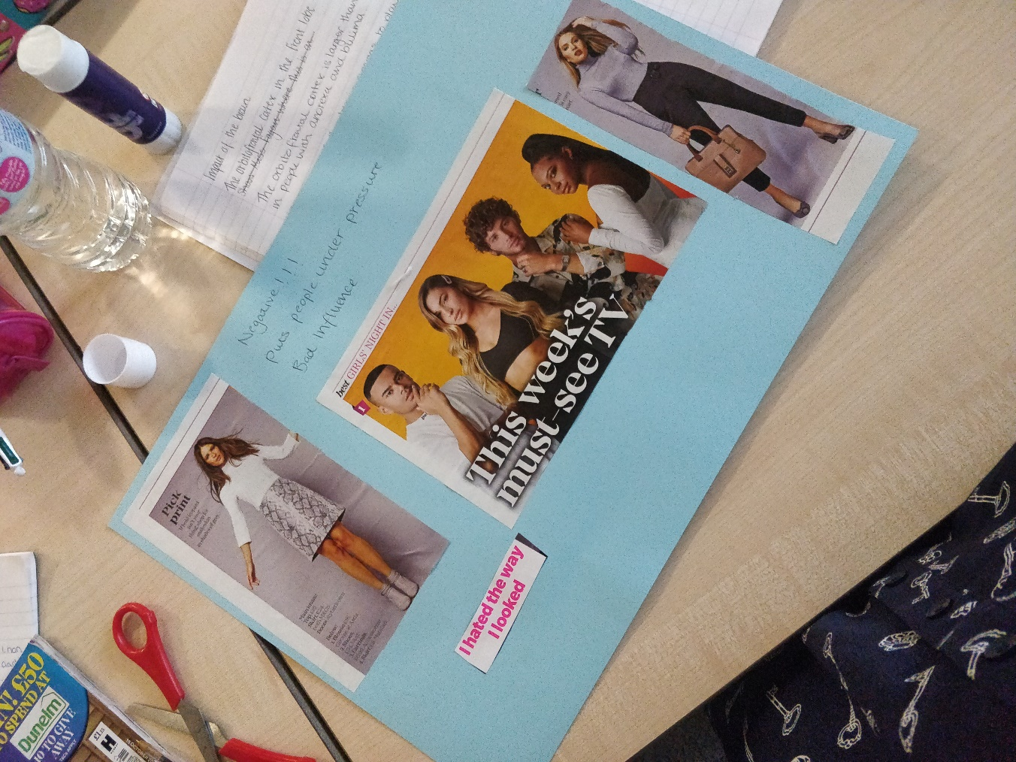


Examples
Notes:
Spectrum
Research / presentations
Stigma – zombie, language, newspaper tasks films
Legislation research – podcasts
Trying out different therapies for phobias, interviewing teachers
Poverty tasks – rent, weekly shop
Area tasks –
Body image tasks
Sense tests

