Slide 1


Growing a new generation of computer scientists
Judy Robertson
Professor of Digital Learning

Slide 2
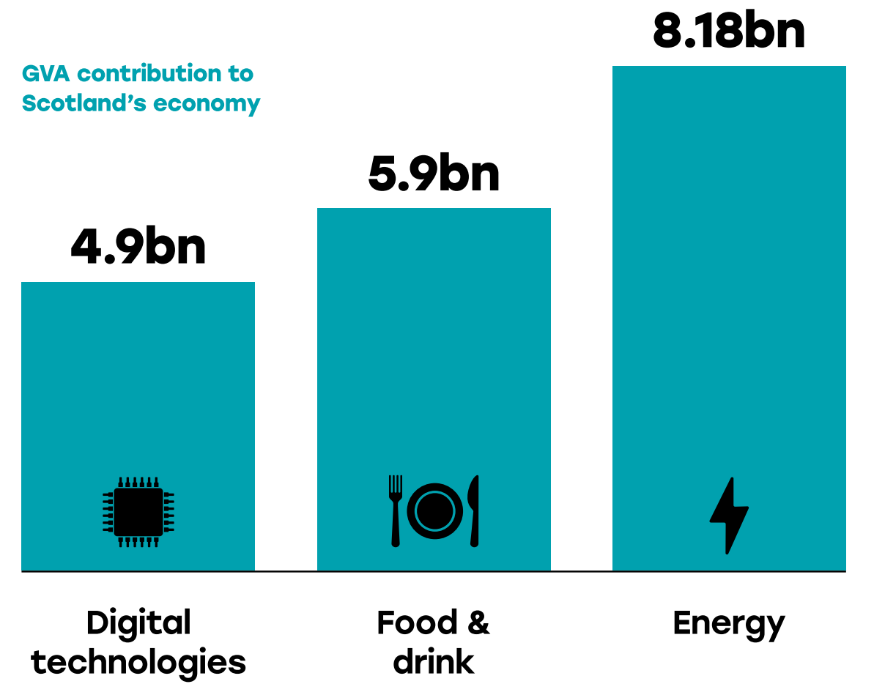
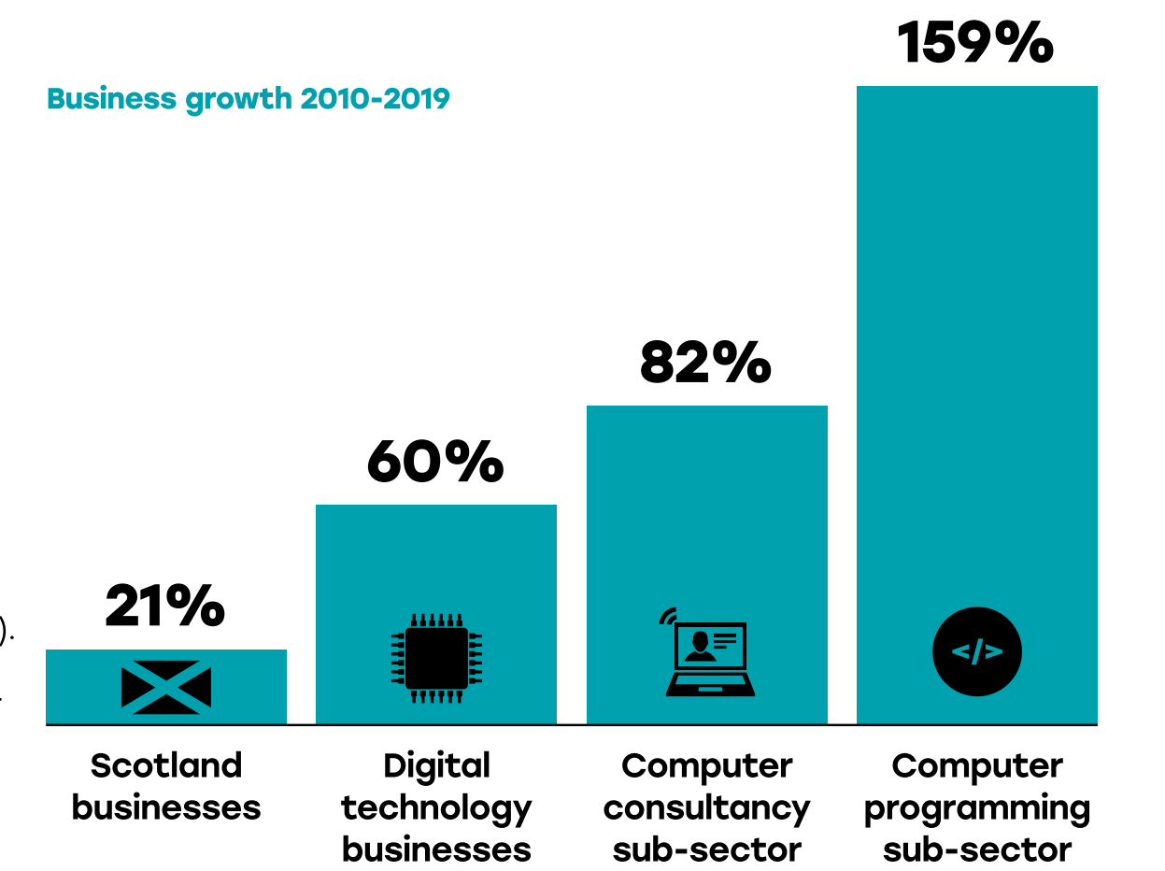
The digital sector in Scotland is growing fast
https://www.skillsdevelopmentscotland.co.uk/media/43306/scotlands-digital-technologies-summary-report.pdf

Slide 3
University Computing student numbers have rocketed internationally
https://cra.org/generation-cs-three-years-later/

Slide 4
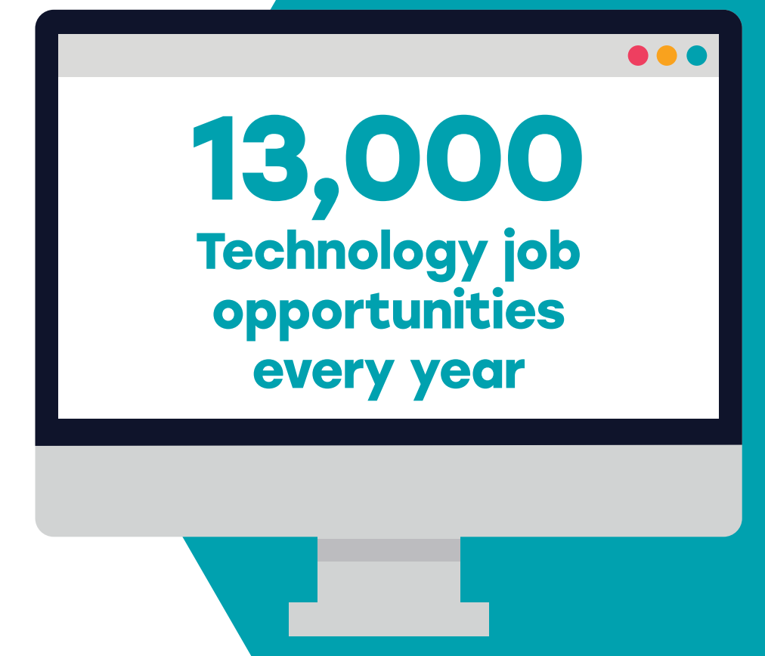
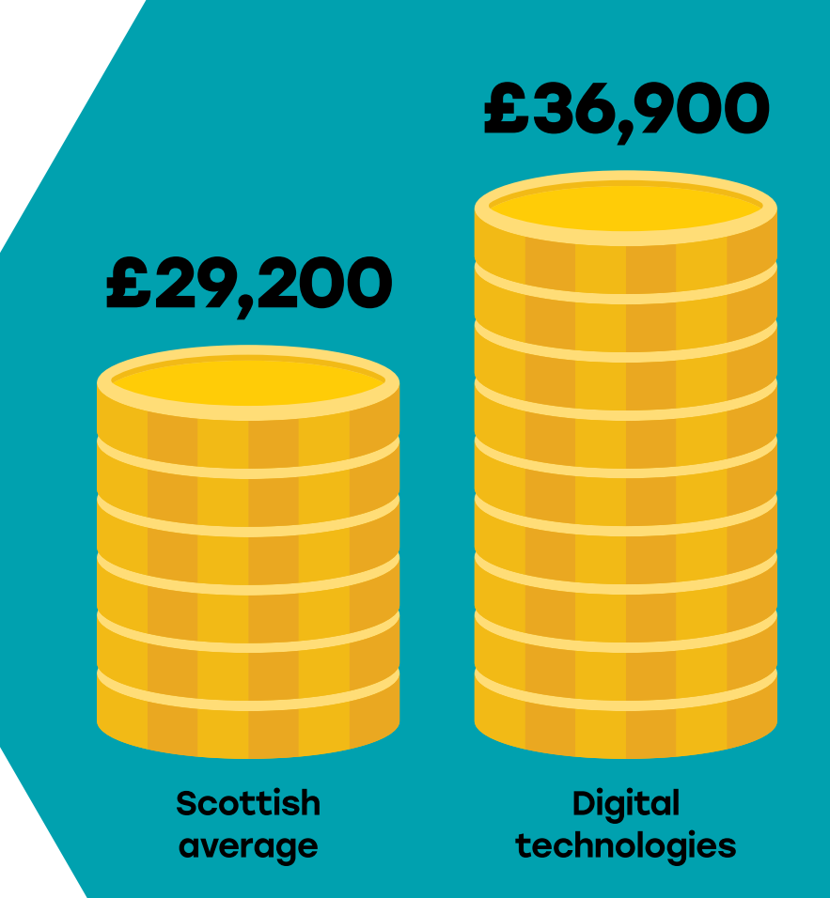
Computing qualifications lead to well paid jobs
https://www.skillsdevelopmentscotland.co.uk/media/43306/scotlands-digital-technologies-summary-report.pdf

Slide 5
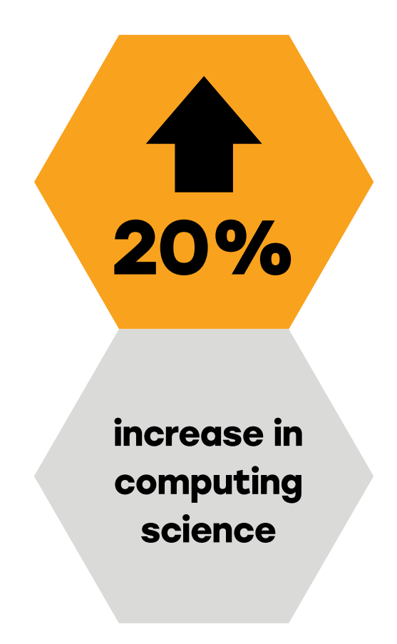
Computing student numbers in Scottish Universities have also rocketed
17,000 computer science students at Scottish Universities

Slide 6
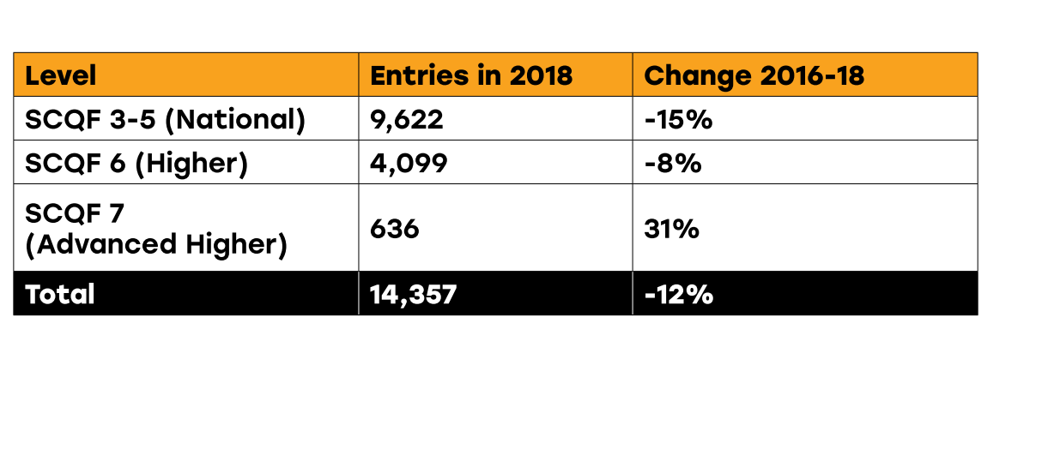
But school computing numbers are shrinking

Slide 7
Where do computing students come from?
https://www.gov.scot/publications/impact-international-students-scotland-scottish-government-response-migration-advisory-committees/

Slide 8
Why doesn’t the early leaky pipeline affect university numbers?
Because universities usually don’t require computing qualifications for entrance to HE computing courses

Slide 9
Why does a drop in school computing numbers matter?
Fairness – everyone should get to choose whether to do computing
Diversity – we need a wider variety of people in the computing industry
Computing skills are needed in all walks of life, not just for university

Slide 10
What research tells us about gender in Computer Science

Slide 11
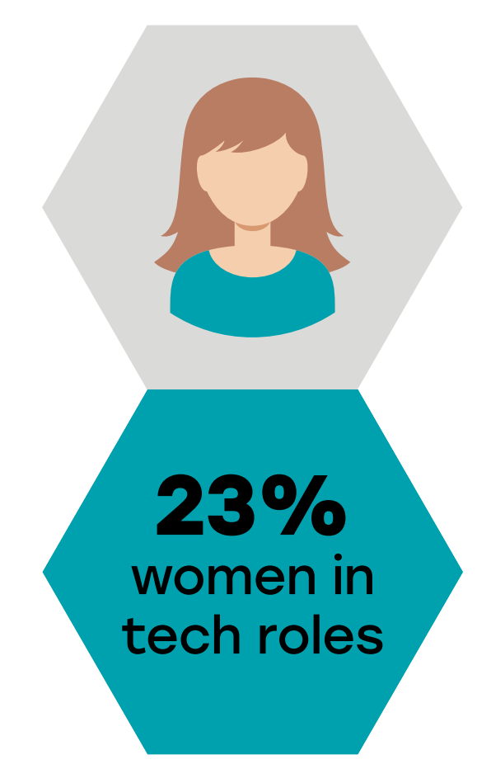
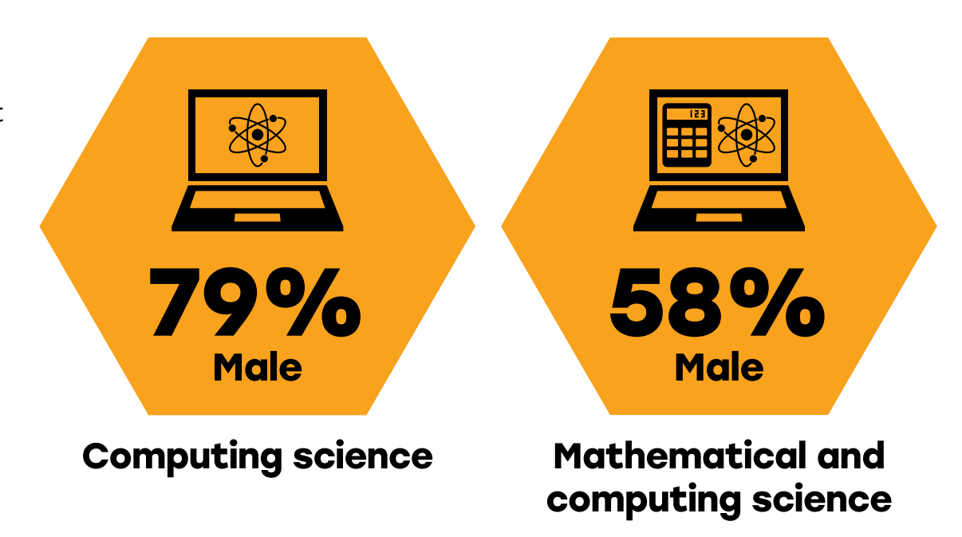
Gender in Scottish tech sector
https://www.skillsdevelopmentscotland.co.uk/media/43306/scotlands-digital-technologies-summary-report.pdf

Slide 12
Why are there so few women studying computer science?
It’s the same all over the world
It’s a problem in all of STEM
It’s because of the maths
It’s always been this way

Slide 13
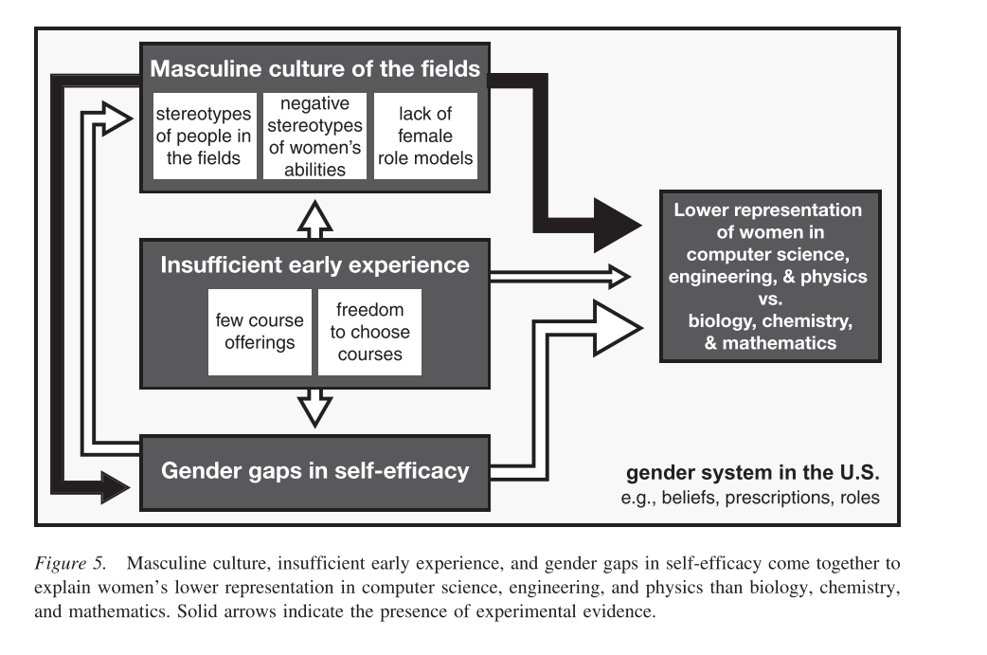
A model to explain lower participation of women in CS
Cheryan, S. et al. (2016) ‘Why are some STEM fields more gender balanced than others?’, Psychological Bulletin, 143(1), p. Advance online publication. doi: 10.1037/bul0000052.

Slide 14
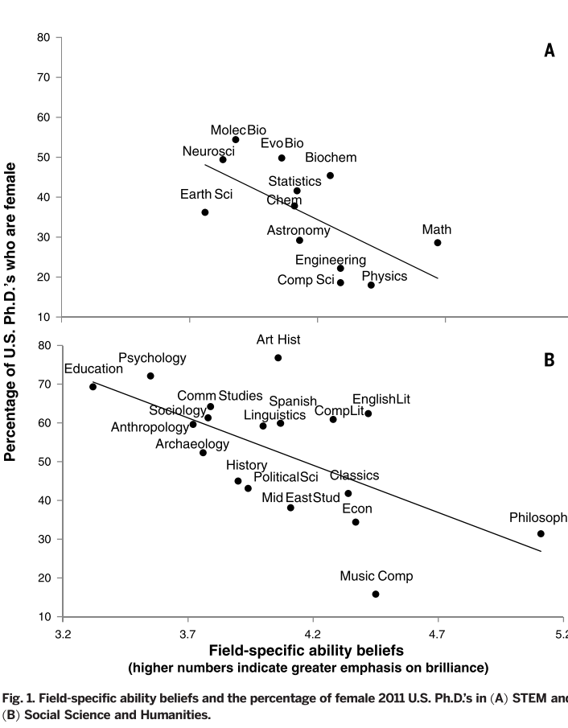
Perceptions of brilliance
Leslie et al (2015)

Slide 15
There’s more to it than gender

Slide 16
How can we make our classrooms more inclusive?

Slide 17
Role models in the classroom
Young people need a selection of role models: invite computer scientists into the classroom
Lots of different sorts of roles and people with varying career paths
Don’t believe that s single on-off visit will “inspire” kids - your own work will have a longer lasting effect!
Profiles of women in data sector: https://ddi.ac.uk/women-in-data/
Book industry visits to your classroom: https://www.founders4schools.org.uk/
(Also talk to Craig Steele about his SDS pilot project for industry volunteers in the classroom https://craigsteele.com/)

Slide 18
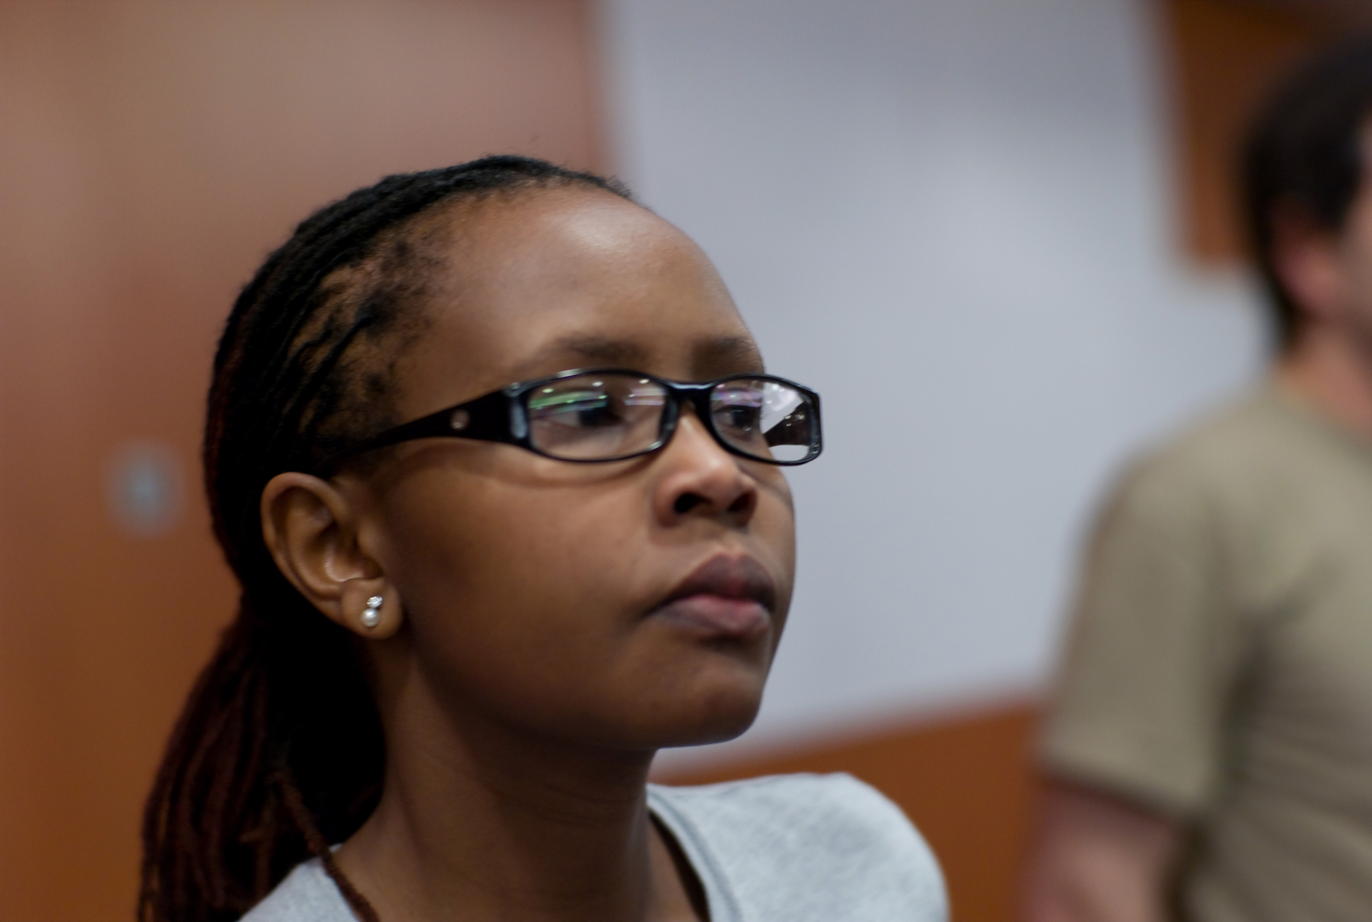
Gender balancing the curriculum
Thank you, Juliana Rotich.
Thank you, Juliana Rotich.
Check your text books or handouts to see if they:
Depict women and girls (not in helper roles!)
Mention computing heroes who are not white men (Free posters at https://teachinglondoncomputing.org/celebrating-diversity-in-computing/)
Avoid examples or exercises which fit the stereotype of being ”for” one particular group
You co-developed a platform that saves lives and supports democracy across the world.
Find out who provides the data
for Ushahidi.

Slide 19
Encouraging everyone to choose computing
Don’t go on about how hard computing is (it could trigger stereotype threat)
Pay attention to what the classroom looks like (don’t make it seem like a nerdy den)
Reach out to families too – mums in particular
Focus on why your subject is great, and what opportunities it brings
Don’t make a big deal of gender gap

Slide 20
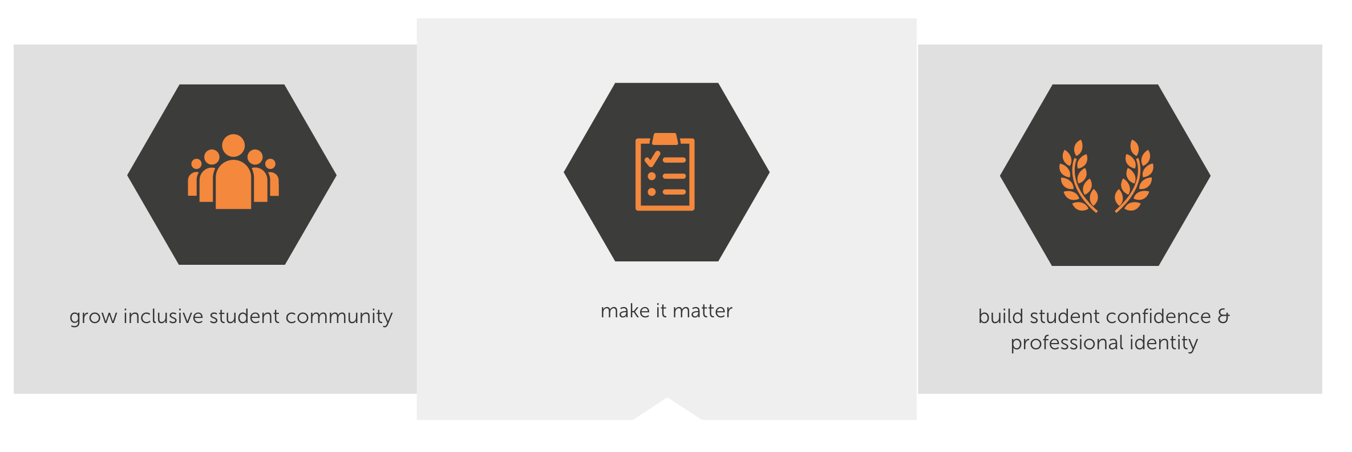
Resource: Engage CS
https://www.engage-csedu.org/

Slide 21
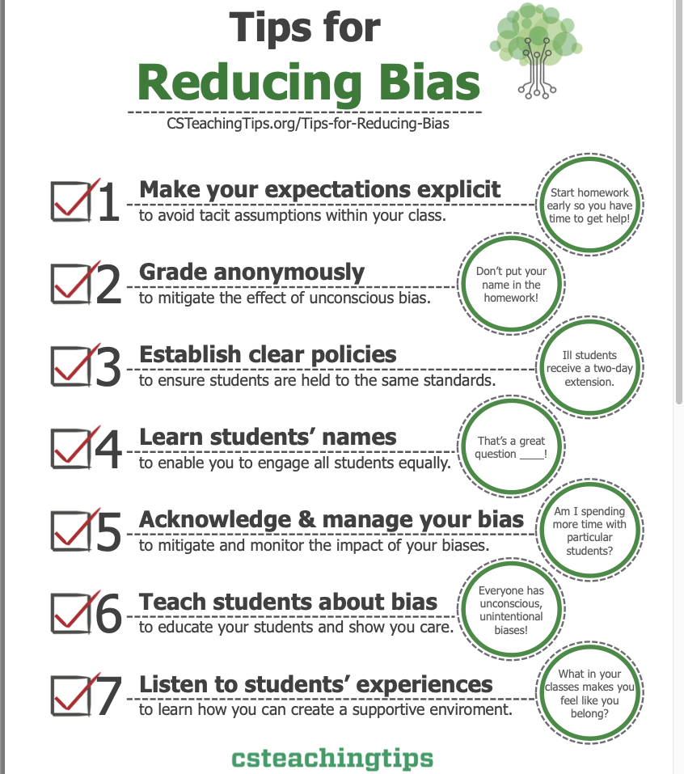
Resource: CS Teaching Tips
http://csteachingtips.org

Slide 22
Conclusions
There is growing demand for more people with computing skills in Scotland, and the rest of the world
While university student numbers have grown, school computing numbers have not
This is a problem because it reduces equity and diversity in computing
When we teach in an inclusive way, we all help to grow the next generation of computer scientists

Slide 23

Judy.Robertson@ed.ac.uk

