Slide 1

Bridging the Digital Gap
MELINDA MATTHEWS-CLARKSON
CEO, CODECLAN LTD
FEBRUARY 5, 2020

Slide 2
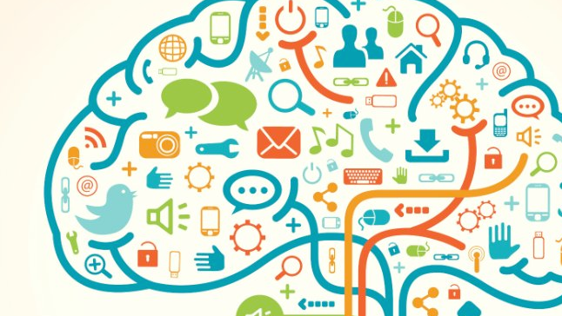
Knowledge
is a familiarity, awareness, or understanding of someone or something, such as facts, information, descriptions, or skills, which is acquired through experience or education by perceiving, discovering, or learning. Knowledge can refer to a theoretical or practical understanding of a subject.

Slide 3

A skill is the ability to carry out a task with determined results often within a given amount of time, energy, or both. Skills can often be divided into domain-general and domain-specific skills. For example, in the domain of work, some general skills would include time management, teamwork and leadership, self-motivation and others, whereas domain-specific skills would be used only for a certain job. Skill usually requires certain environmental stimuli and situations to assess the level of skill being shown and used.

Slide 4
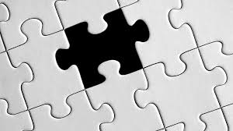
How to Bridge today’s Digital Gap?
We all have Knowledge regardless of our education.
We are taught Skills for our success in life.
But what is the Digital Gap?

Slide 5
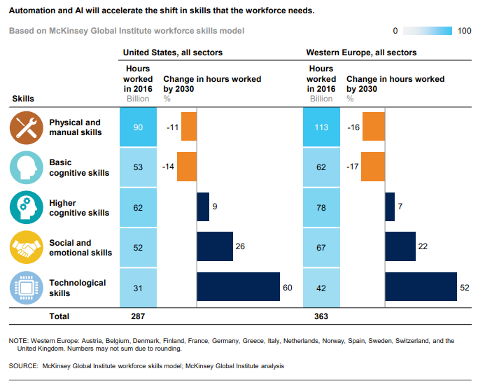
Shift in our Skill Set for Future Work

Slide 6

Digital Inclusion will make the biggest difference in society’s growth

Slide 7
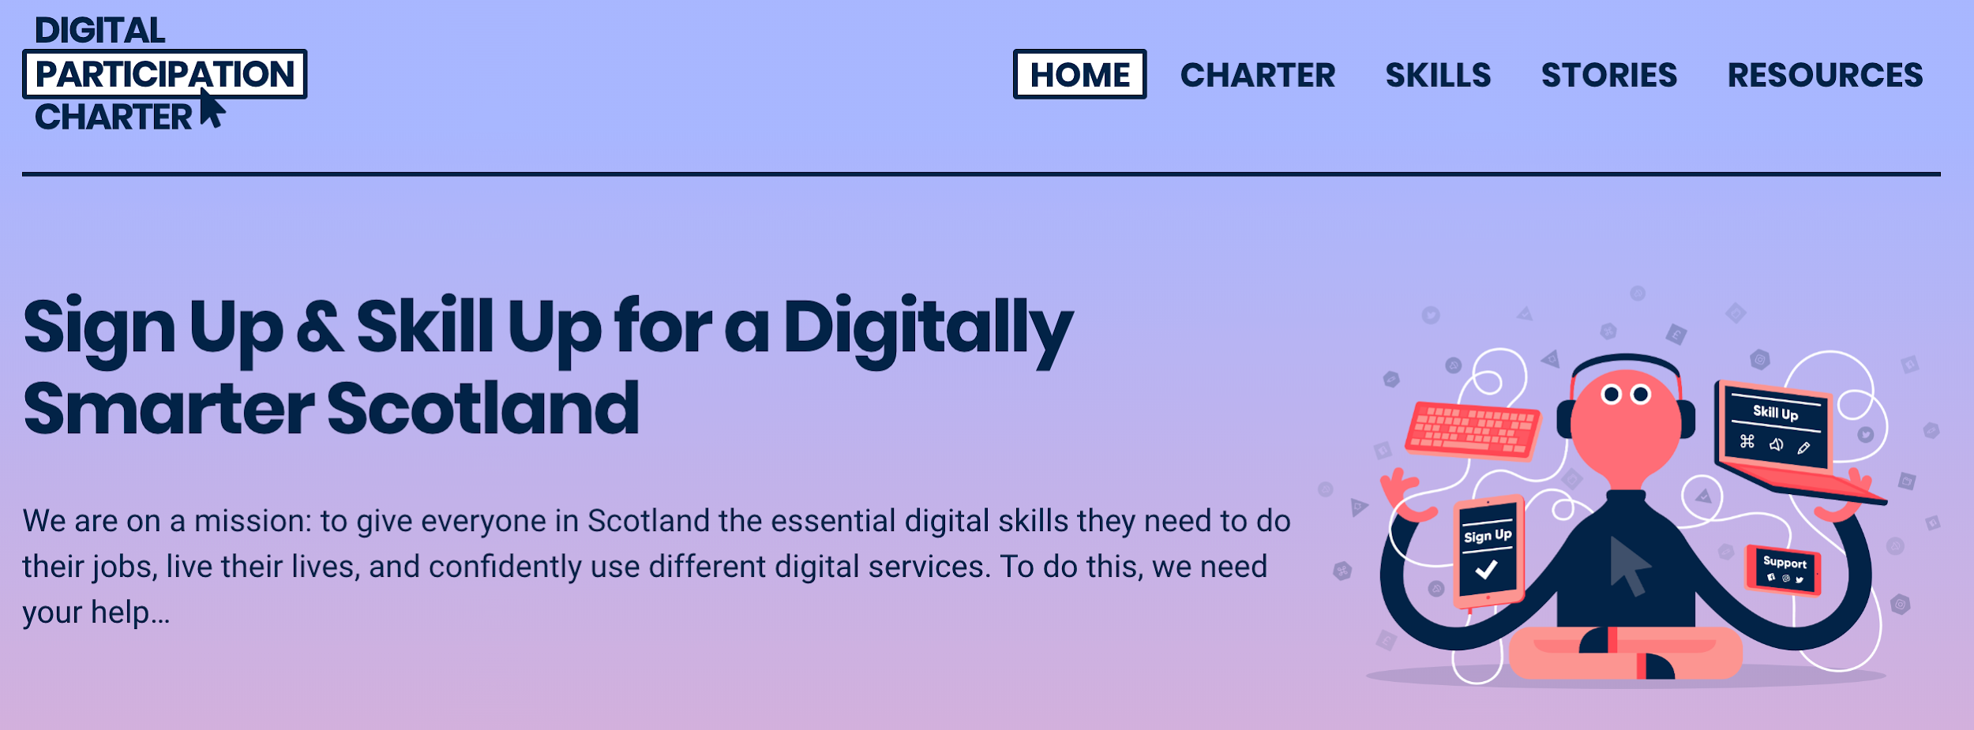
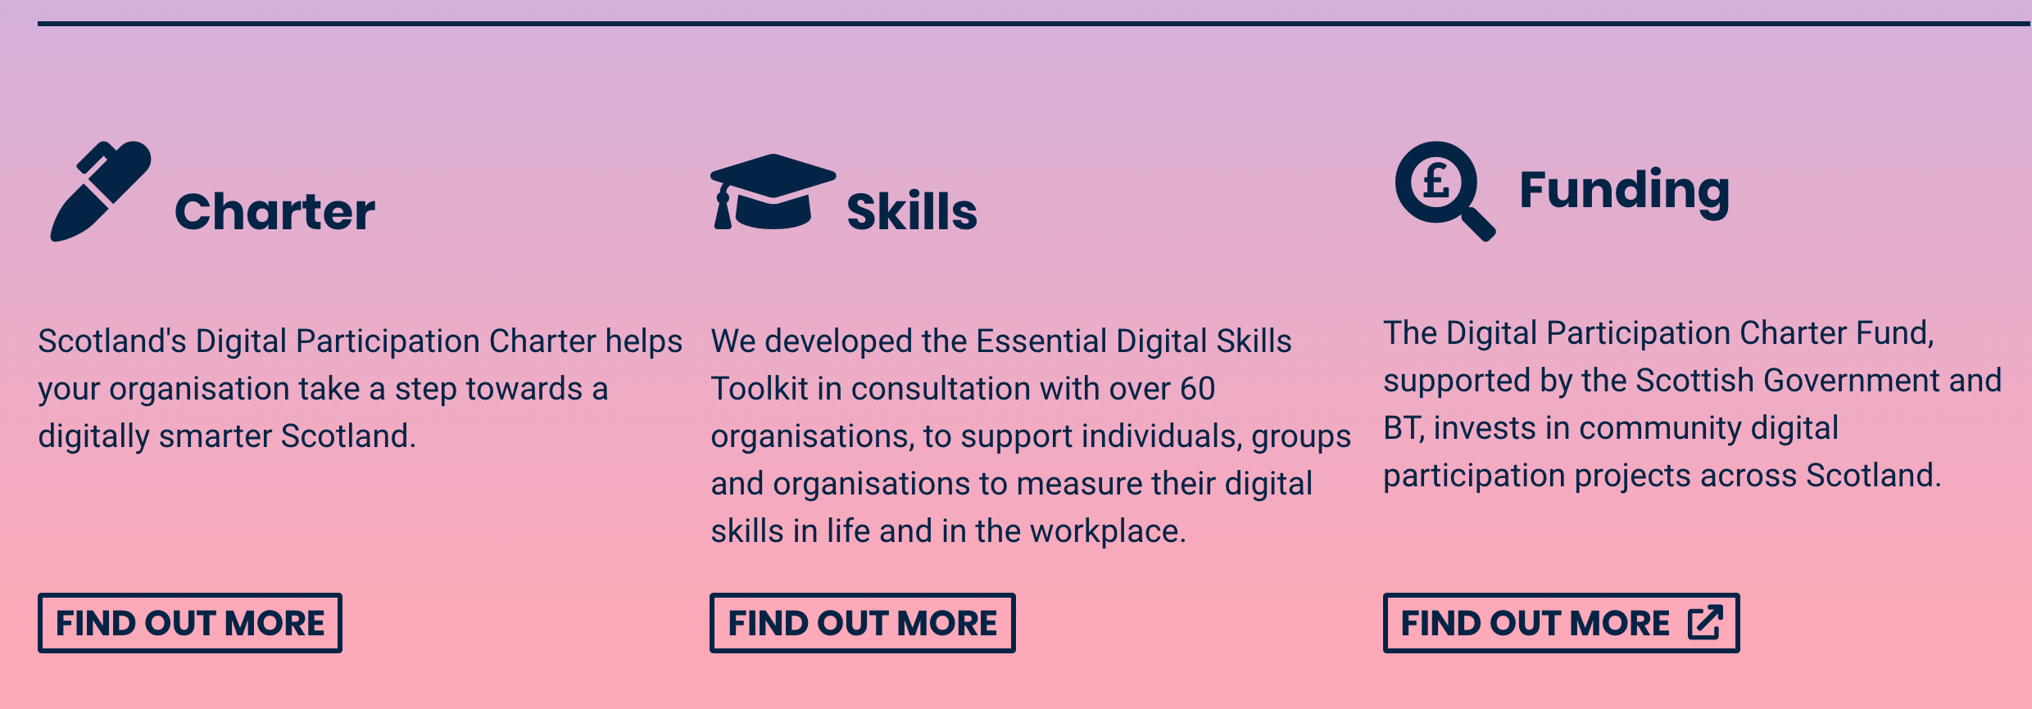

Slide 8
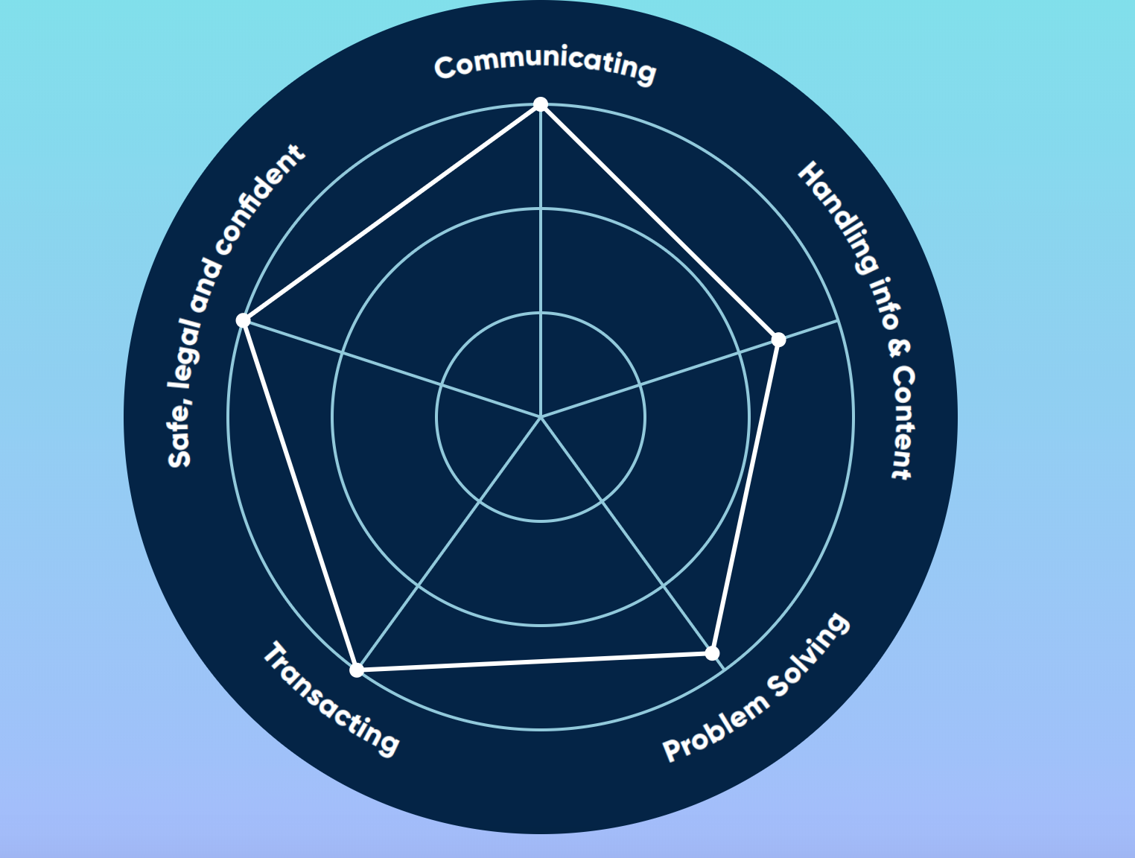
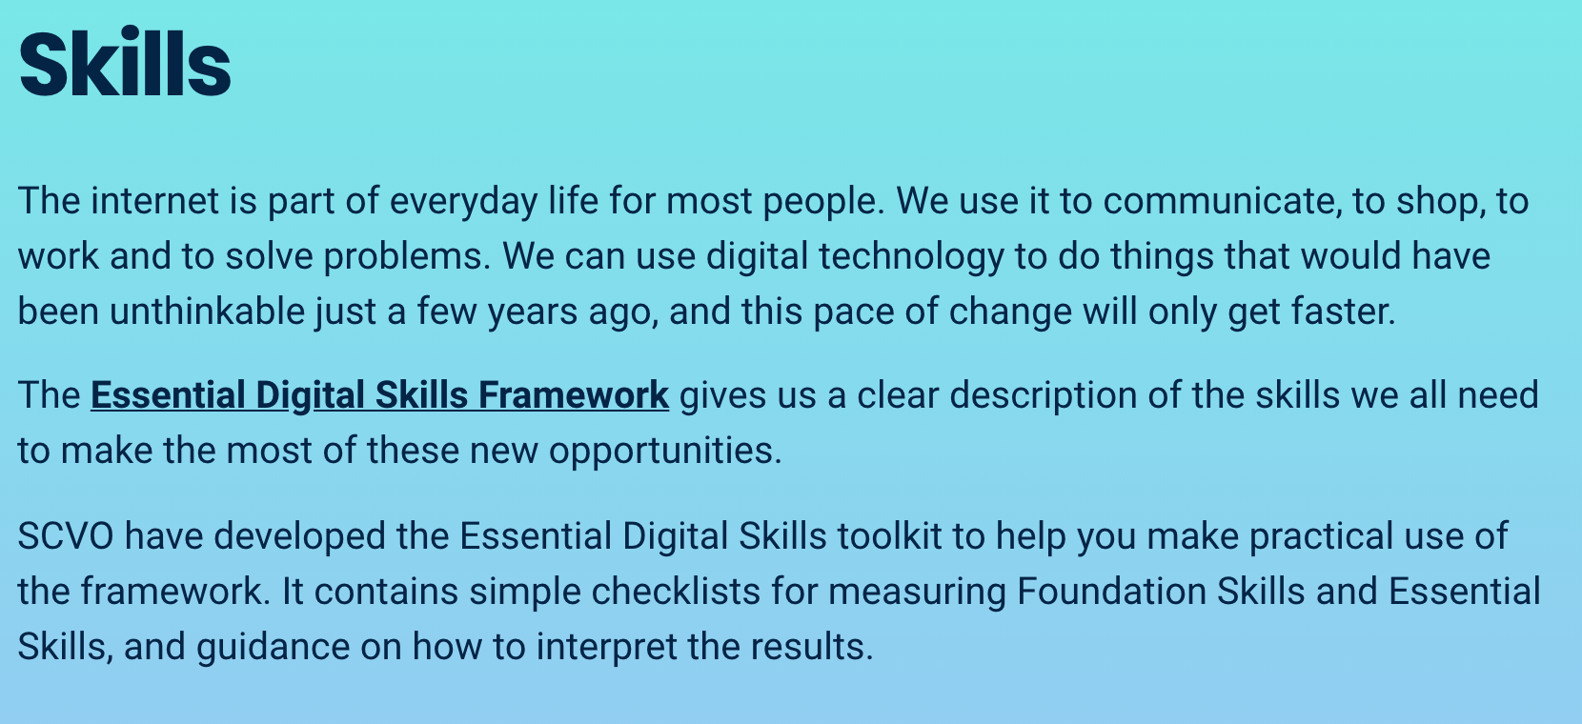

Slide 9
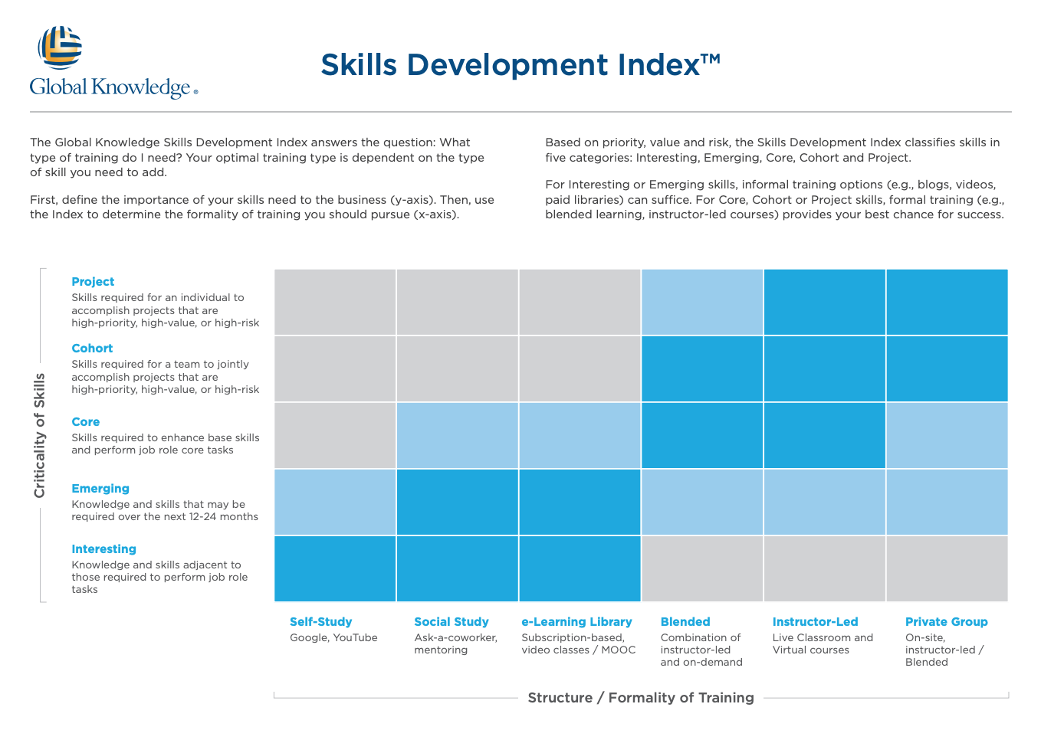

1
Environment for Learning including digital sources for learning

Slide 10
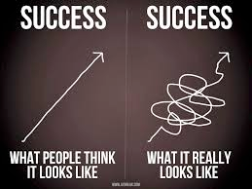
2
Confidence and Respect in Failing or Learning – Did You GTS?

Slide 11
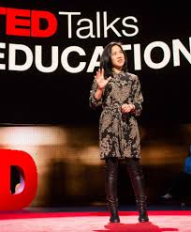
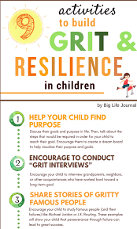
3
GRIT is the essential skill for the digital world
Angela Duckworth

Slide 12
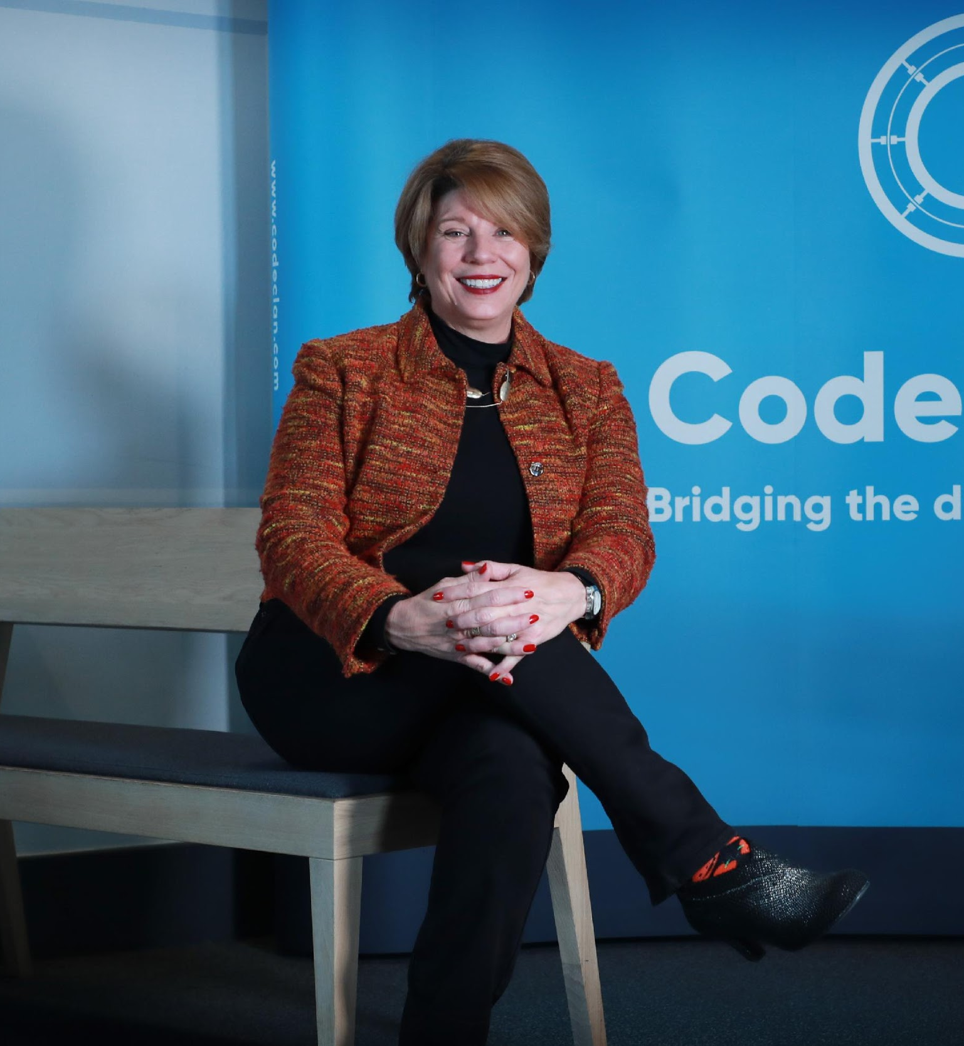
Thank You
Melinda.Matthews@CodeClan.com

