Slide 1


Digital Literacy units workshop
Frances O’Neill

Slide 2
SQA Digital Literacy Unit specifications
J3H6 42 Digital Literacy (SCQF level 2)
J3H6 43 Digital Literacy (SCQF level 3)
J3H6 44 Digital Literacy (SCQF level 4)
J3H6 45 Digital Literacy (SCQF level 5)
J3H6 46 Digital Literacy (SCQF level 6)

Slide 3
Cyber Resilience Resources
Scouts/Nominet Trust - Digital Detectives
scouts.org.uk/activities/digital-detectives/
Choices for Life/ Police Scotland – BeSmart
https://young.scot/get-informed/national/be-smart-internet-safety-resources
How private is your personal information?
https://www.youtube.com/watch?v=yrjT8m0hcKU
Action Fraud / Police UK
https://www.actionfraud.police.uk/campaign/not-with-my-name-tips-to-prevent-identity-crime
Password protection – Last Pass
https://www.lastpass.com/

Slide 4
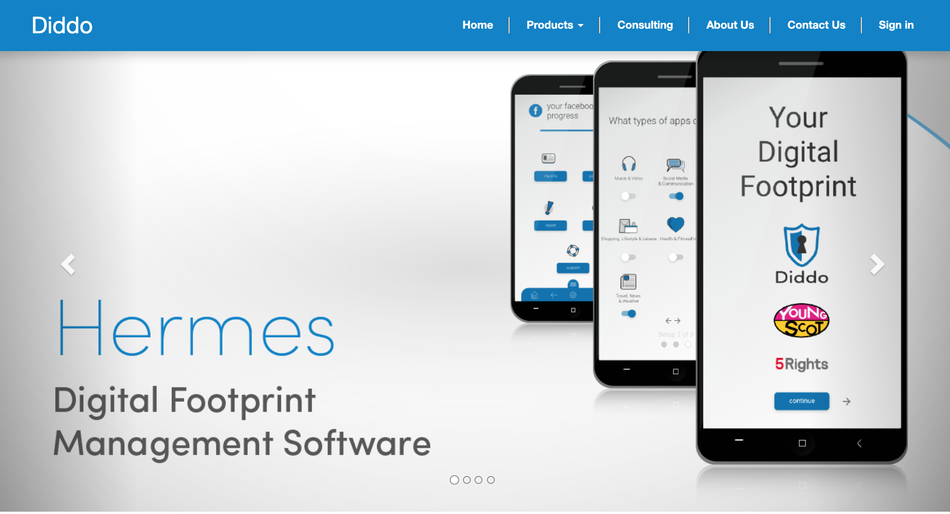
Cyber Resilience Resources

Slide 5
Project Management Tools
Project Management Software comparison list https://bit.ly/2OwMB2y
Microsoft Teams https://products.office.com/en-GB/microsoft-teams/group-chat-software
Google Classroom https://play.google.com/store/apps
Slack https://slack.com/intl/en-gb/?eu_nc=1
Basecamp https://basecamp.com/
Padlet https://padlet.com/
Trello https://trello.com/
WeChat play.google.com
apps.apple.com

Slide 6
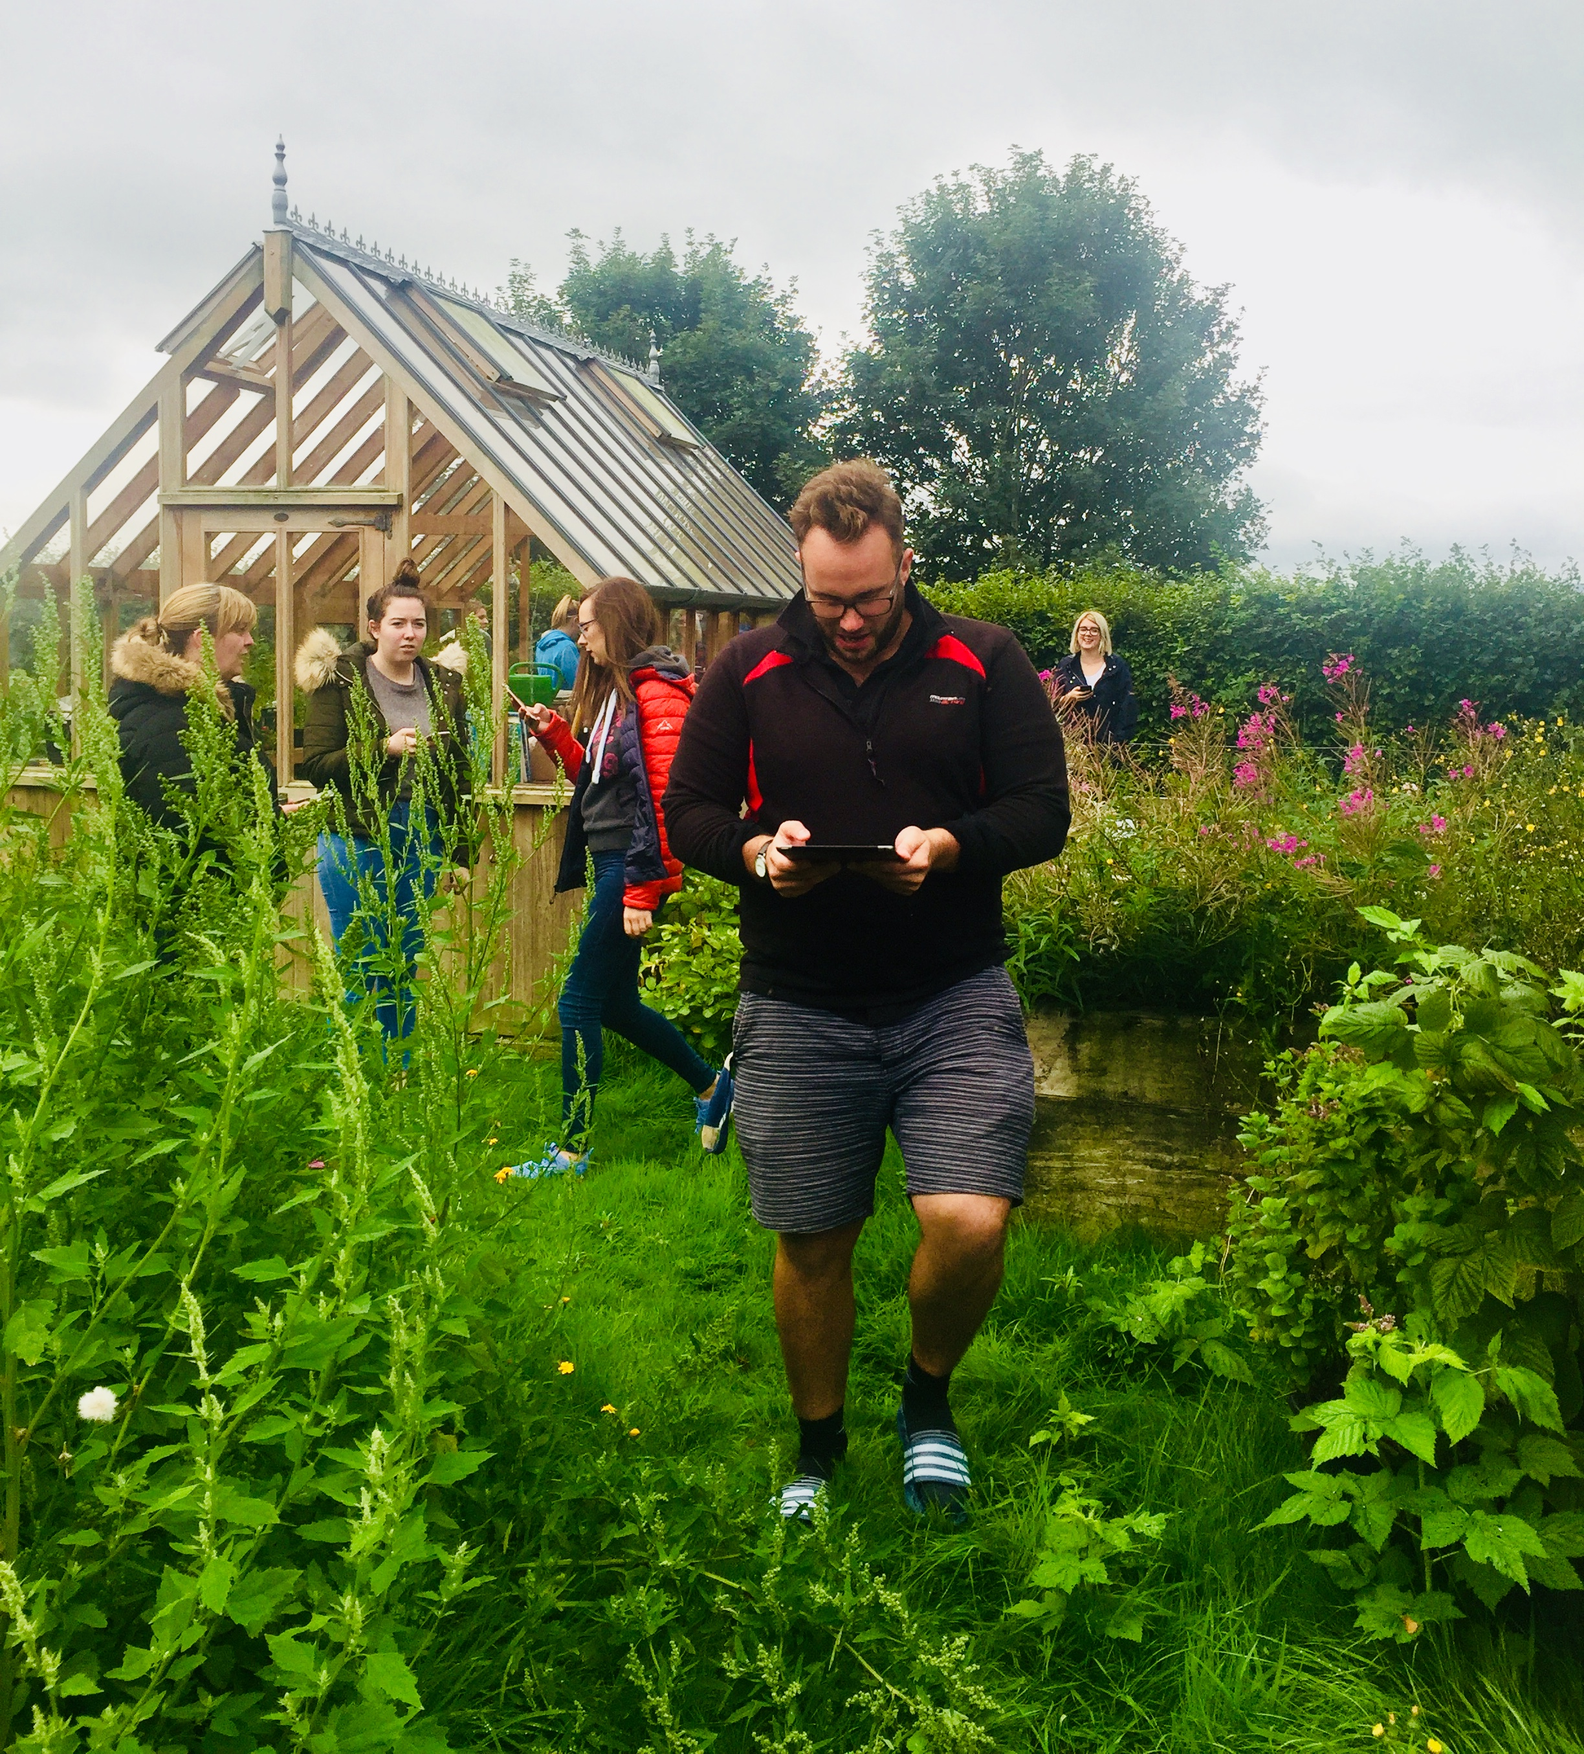
Learning on Location Apps
BeED
Ecosystem for Education
https://www.beed.world/
Seppo
Spark for Learning
https://seppo.io/
Global Treasure Apps
Edutainment
https://www.globaltreasuretrails.com/
Global Trails

Slide 7




Publishing Resources

Slide 8
Other Resources
SQA U-share (Cyber Security/NPA Digital Passport): https://ushare.education
SQA Academy Internet Safety course: https://www.sqaacademy.org.uk/course/
SQA Support Materials: https://www.sqa.org.uk/sqa/46233.2824.html
iDEA Awards: https://idea.org.uk
Minecraft.edu on GLOW: https://education.minecraft.net/error
Immersive Minds: https://www.immersiveminds.com

