Slide 1


Slide 2
HN Review of computing
SCOTTISH QUALIFICATIONS
AUTHORITY
Proposed changes to
Higher National Awards
in Computing

Slide 3


Slide 4
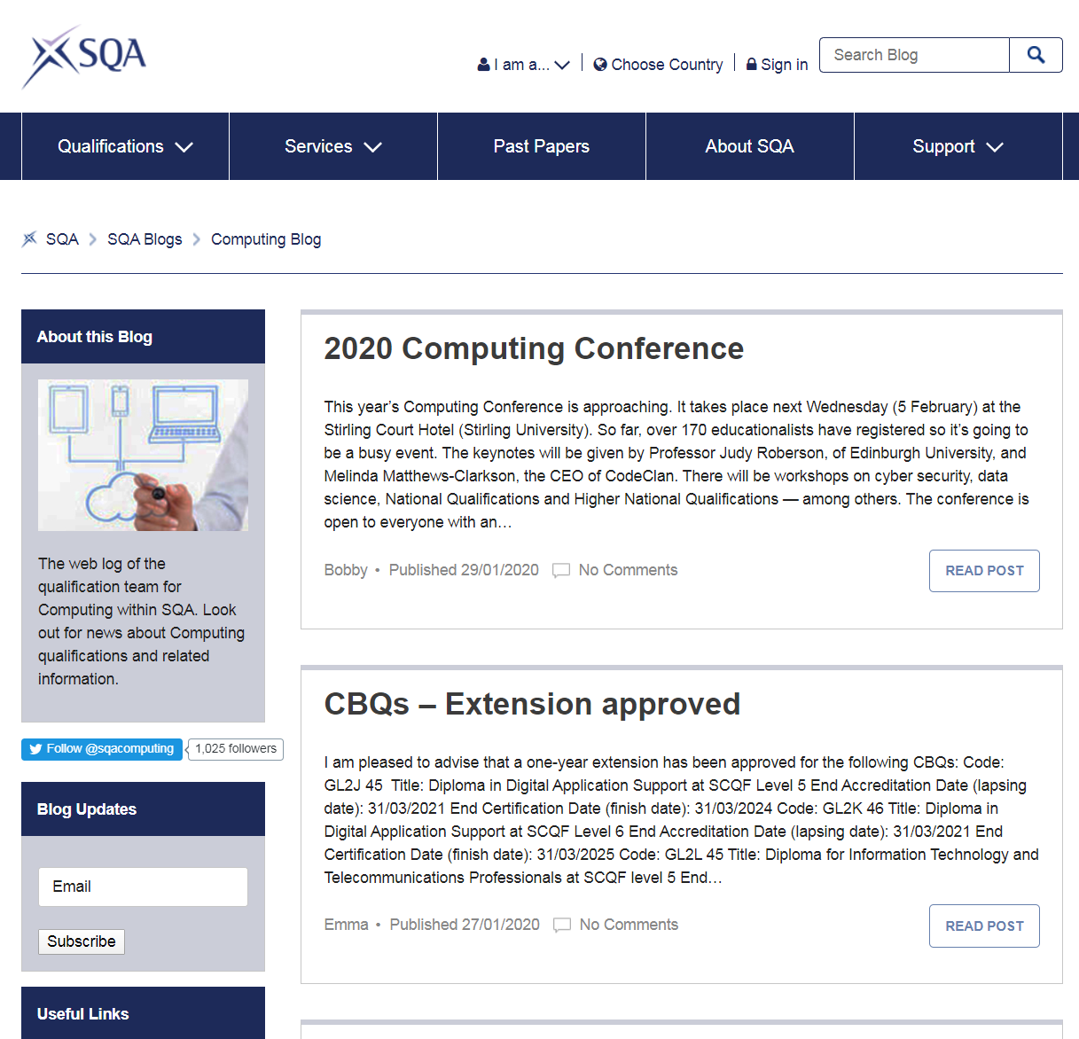
SQA blog
http://blogs.sqa.org.uk/computing

Slide 5

SQA on Twitter
https://twitter.com/SQAComputing

Slide 6
Workshop objectives
Why is it being reviewed?
Questions for me
How will it be reviewed?
Questions for you
Why is it being reviewed?
What is being reviewed?
When is it being reviewed?
How is it being reviewed?
What has been done so far?
How will HN Next Gen affect it?
How do I get involved?
Is the current plan OK?
Would you like to see any changes?
What do you like about the current qualifications?
What do you not like about them?
What changes to the design rules would you like?

Slide 7
Short history of computing

Slide 8
Trends in computing
Software development
Coding
Internet of Things
Cloud Computing
Cyber Security
VR
Data Analytics
Data Science
AI
Machine Learning

Slide 9
HN Computing scoping
Carried out in 2018
Recommendations
  Maintain single HNC
  Maintain the following HNDs
    HND Computer Science
    HND Software Development
  Combine these HNDs
    HND Networking
    HND Technical Support
  New HND Computing: Networking & Infrastructure
Recommendations accepted
Development will be part of HN Review

Slide 10
HNC/D Data science scoping
Carried out in 2019
Recommendations
  Demand for new award
  No need for HNC
    Update HNC Computing to include data science
    HNC Data Analytics should be replaced
  HND Data Science should be developed
    Added as new option alongside existing HNDs
Recommendations accepted
Development will be part of HN Review

Slide 11
Proposed changes
HNC Computing
HND Computer Science
HND Networking
HNC Computing
HND Computer Science
HND Networking & Infra.
HND Software Dev.
HND Technical Support
HND Software Dev.
HND Data Science

Slide 12
HN next generation
Last major review of Higher National Qualifications was 2003
Current design rules
  HNC: 12 credits
  HND: 30 credits
  Mostly single credit units
  Unit assessment
  Ungraded units (pass/fail)
  Graded Units
Possible changes
  HNC: 15 credits?
  Larger units?
  Less assessment?
    Combined/integrated
  Grading?

Slide 13
Development process
2020 Q1
  Create Qualification Development Team (QDT)
  Consult on design rules
2020 Q2
  Finalise design rules
2020 Q3/Q4
  Develop HNC Computing
2021 Q1/Q2
  Produce support materials for HNC
  Commence development of HNDs
2021 Q3/Q4
  HNC available to centres
  Finalise HNDs
2022 Q1/Q2
  Produce HND support materials
  Launch new awards

Slide 14
questions
Do you agree with the proposed changes?
What do you like about the current awards?
What do you dislike about the current awards?
What changes to the design rules would you like?
How should we deal with grading?
  Grading units?
  Grading awards?

Slide 15
https://tinyurl.com/SQA2020

Slide 16



THANK YOU
Bobby Elliott
07825 926357
bobby.Elliott@sqa.org.uk
www.sqa.org.uk

