Slide 1



HND Cyber Security joe.harkins@wcs.ac.uk
Joe Harkins : Lead Developer
February 2020

Slide 2
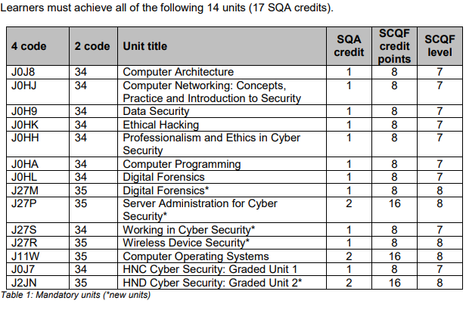
HND Cyber Security https://www.sqa.org.uk/sqa/files_ccc/GP8316.pdf

Slide 3


HNC/D Cyber at West College Scotland
Greenock Campus
Introduced HNC August 2018
Background: HNC Computing was failing
Recruitment: 40 students enrolled
Advertising: limited
Feedback: Good
Staffing
Resources

Slide 4
HNC/D Cyber at West College Scotland
Clydebank Campus
Introduced NPA Cyber Security: Schools, NQs.
Introduced current Cyber Units to HNCs HNDs over last 3 years
Advertised “With Cyber Security”
Recruitment for HNC Cyber Security August 19 Start:
40 Unconditional Offers from almost 100 applications
Marketing: SQA Video Launch
Guest Lectures

Slide 5
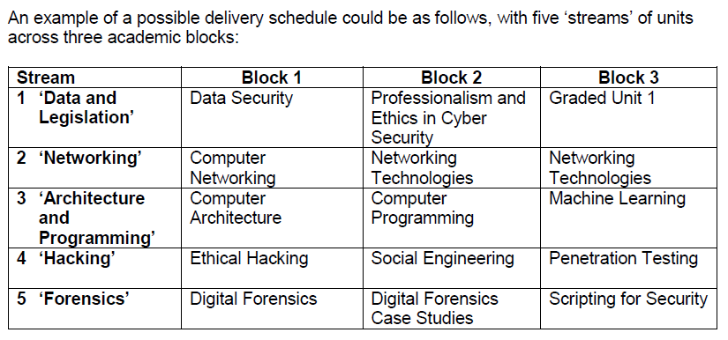
For the HNC there were suggested ‘streams’ or ‘themes’
Notes:
There are lots of options for delivering HNC/D ,

Slide 6
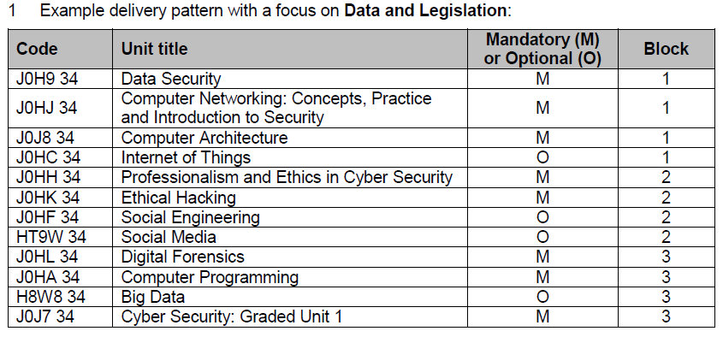

Slide 7
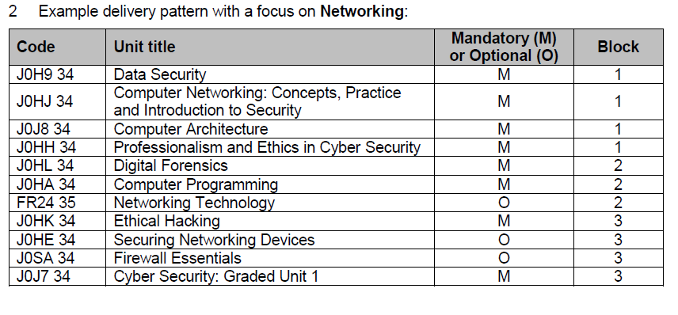
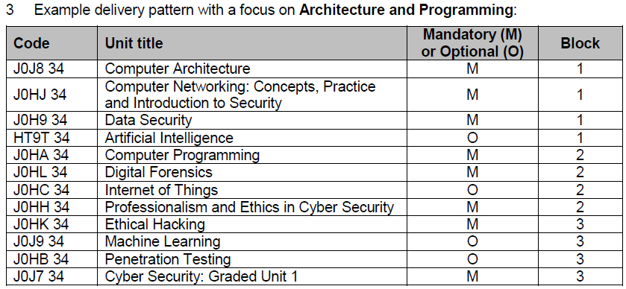

Slide 8
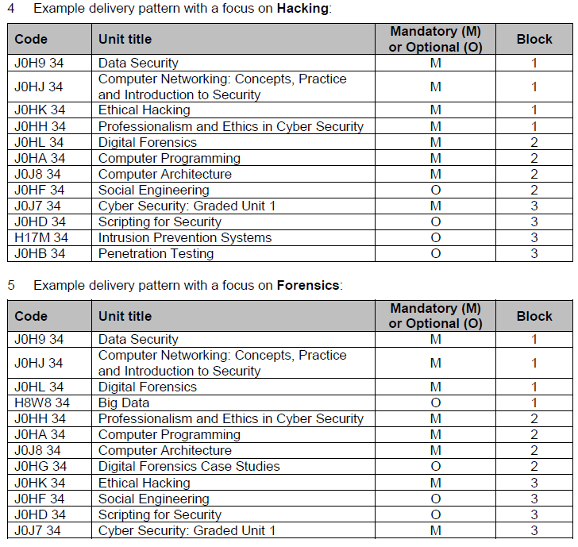

Slide 9

Resources
Digital Skills Partnership: Materials have been created for
Digital Forensics and Data Security
Data Security
https://www.dropbox.com/sh/zn0jiwm0qd4uoix/AAAQ4KuSXHPvUZv0zxk1C4w3a?dl=0
Cisco Netacad
Fortinet Academy
Palo Alto
Cloud computing:
portal.azure.com
AWS
Oracle

Slide 10
Resources
Digital Skills Partnership: Materials have been created for
Digital Forensics
Off the shelf resources from DSP
Numerous real-life cases (following crown prosecution service and procurator fiscal)
FTK Imager to capture RAM and HDDs
Need admin rights
Kali Linux and all its tools (run on virtualisation software) Oracle Virtual seems to work well.
Autopsy
Chromeensics
Guest Speakers
and Data Security

Slide 11
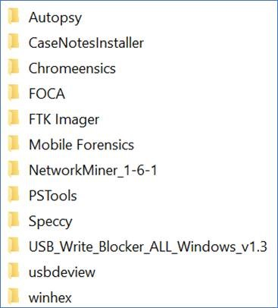
Resources

Slide 12
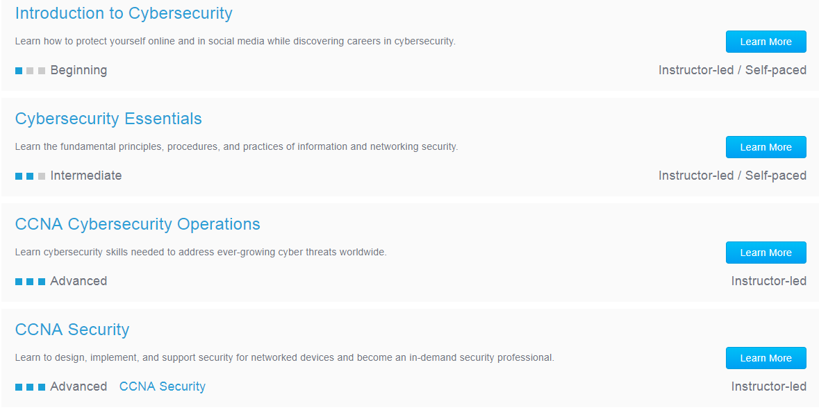
Resources - Cisco
Netacad.com

Slide 13
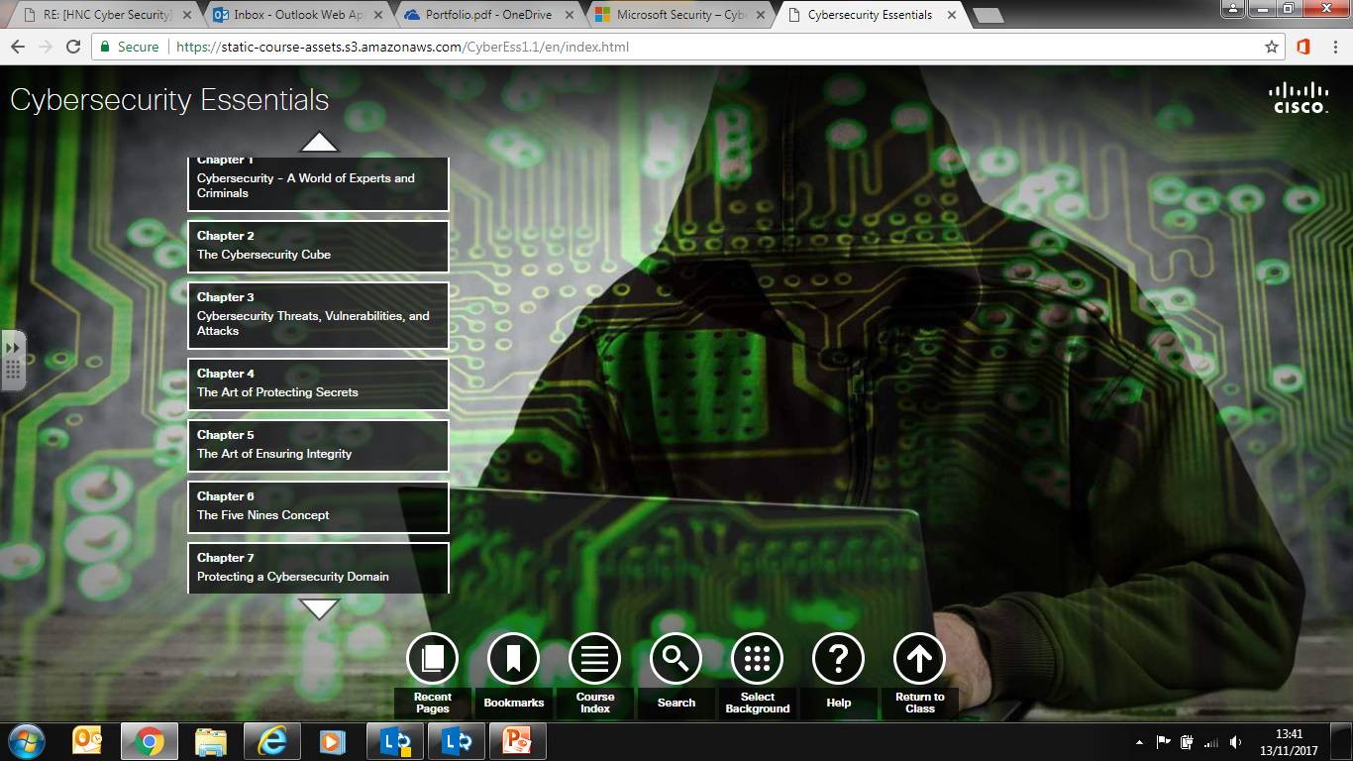

Slide 14
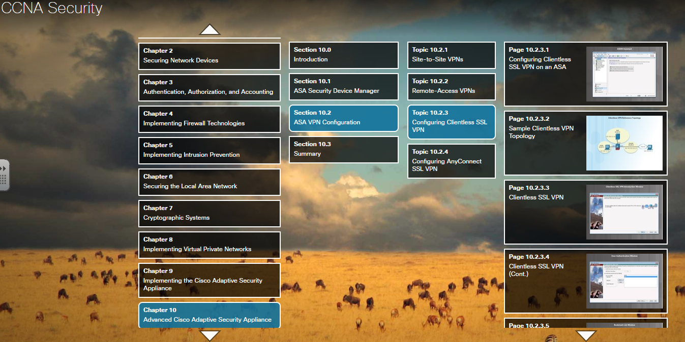

Slide 15
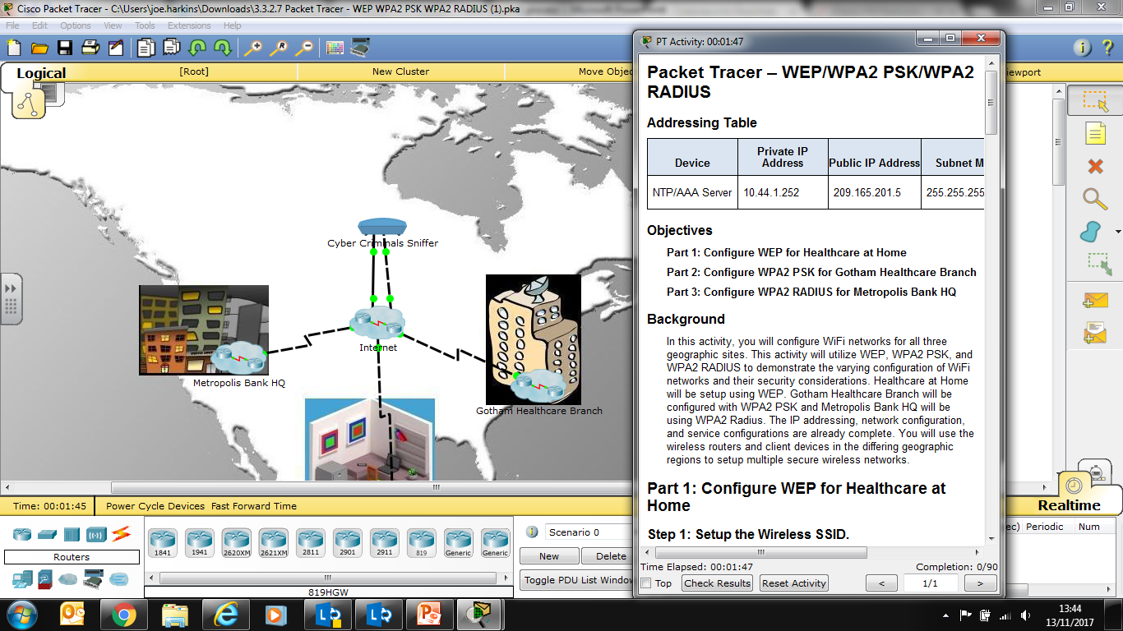

Slide 16
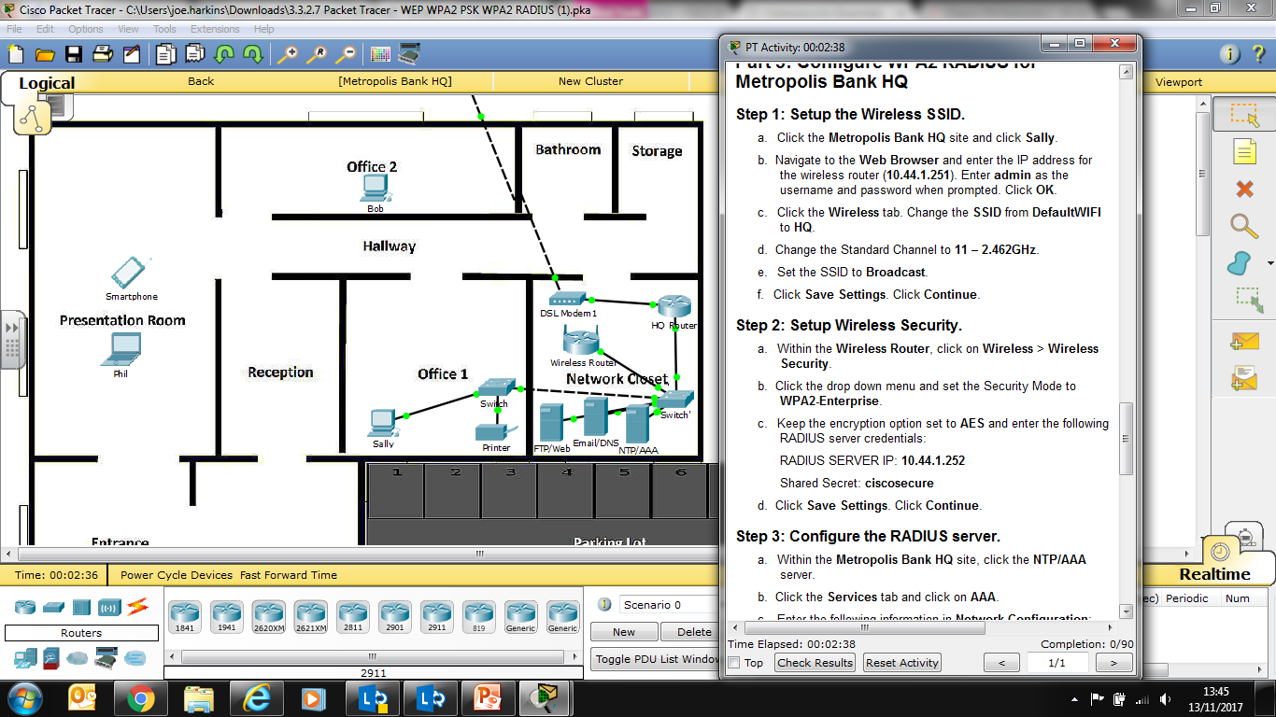

Slide 17
Conclusions
Work in Progress
Challenging
Evolution not revolution
PDA
Joint working/communication group?
Thank you for attending

