Slide 1


National Progression Award
Cyber Security Workshop

Slide 2
Plan for the Workshop
Introduction to the Award
(Eric Forrester)
Hands-on Hacking Simulation
(Craig Steele)
Questions and Answers

Slide 3

Cyber Security NPA
Currently, demand for professionals outstrips the available personnel.
Both UK and Scottish Governments agree that Cyber Security education should be national priority.
Cyber Security NPA provides an interesting introduction to this dynamic and developing subject.

Slide 4
NPA Award Structure
Data Security
Ethical Hacking
Digital Forensics
Each at levels 4, 5 and 6

Slide 5
Support
Educator’s Guide
Learner Notes
Practical Exercises
Written Exercises
Formative Assessment
Support Pack for Digital Forensics
YouTube Channel
Yammer Group

Slide 6
Student Materials are Integrated…
Learner Notes direct students to:
Written Exercises
Formative Assessments on solar
Practical Exercises

Slide 7

Common Theme
The Law:
  What you can do
  and
  What you can’t do!

Slide 8

Educators’ Support
Educator’s Guide:
  includes the preparations needed for each unit
  Sources of software applications
  List of additional resources
  Glossary
Yammer Group:
  If you get stuck – ask the group!

Slide 9

Assessment
Summative Assessment on SOLAR
Practical Element:
  A report on an investigation
  A report on a practical exercise
  Folio of work

Slide 10
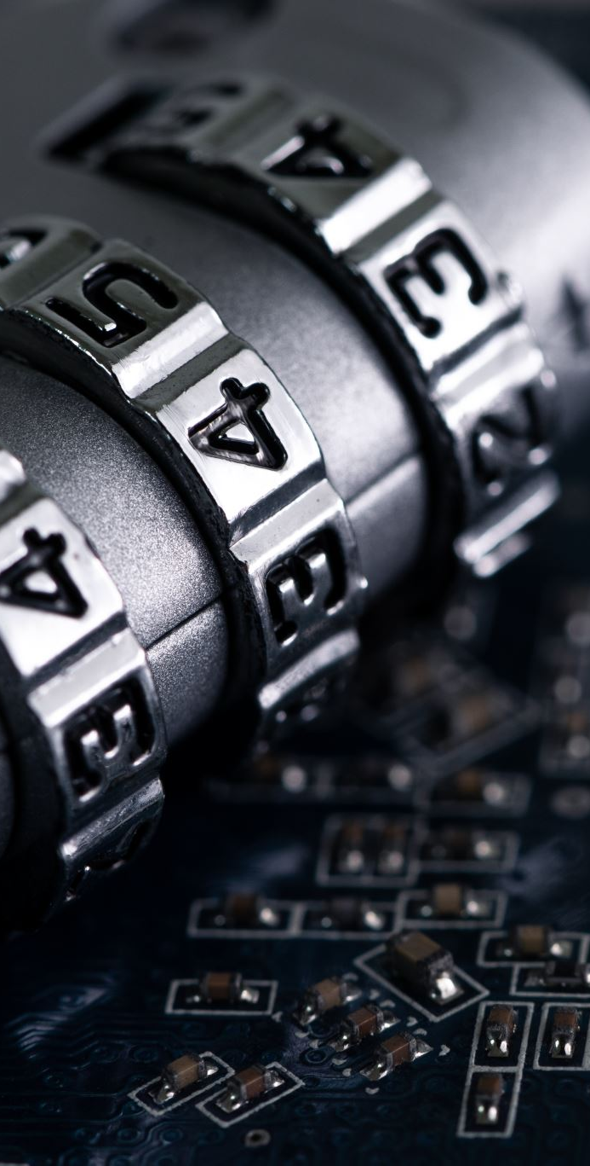
Preparations: Data Security
You will need…
  Pringles™ tins to make an Enigma Machine
  For level 5 assessment only – unsecured Wi-Fi router

Slide 11

Preparations: Ethical Hacking
Access to a ‘Controlled Environment’
  Virtualisation on local computer
  ‘Hacking Lab’ at local college
  Remote access to ‘Hacking Lab’ at a university.
  RaspberryPi network

Slide 12
Preparations: Ethical Hacking
Instructions to install and set up VirtualBox virtualisation software included in Educator’s Guide
Further instructions to install ‘Kali’ as the hacking tool and ‘Metasploitable’ as the target.

Slide 13
Preparations: Ethical Hacking
There are also practical exercises on:
  Windows XP SP0
  Windows 7
  Cloning a website
  Spoofing an email address

Slide 14
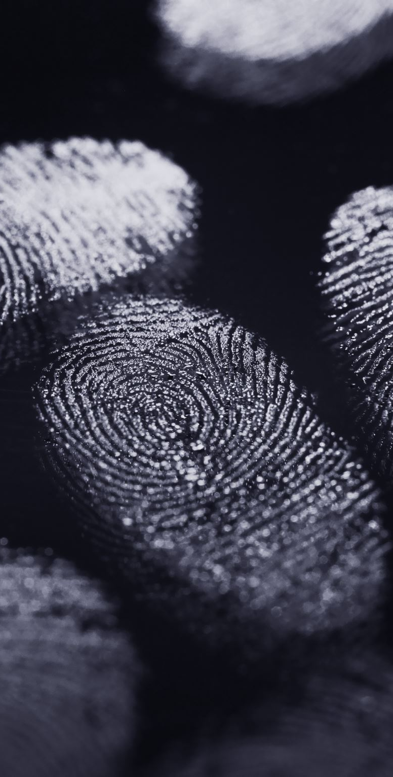
Preparations: Digital Forensics
Set of applications making up a portable ‘forensics kit’
Some Lego™
USB drives to set up with ‘evidence’ to examine
  These need to have their capacity reduced!
  Instructions in the Educator’s Guide.
At level 6, small isolated network.

Slide 15
Preparations: Digital Forensics
The forensics kit is made up of:
  FTK Imager
  Autopsy
  Speccy
  JPHSwin
  USBdeview
Plus ‘NetworkMiner’
  Only run on isolated network!

Slide 16
Preparations: Digital Forensics
A ‘resource pack’ is available to download. This contains:
  Files referred to in the Practical Exercises
  Files to make up ‘evidence’ drives
  Report proformas
  For level 6, police training exercise

Slide 17

Hands-on Hacking Exercise

