Slide 1
Computing Conference 2020
Feb 5th 2020, Stirling
NPA Data Science – walter patterson

Slide 2

Why Data Science?

Slide 3
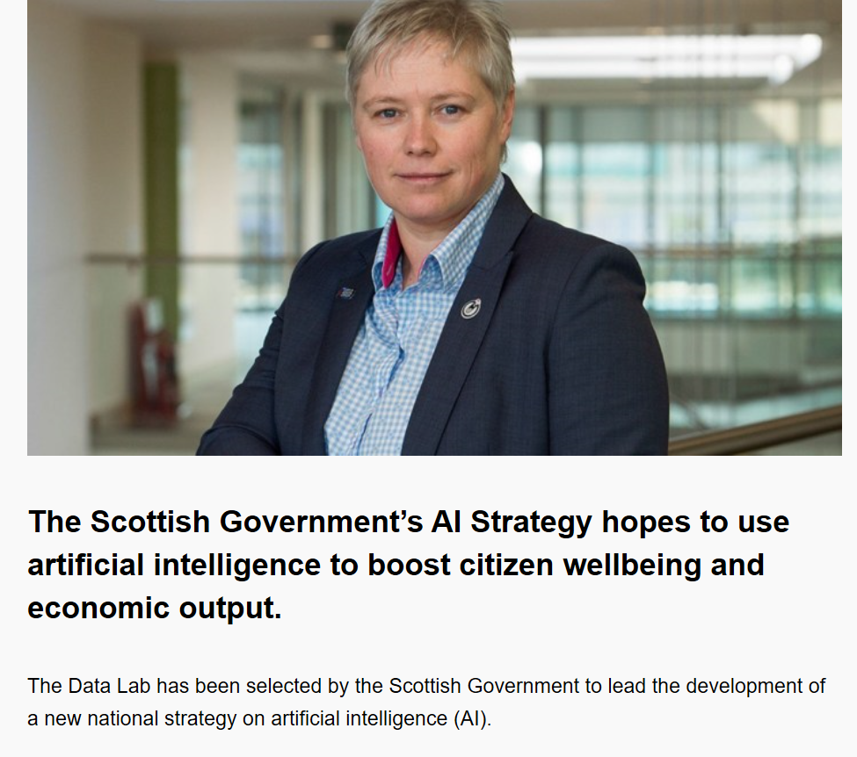
Scottish Government – AI strategy

Slide 4

Why Data Science?

Slide 5
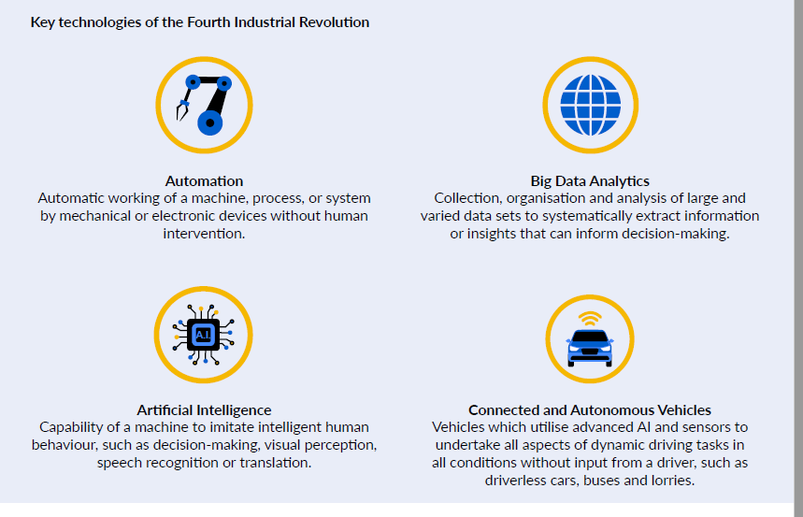
Why Data Science?

Slide 6
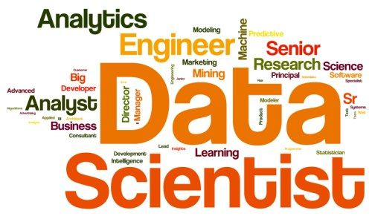
What content would you expect in NPA Data Science?

Slide 7
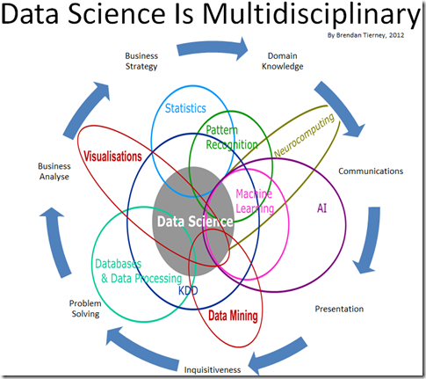
What’s in a data science course?

Slide 8

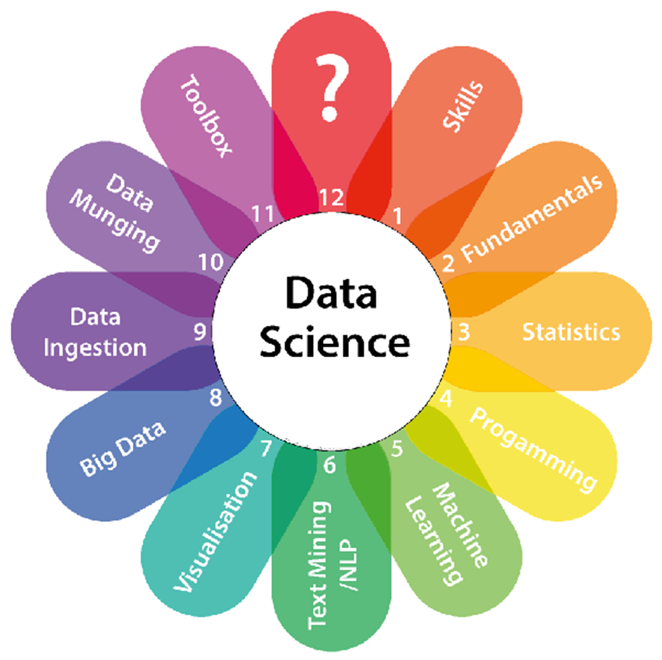
What’s in a data science course

Slide 9

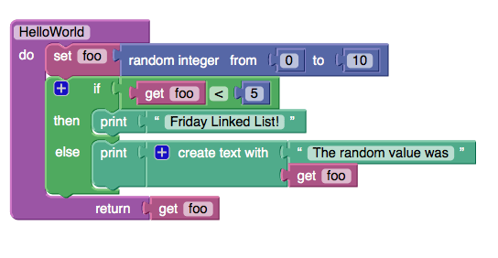
QDT dilemmas
VS

Slide 10

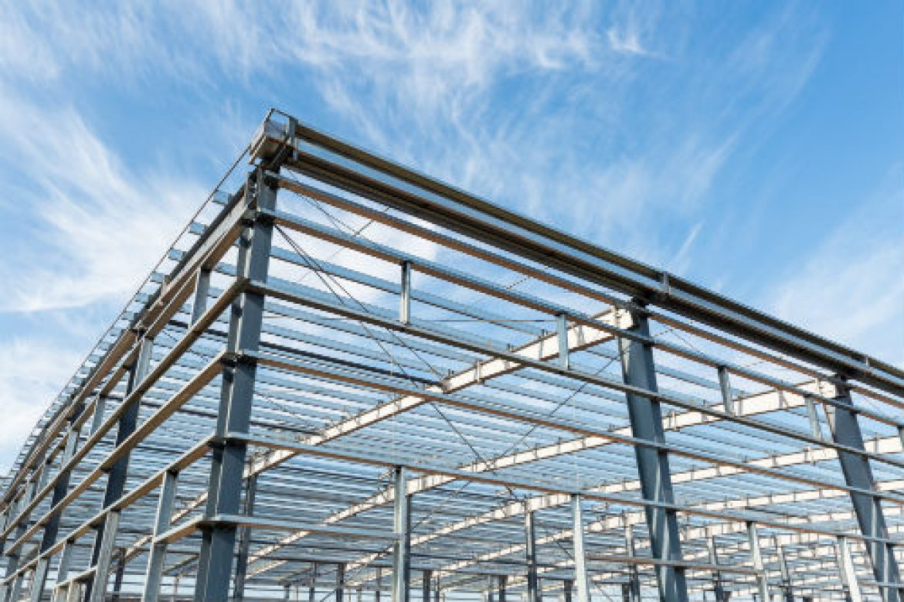
QDT dilemmas
VS

Slide 11
What do we mean by fun?
Machine learning – Apps4Good
https://www.appsforgood.org/courses
Machine learning for Kids
https://machinelearningforkids.co.uk/#!/worksheets
CS4Fun
http://www.cs4fn.org/ai/
eCraft2Learn (Snap! coding implementation) https://ecraft2learn.github.io/ai/

Slide 12
What do we mean by structure?
SCQF Level | Mandatory |  | Mandatory |  | Options (1 only)
4 | Data Citizenship |  | Data Science
5 | Data Citizenship |  | Data Science |  | Computer Programming Data Security Data Science Project Data Science: Statistics Machine Learning
6 | Data Citizenship |  | Data Science |  | Computer Programming Data Security Data Science Project Data Science: Statistics Machine Learning Statistics

Slide 13
Data Citizenship
Outcome | SCQF Level 4 J2HN 44 | SCQF Level 5 J2HN 45 | SCQF Level 6 J2HN 46
LO1 | State the use of data in society | Describe the use of data in society | Explain the use of data in society
LO2 | Describe data literacy concepts | Explain data literacy concepts | Explain data literacy concepts
LO3 | Interpret simple data | Interpret data | Interpret complex data

Slide 14
Data Science
Data Science
Outcome | SCQF Level 4 J2G2 44 | SCQF Level 5 J2G2 45 | SCQF Level 6 J2G2 46
LO1 | Describe data science | Explain data science techniques | Explain the principles of data science
LO2 | Describe simple ways of analysing data. | Describe the tools and techniques of data science | Describe methods of routine data analysis
LO3 | Analyse a small dataset to identify patterns. | Analyse a dataset to identify patterns and trends | Analyse a dataset to make predictions

Slide 15
Machine Learning (Option)
Outcome | SCQF Level 4 | SCQF Level 5 J2G6 45 | SCQF Level 6 J2G6 46
LO1 |  | Describe the purpose, applications and key features of machine learning | Explain the purpose, applications and key features of data preparation and feature selection for machine learning
LO2 |  | Explain the importance of good quality data and feature selection in effective machine learning. | Explain how machine learning models can be evaluated, and their predictive performance improved by ensemble methods
LO3 |  | Apply standard machine learning techniques to create and evaluate a classification model | Describe the application of regression models to problems of prediction and classification
LO4 |  |  | Derive a prediction model from a given dataset using linear regression.

Slide 16
Assessment
Data Citizenship
SCQF Level 4
Dataset: 500 items. Create 2 visualisations.
Interpret the data and make recommendations
SCQF Level 5
Dataset: 1000 items. Create visualisations.
Explore the data and make conclusions and decisions
SCQF Level 6
Dataset: 10,000 items plus supplied visualisations and a dashboard.
Evaluate quality of dataset. Critique the supplied visualisations and dashboard. Create additional visualisations. Identify patterns/trends and communicate findings.

Slide 17
Assessment
Data Science
SCQF Level 4
Dataset: 500 items
The dataset must be cleaned, structured, sorted, filtered, grouped and summarised.
The analysis must include at least one visualisation, which must illustrate patterns in the data.
SCQF Level 5
  Dataset: 5,000 items
  Dataset will be created (captured) by the learner, sourced externally.
  The dataset must be cleaned, structured, sorted, filtered, grouped and summarised.
  Create one interactive dashboard & three visualisations.
SCQF Level 6
  Dataset: 20,000 multivariate items
Summary of the dataset required, collection method and storage approach.
Analysis of the dataset, including the steps taken and output of the analysis,
with appropriate visualisations.
Summary of key findings and future activities from the analysis to be presented to a wider audience

Slide 18

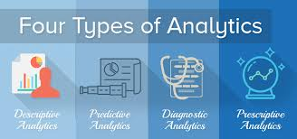
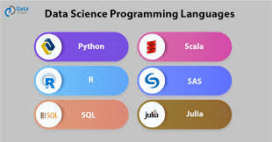

Choice of optional unit
Optional Unit | Focus
Machine Learning | Data Science
Data Science: Project | Data Analytics
Computer Programming | Vocational
Data Science: Statistics | Progression

Slide 19
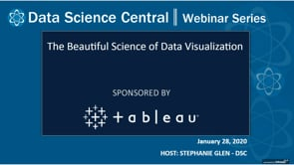
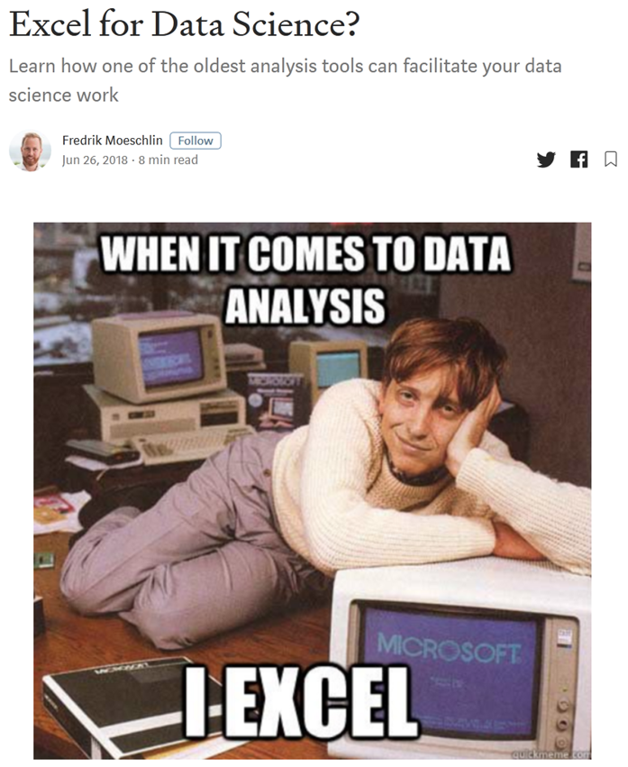
Resources
Websites
https://www.freecodecamp.org
https://towardsdatascience.com
https://www.datasciencecentral.com/

Slide 20
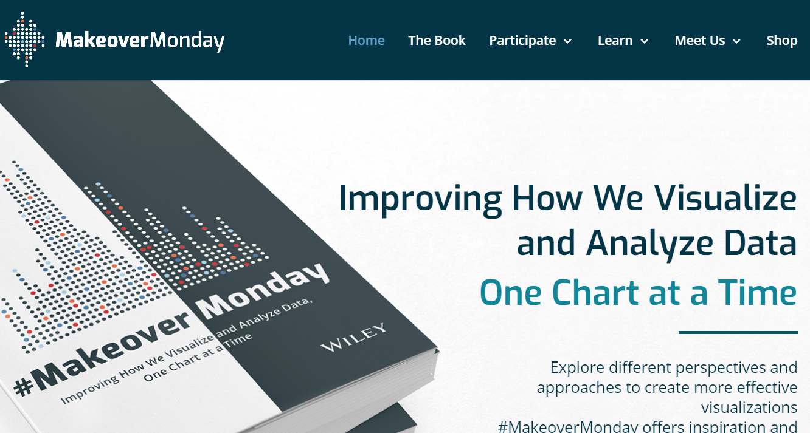
Resources (Visualisation)
#MakeoverMonday
https://www.makeovermonday.co.uk/

Slide 21
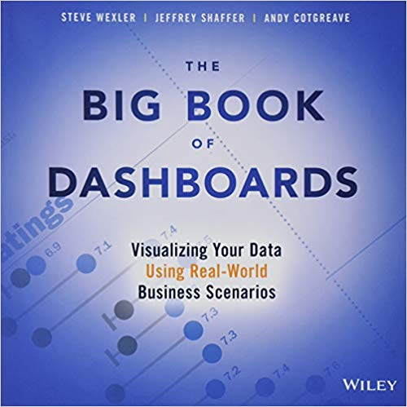
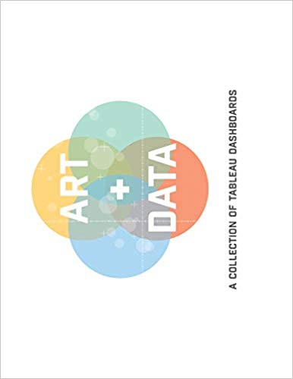
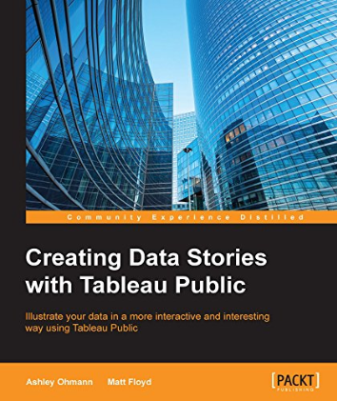
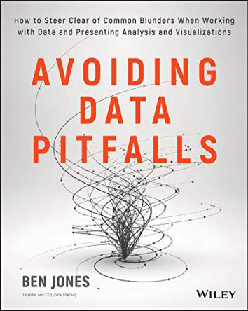
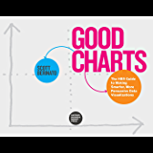
Resources (visualisation)
Books on visualisation

Slide 22
Resources
Tech company free resources
All of the large tech companies offer free training in data science topics:
Google Digital Garage; Google Cloud Training
IBM Data Science Professional Certificate
AWS Training – Data Scientist Path
Microsoft Professional Program in Data Science
Tableau – free tools, webinars, tutorials

Slide 23
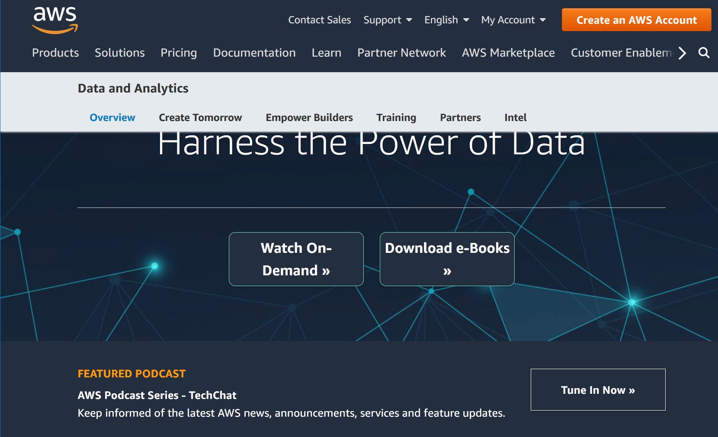
Resources

Slide 24
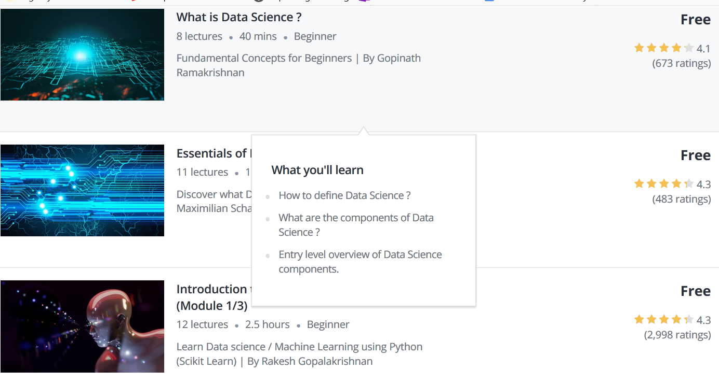
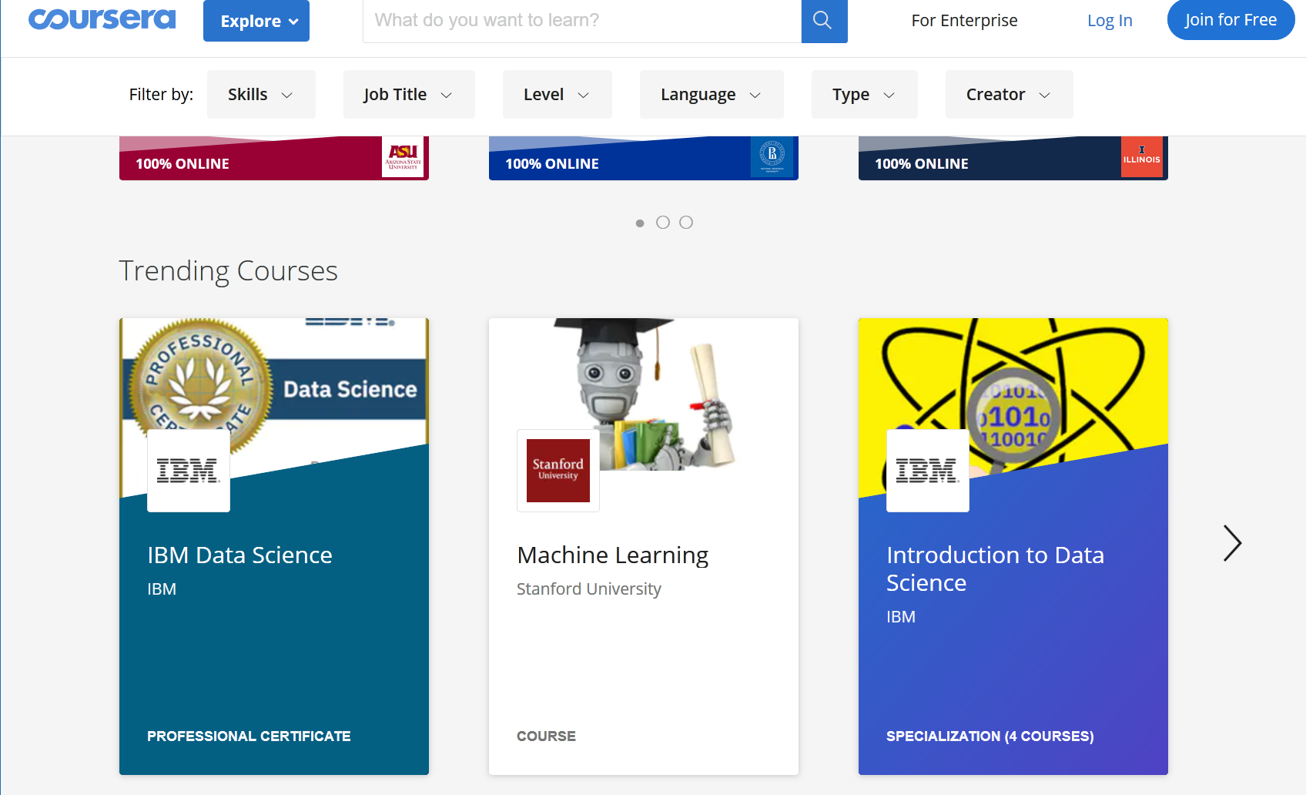
Resources
MOOCs
A useful source of additional training can be found in:
Udemy Coursera

Slide 25
Resources (CPD for lecturers)
ScotlandIS training
Event title: Industry Current Practice on Data Science Wednesday 18th March 1:00-4:00pm
Aggreko, City Park 368 Alexandra Parade, Glasgow
Speakers: Elizabeth Hollinger, Head of Analytics & BI at Aggreko; academic speaker tbc
What this will cover:
how data science is applied within Aggreko, through illustrative examples;
opportunity to hear how university colleagues are delivering data science at undergraduate level, and include a site visit.
To register your interest for this event, please email Lesley.broadwood@scotlandis.com

Slide 26
Resources
Datasets
Kaggle https://www.kaggle.com/datasets
UCL ML Repository https://archive.ics.uci.edu/ml/index.php
Google Open Data https://cloud.google.com/public-datasets/
Open source community https://www.freecodecamp.org

Slide 27
Resources (Analytics & Visualisation)
TOOLS - FREE!
EXCEL (with institutional O365 subscription)
Tableau Public
Google Charts & Google Data Studio
Datawrapper (web based)
Trifacta
KNIME
Orange

Slide 28

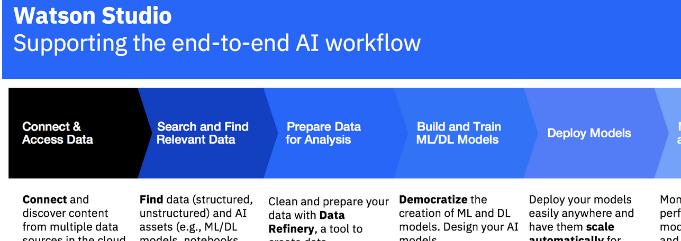
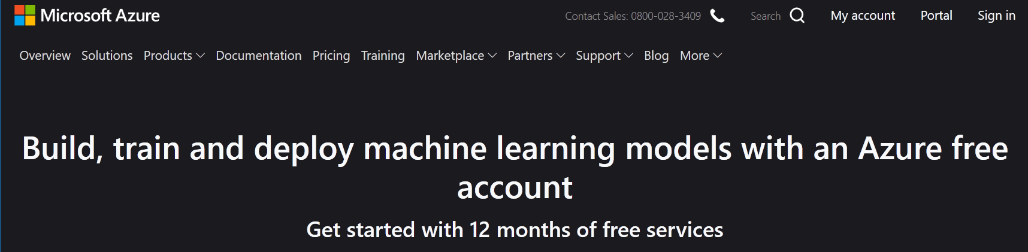
Resources (Data modelling; Machine learning)
TOOLS - WORKBENCHES
Weka https://www.cs.waikato.ac.nz/ml/weka/
IBM Watson Studio Desktop
Amazon SageMaker
Microsoft Azure Machine
Learning Studio

Slide 29
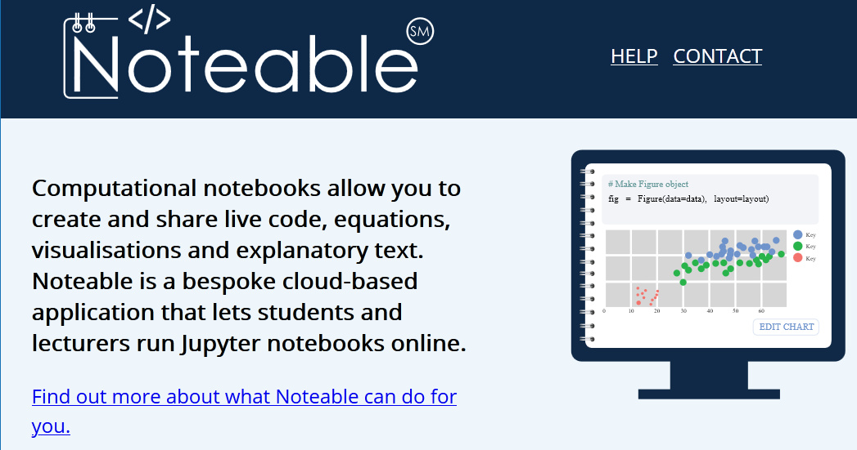
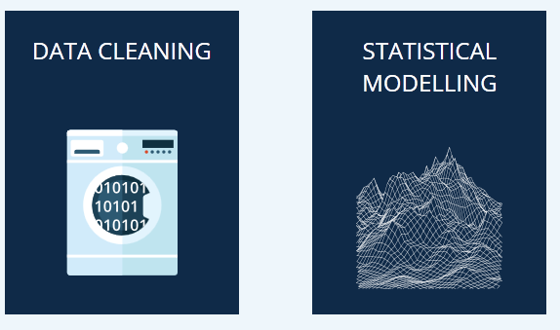
Resources
Edinburgh University (EDINA) https://noteable.edina.ac.uk/

Slide 30
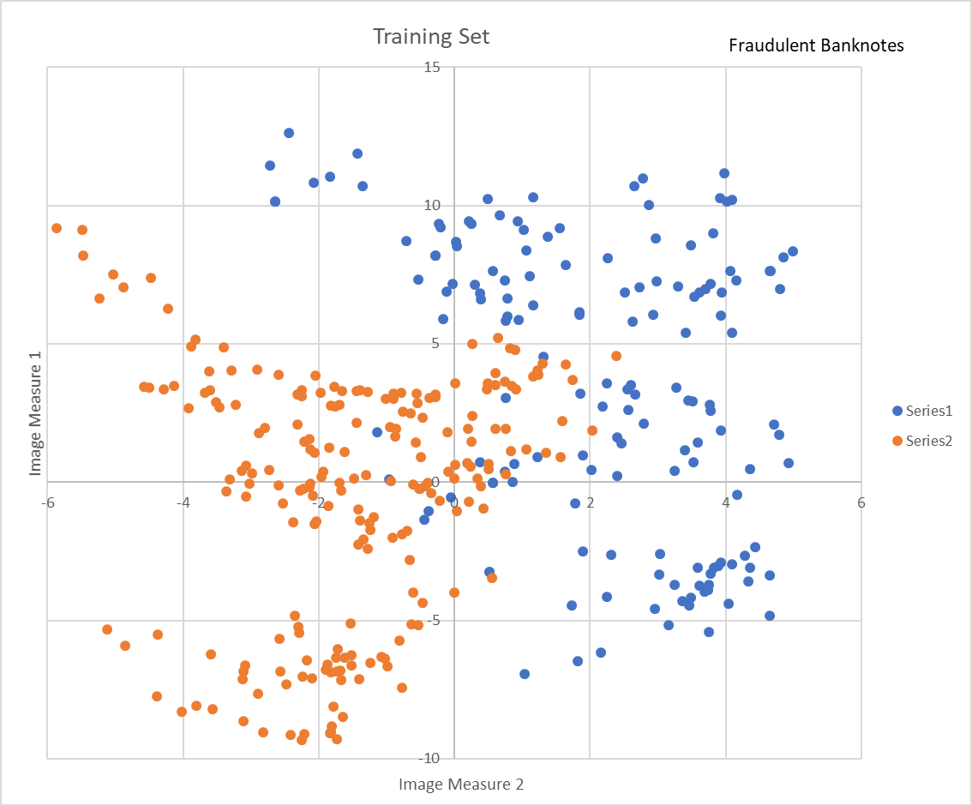
At last! A wee bit of practice
4.0422,-4.391,4.7466,1.137,0
2.2546,8.0992,-0.24877,-3.2698,0
0.38478,6.5989,-0.3336,-0.56466,0
3.1541,-5.1711,6.5991,0.57455,0
2.3969,0.23589,4.8477,1.437,0
4.7114,2.0755,-0.2702,1.2379,0
4.0127,10.1477,-3.9366,-4.0728,0
2.6606,3.1681,1.9619,0.18662,0
3.931,1.8541,-0.023425,1.2314,0
0.01727,8.693,1.3989,-3.9668,0
3.2414,0.40971,1.4015,1.1952,0
2.2504,3.5757,0.35273,0.2836,0
-1.3971,3.3191,-1.3927,-1.9948,1
0.39012,-0.14279,-0.031994,0.35084,1
-1.6677,-7.1535,7.8929,0.96765,1
-3.8483,-12.8047,15.6824,-1.281,1
-3.5681,-8.213,10.083,0.96765,1
-2.2804,-0.30626,1.3347,1.3763,1
-1.7582,2.7397,-2.5323,-2.234,1
-0.89409,3.1991,-1.8219,-2.9452,1
0.3434,0.12415,-0.28733,0.14654,1

Slide 31
Your turn
Working in 2s or 3s
Cover up the test data handout. Use the training data to:
Use the ruler to draw what you think is the ‘best’ line to use as a decision rule for suspect banknotes based on the given measures
Count the misclassified banknotes in each category and complete the confusion matrix (on handout)
Then transfer the line you have drawn to the test set of data and again compute the confusion matrix

Slide 32


Slide 33
Thanks for your participation!
This Slidedeck will be hosted by SQA and made available to all conference attendees
The banknote dataset can be found on Kaggle
Follow-up questions?
DM me: @waltatek
Email me: waltatek@gmail.com

