Slide 1
Mental Health Award
St Machar Academy – Aberdeen
Hannah Smith – Teacher of Modern Studies, Mental Health Award NPA
PT Learning, Teaching & Assessment

Slide 2
MH Award at St Machar
A HUGE thank you to St Ambrose High. Your resources were absolutely invaluable and allowed us to develop materials so easily.
@PsychologyStAmb
The slides have some information about how we have organised the MH Award this year
Included are some screenshots of activities I have used with pupils to give a taster into it
I am happy to answer questions, you can find me on Twitter @MissSmithMods

Slide 3
Timetabled
2020-2021 – First year we have offered and run the award
An option for S5/6 pupils – class of 19 pupils
Level 4 and 5 in same class – differentiation provided
4 periods a week (50 minutes each) – this is the same as other NPAs offered in the school including Personal Development and Travel & Tourism
Teacher led learning
Independent tasks

Slide 4
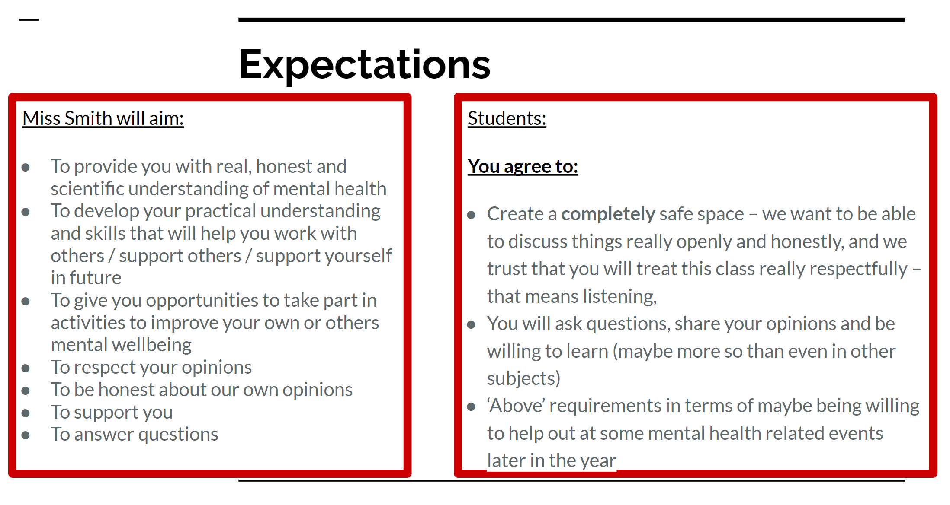
Lessons
Mix of activities
  Teacher talk
  Group tasks
  Independent learning
  Research
  Comparisons
  Videos/ documentaries
  Activities to think outside the box

Slide 5
Feedback
“I wish we had had this before now?”
“All pupils should have to do this course”
Several pupils also noted that this course had helped answer questions related to their own MH or that of friends.
Several pupils felt more comfortable discussing their MH with a teacher during this course
Very positive response – plan to continue to run the course and we are keeping an eye out for Level 6

Slide 6
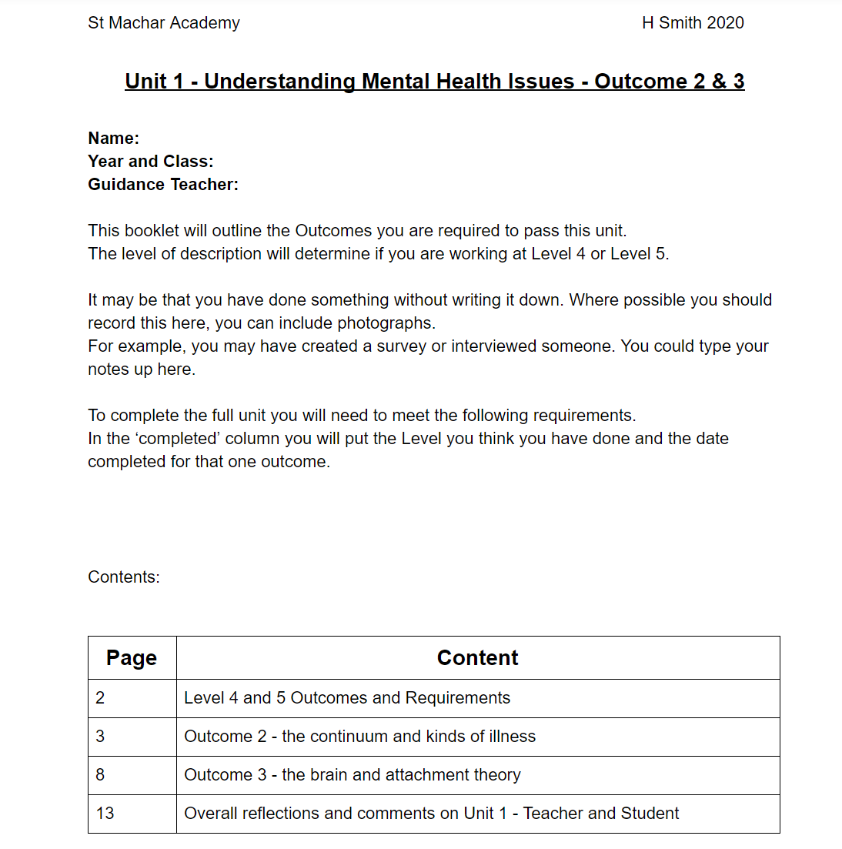
Assessment
Throughout the year
Booklets created online to help pupils keep track – this includes taking photos of jotter work or entering links to Google Docs/Slides of evidence
Mix of questions and creative work
Many students clearly reaching Level 5 understanding and have suggested they would have loved to have had/to have a Level 6 option in future

Slide 7
Extras
Safe space: we started the year by making a pupil contract – reminding them of the sensitive nature of some elements. All pupils have been incredibly respectful. Some students have shared some very personal information and felt comfortable and safe to do so.
Trigger warnings: when we discuss topics I know may be triggering, such as suicide, I make sure to remind pupils that they can take a breather or step outside if it gets too much. No questions asked.
Pupils have found areas interesting that have linked in to their future college/university courses so we have explored this more (clear links to progression, DYW, FE/HE applications)
For example, a few pupils are considering nursery or working with children in some way so we delved deeper into ACEs and trauma which they were interested in
Others have experiences of mental illness – themselves or they know someone impacted by it – so we could explore a wide range of these

Slide 8
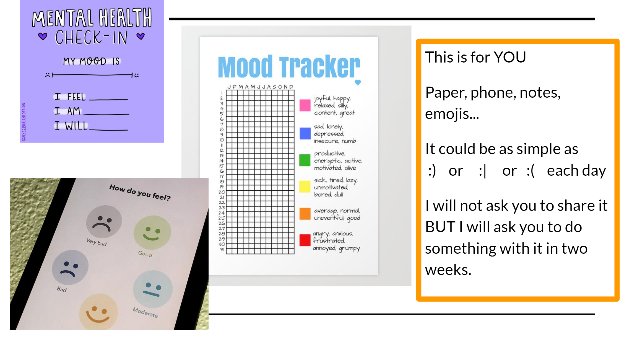
TASK IDEA

Slide 9
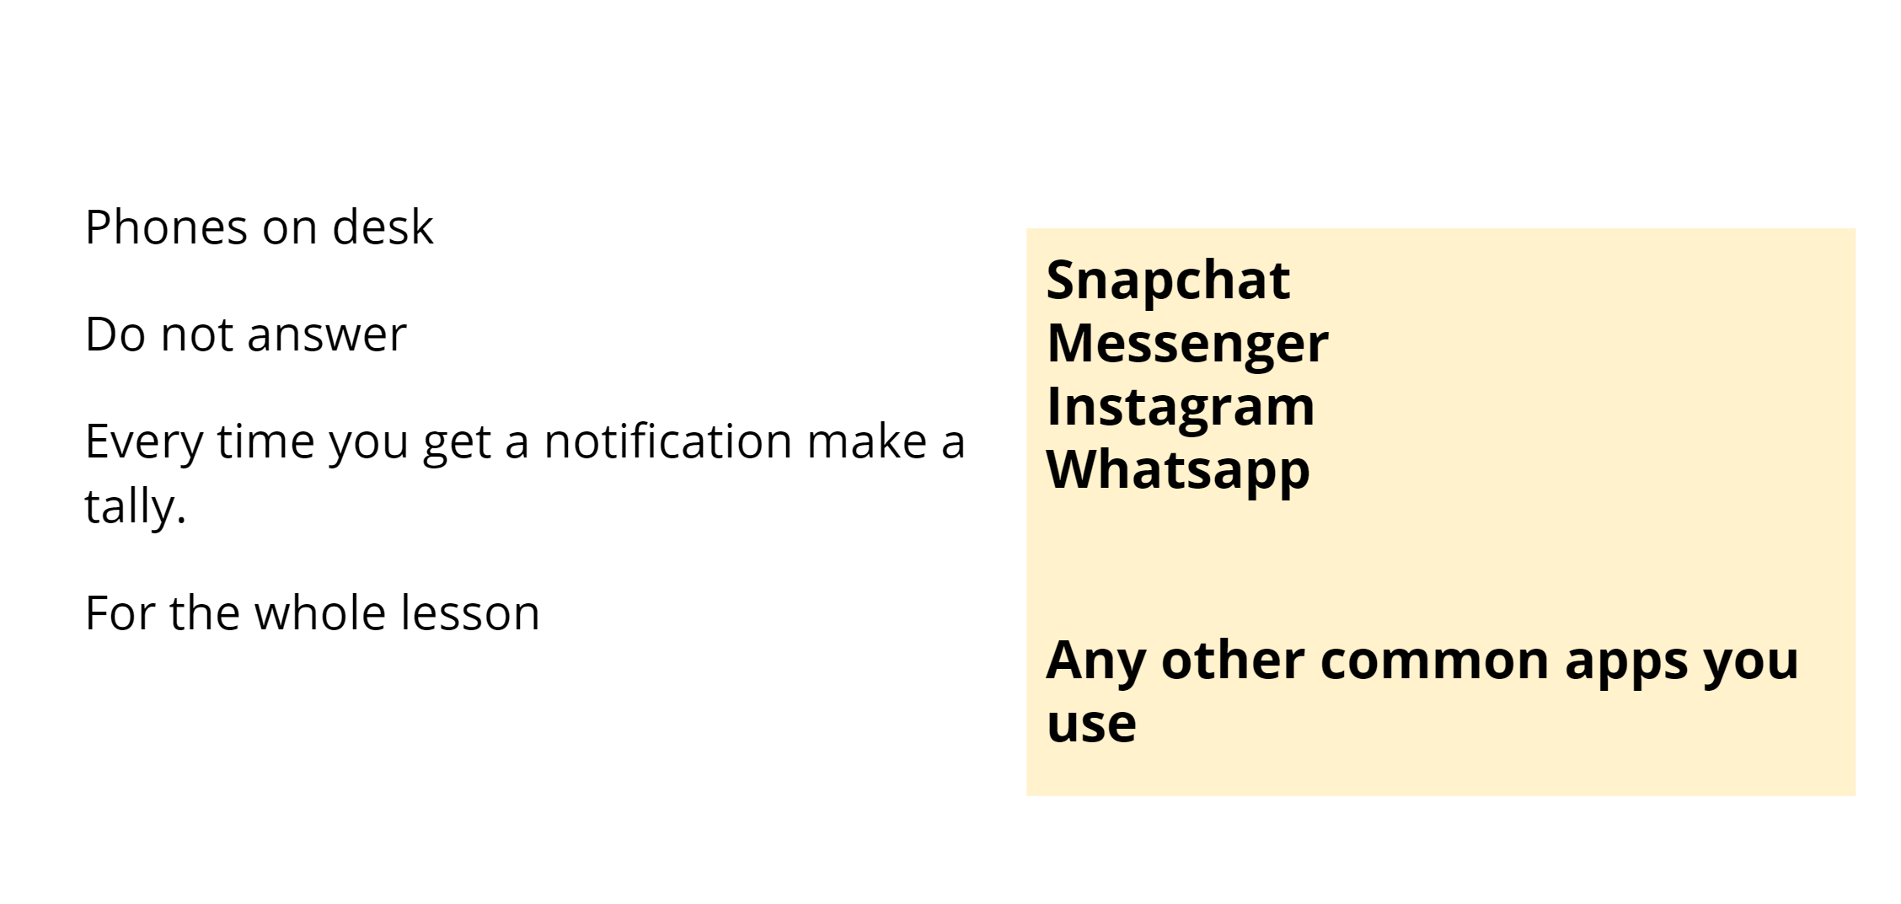
TASK IDEA

Slide 10
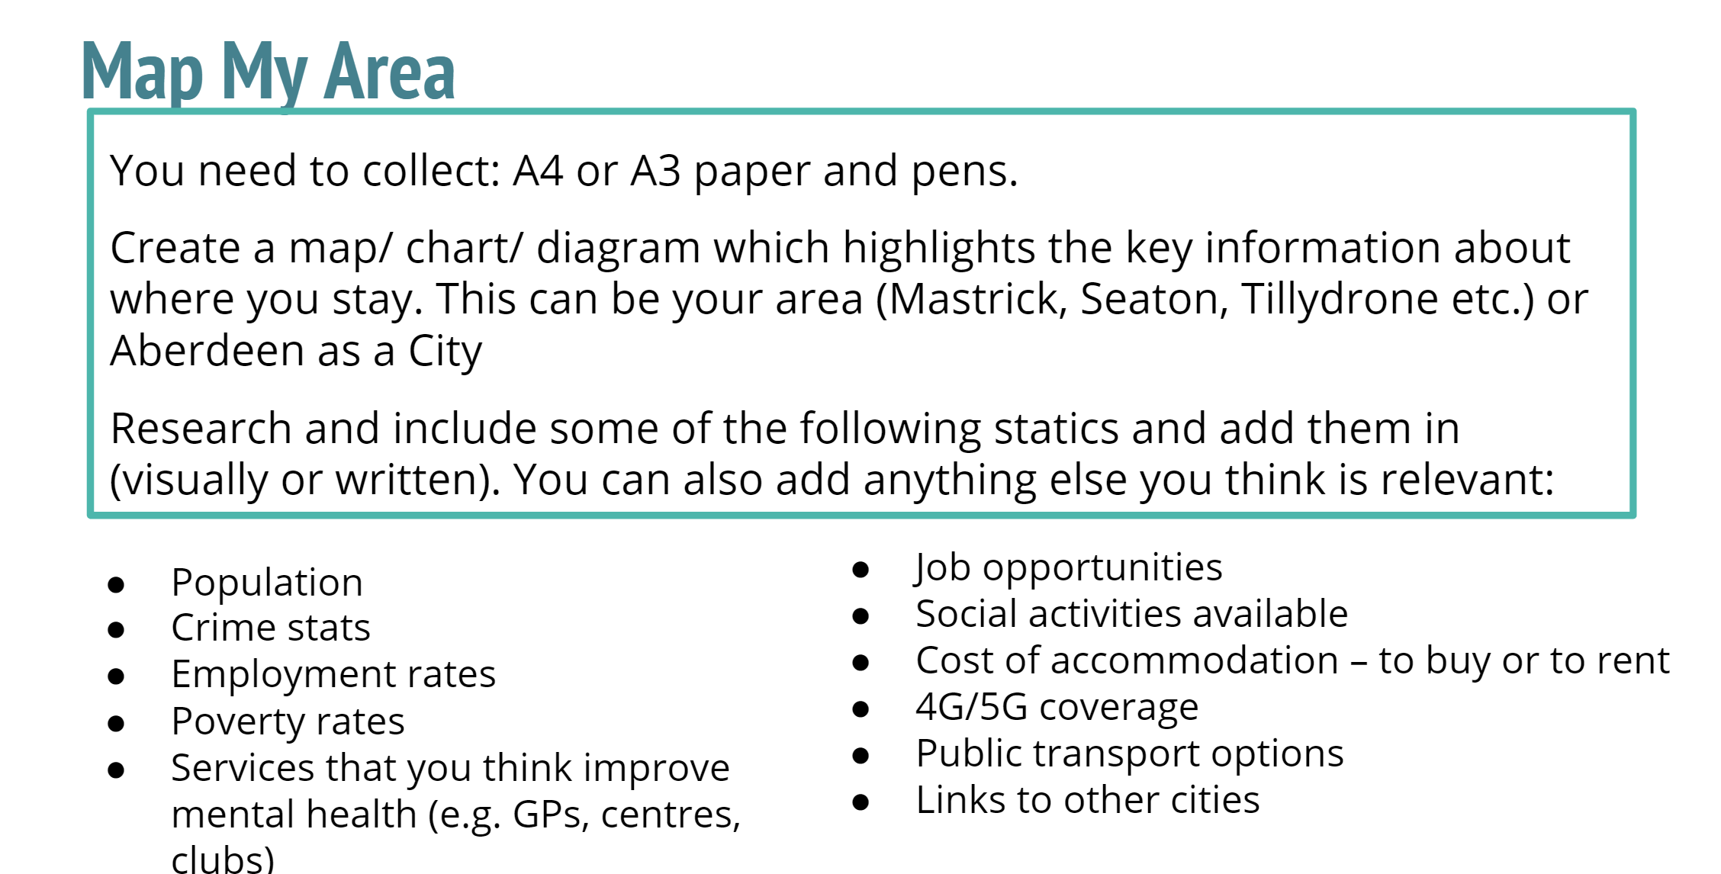
TASK IDEA

Slide 11
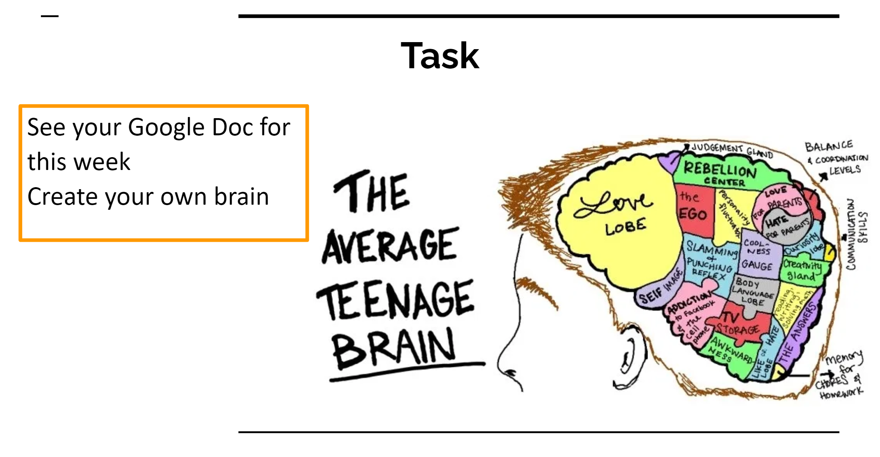
TASK IDEA

Slide 12
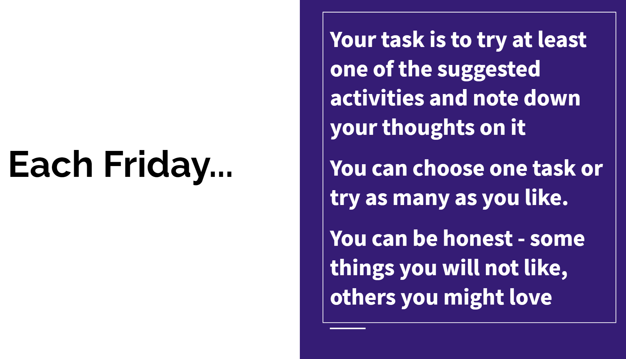
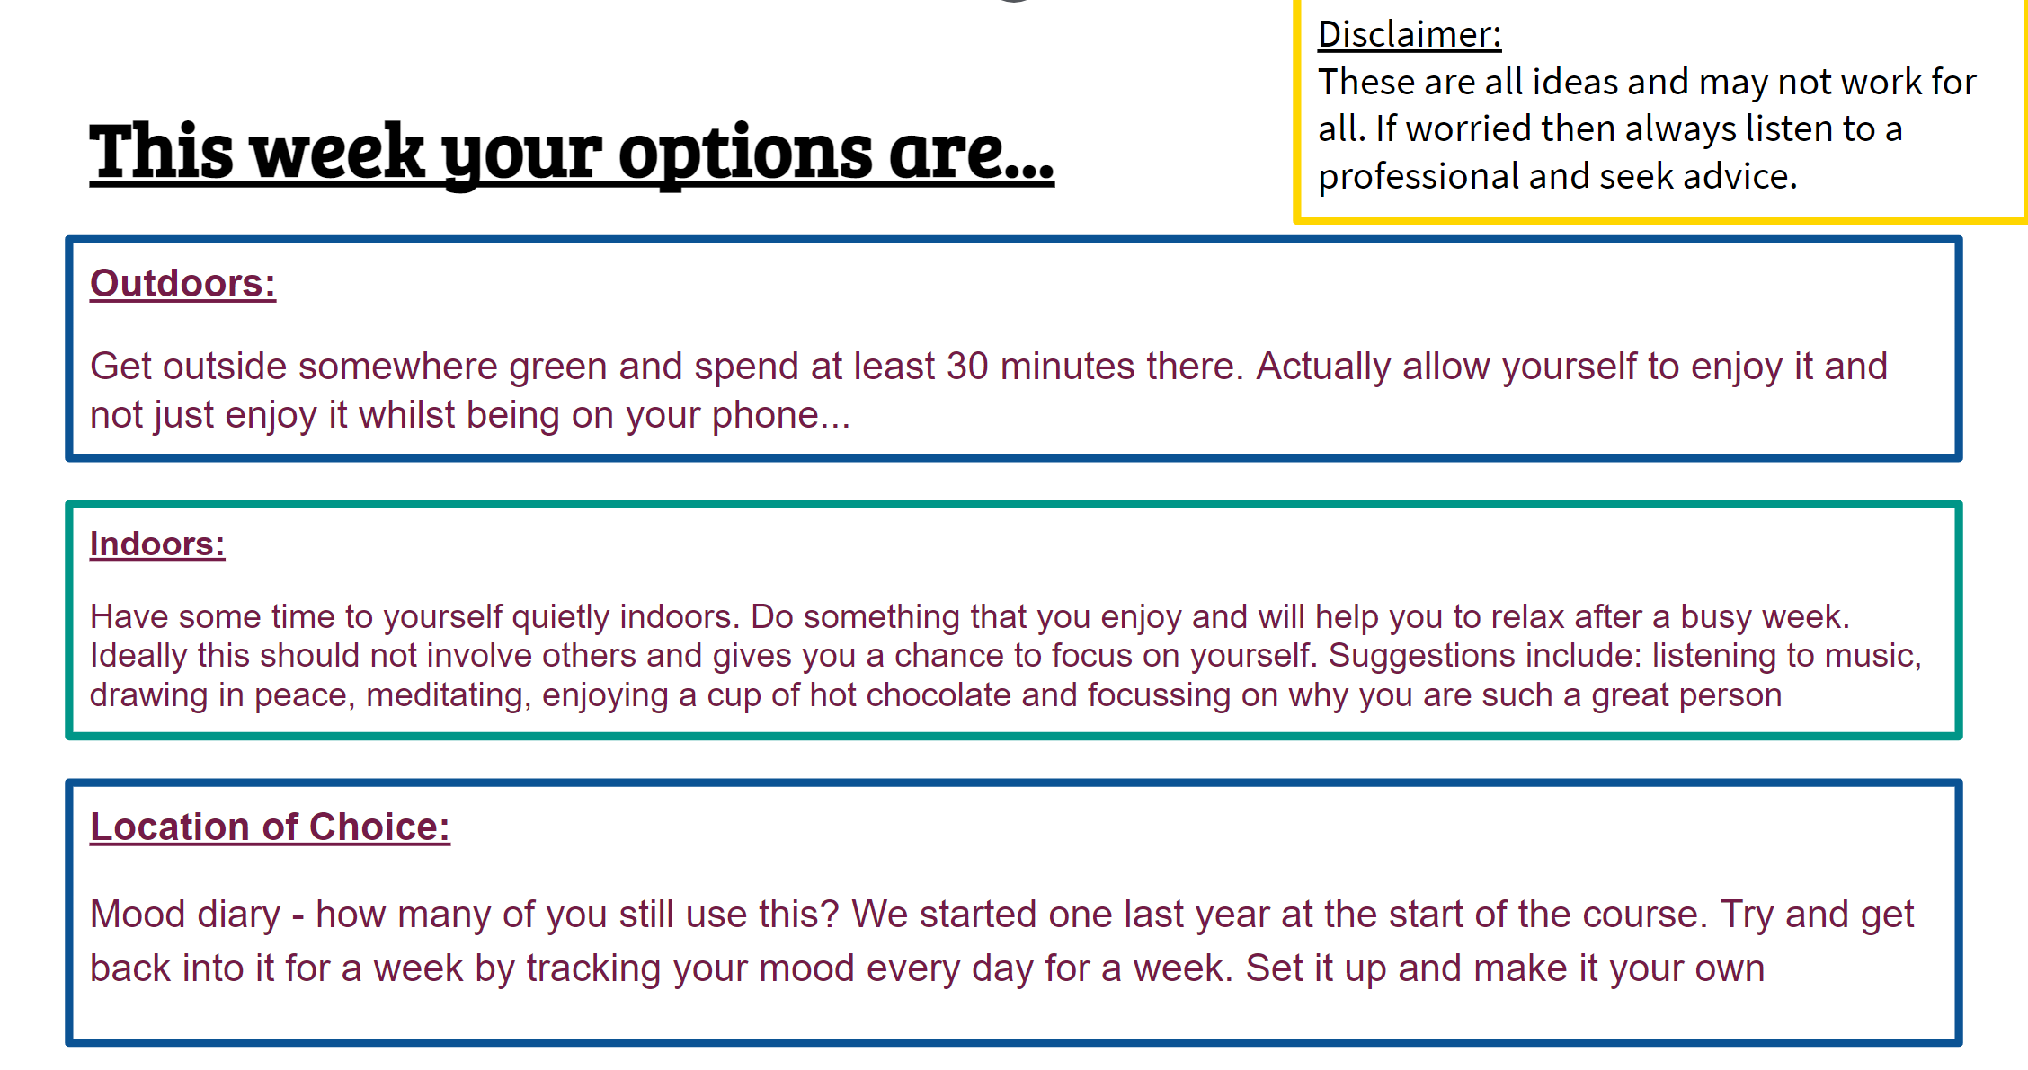
TASK IDEA

Slide 13
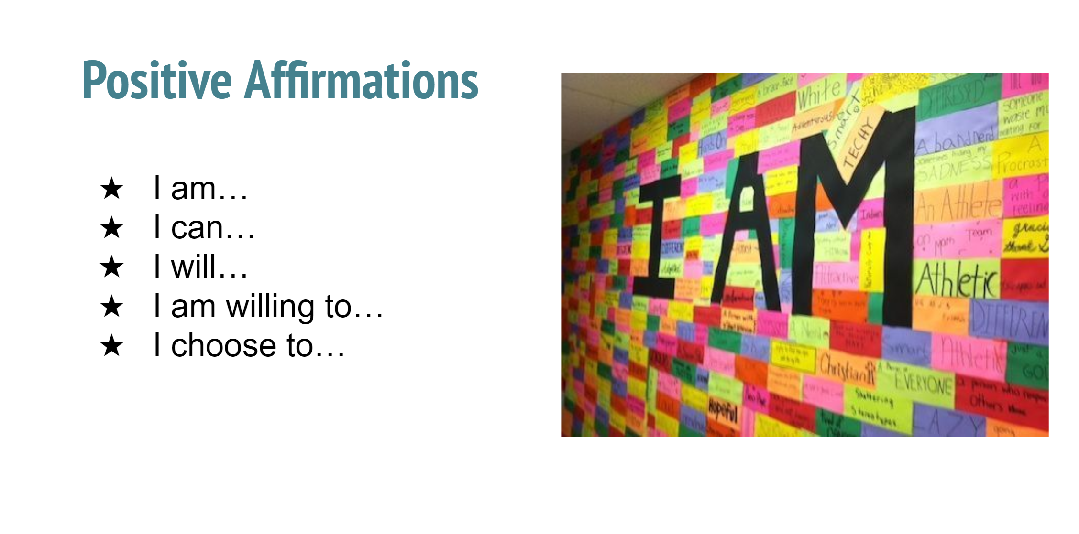
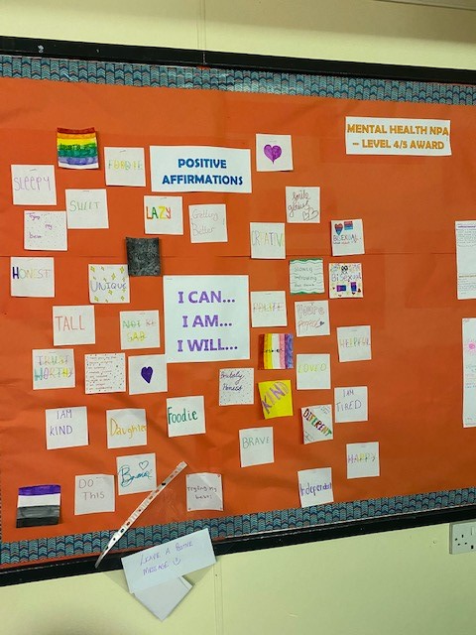
TASK IDEA
This was an activity in the last week of term in December.
Pupils in other classes asked about it…so they joined in too.
The picture on the right is what we have…so far. Pupils are planning to add to it so everyone feels welcome

Slide 14
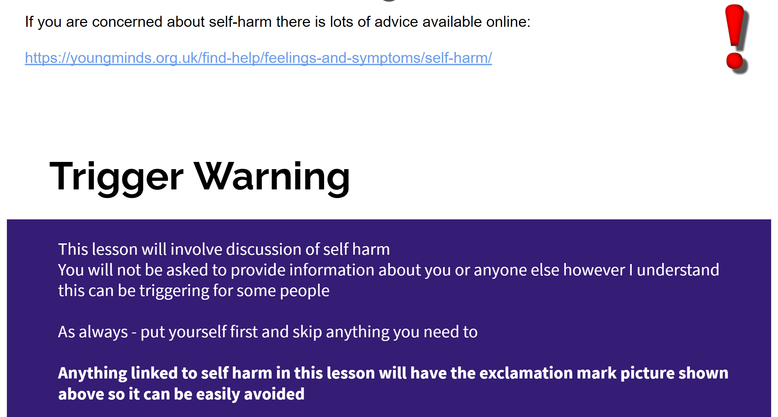
TASK IDEA

Slide 15
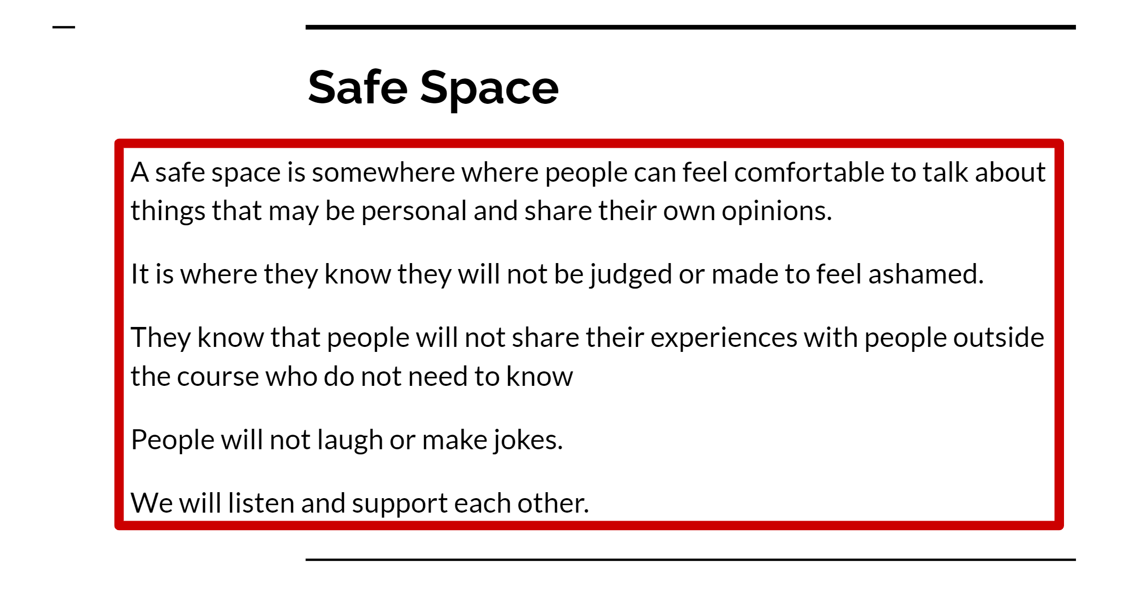
TASK IDEA

